Slide 1


Heavy Water Cooled Thorium Breeders and
Static Molten Salt Breeder
Naoyuki Takaki
Department of Nuclear Safety Engineering

Slide 2
Contents
Why thorium breeder?
Three concepts
  D₂O cooled thorium thermal breeder (CANDU type)
  D₂O cooled thorium fast breeder (PWR type)
  Static molten salt breeder (Moltex type)
Proliferation concerns
Conclusions

Slide 3
Why breeder ?
CR>1
Averaged burnup : 7%
Recovery loss
1 [%]
3[%]
5[%]
JSFR
Monju
CR<1
U-235 enrichment: 5%
Burnup: 5%
Breeder
Converter
Burner
CR vs U utilization factor
BU vs U utilization factor for FBR

Slide 4
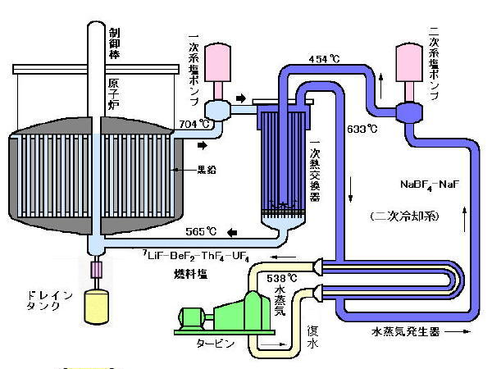
Pros and Cons of MSR
Pros
Low pressure and high B.P.
Burnup is not limited by irradiation damage
Coolant = Fuel → simplified shutdown and decay heat removal
No need for fuel fabrication
Cesium and Iodine stable within fuel salt
etc.
Cons
Fuel salt circulates through whole primary system
Integrity of heat exchanger (Achilles heel)
Materials and chemistry in high temperature circumstance
Loss of delayed neutrons
Large neutron absorption by salt
etc.

Slide 5
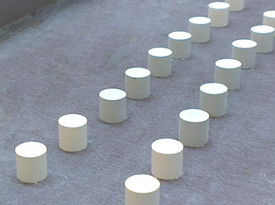
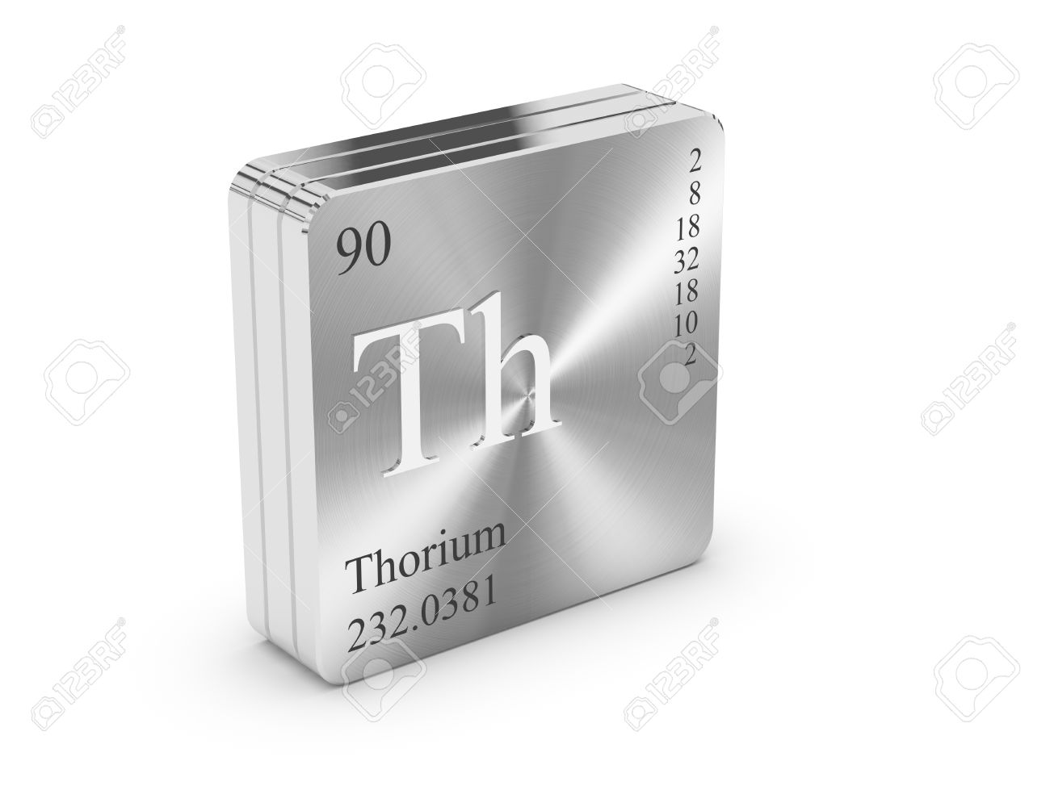
Incentives
Why water cooled / oxide fuel?
  well-established plant / fuel technology
Why thorium ?
  Breeding potential in fast/thermal spectrum with negative void effect
  No severe energetics during CDA
  Diversify fission energy resource
  Smaller MA production
http://thorenergy.no/

Slide 6

Contents
Why thorium breeder?
Three concepts
  D₂O cooled thorium thermal breeder (CANDU type)
  D₂O cooled thorium fast breeder (PWR type)
  Static molten salt breeder (Moltex type)
Proliferation concerns
Conclusions

Slide 7
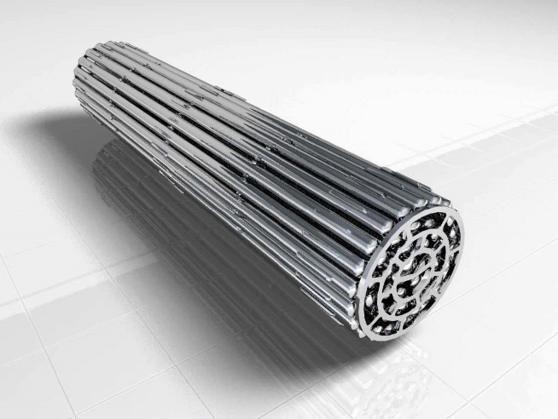
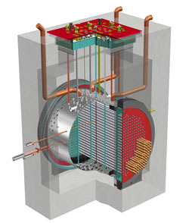
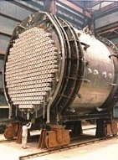
Heavy Water Cooled Thermal Breeder
Low ²³³U enrichment
in Th-U oxide fuel
meets breeding condition
Fissile number density

Slide 8
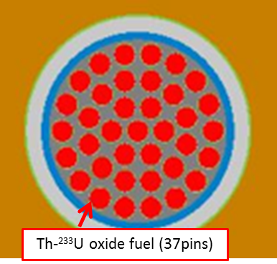
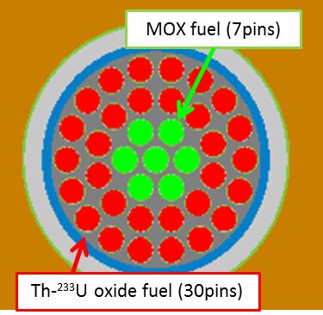
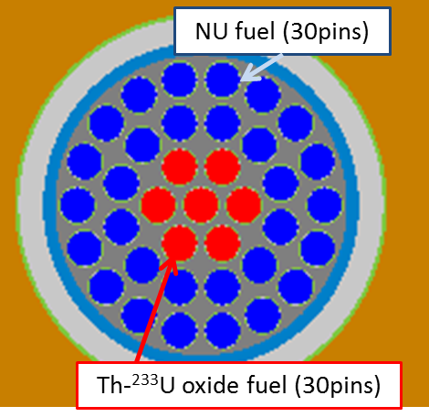
Fuel Bundle Designs
Sustainer
+ Pu burner
Nat.U supported
²³³U breeder
Sustainer
1
2
3
²³³U enrichment: 1.4%
²³³U enrichment: 1.4%
Pu enrichment: 2.5%
²³³U enrichment: 1.4%
Discharged burnup | 3.9 GWd/t | 7.9 GWd/t | 2.9 GWd/t
Compound system doubling time (CSDT) | 729 years | 206 years | 13 years

Slide 9
Contents
Why thorium breeder?
Three concepts
  D₂O cooled thorium thermal breeder (CANDU type)
  D₂O cooled thorium fast breeder (PWR type)
  Static molten salt breeder (Moltex type)
Proliferation concerns
Conclusions

Slide 10
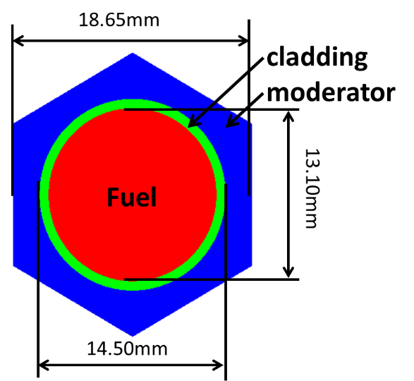
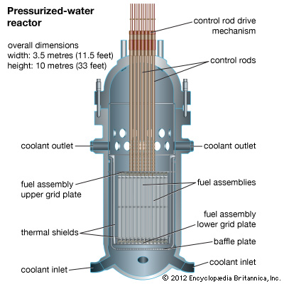

Heavy Water Cooled Fast Breeder
²³³U-Th fuel (282)
D₂O reflector (96)
B₄C control rod (19)
Fuel pin cell
(MFR≒1.0)
(Moderator to fuel volume ratio)
Top view of
PHWBR core
(PHWBR: Pressurized Heavy Water Breeder Reactor)
Hexagonal fuel assemblies

Slide 11
Neutron Spectrum
Unit: n/cm²
 | Fast fluence | Limitation
Zircaloy-4 | 2.87×10²² | < 1.5×10²²
SiC | 2.88×10²² | < 8.0×10²²
U-Pu FBR
Th-U233 PHWBR
Zircaloy
SiC
UOX LWR

Slide 12
Performances
Similar output (1.3GWe) and core size (<4m) with current PWR
Homogeneous, hexagonal tight pin pitch core (MFR=0.6)
Breeding (BR>1.05) with negative void reactivity coefficient
Higher burnup than LWR (>70GWd/t)
Acceptably small fissile/HM inventory (15ton/200ton)
SiC cladding suited for ATF and high fast neutron fluence

Slide 13


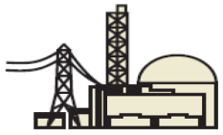
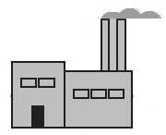



Deployment Scenario
Current phase
Natural
uranium
UOX Fuel
Fabrication
LWR
Reprocessing
Disposal
?
Pu
Th/Pu
Transition phase
Thorium
(Th,Pu)O₂ Fuel
Fabrication
(Th,Pu)O₂ Fueled
PHBR
Reprocessing
Disposal
U-233
Th/U-233
Sustainer phase
Thorium
(Th,U-233)O₂ Fuel
Fabrication
(Th,U-233)O₂ Fueled
PHBR
Reprocessing
Disposal

Slide 14
Replacement of U-LWRs by Th-PHWBRs
Constant total capacity
②＋③
①U-LWR
60GWe U-LWRs can be replaced within a century.
③Th-²³³U PHWBR
②Th-Pu PHWBR

Slide 15
Cost Impact
Cost reduction factors | Cost increase factors
No need for enrichment (vs. LWR) | Heavy water coolant (vs. LWR)
Proven PWR plant technology (vs. FBR) | Tritium production (vs. LWR)
Less expensive resource (vs. UO₂ fuel) | Challenging reprocessing technology (vs. UO₂ fuel)
 | High gamma fuel handling (vs. UO₂ fuel)

Slide 16
Generation Cost of PHWBR
LWR (5.3 yen/kWe)
Plant : 1300MWe PWR
Evaluated by FEPC in 2004.
FBR (2.6 yen/kWe)
Plant : 1500MWe MOX-FBR
Evaluated by JAEA in 2010.

Slide 17
Contents
Why thorium breeder?
Three concepts
  D₂O cooled thorium thermal breeder (CANDU type)
  D₂O cooled thorium fast breeder (PWR type)
  Static molten salt breeder (Moltex type)
Proliferation concerns
Conclusions

Slide 18

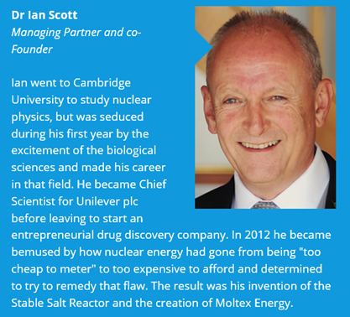
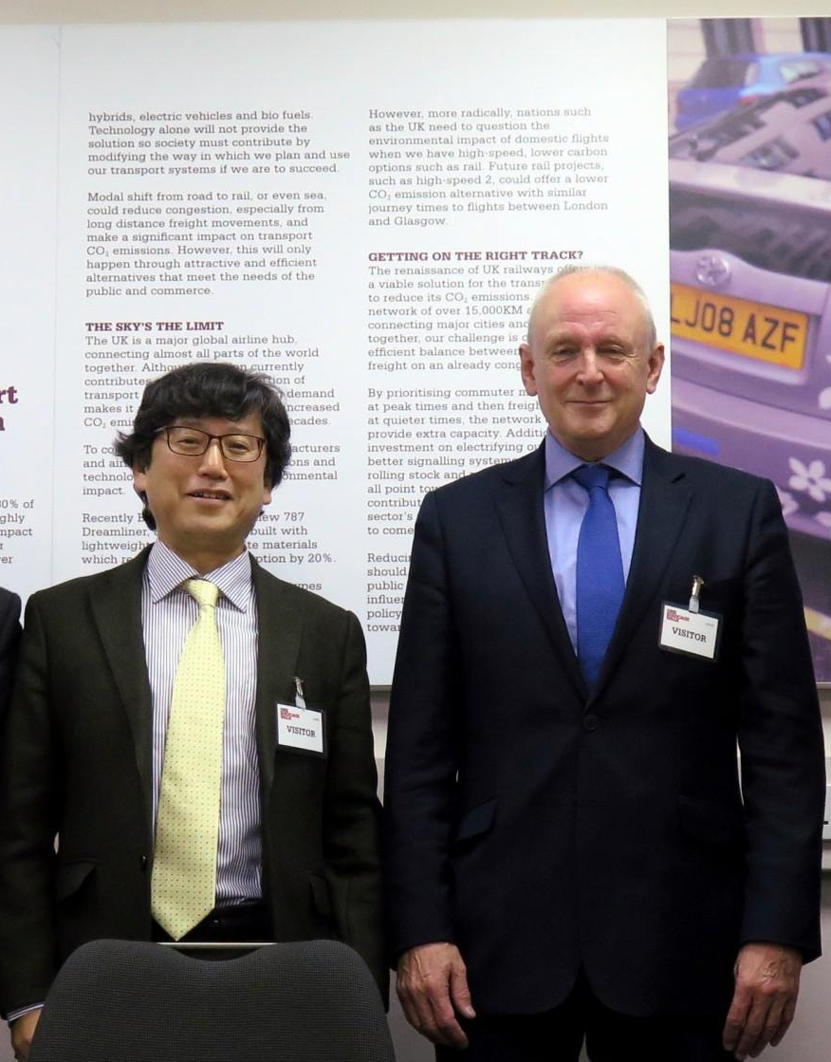
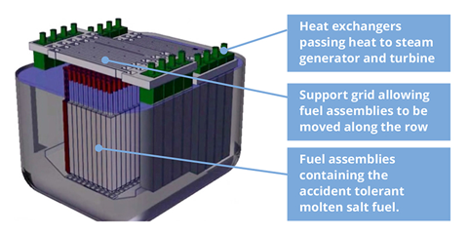
Static Molten Salt Reactor

Slide 19
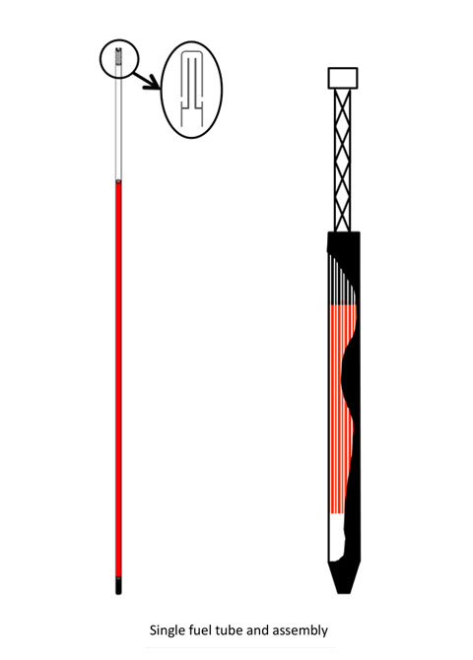
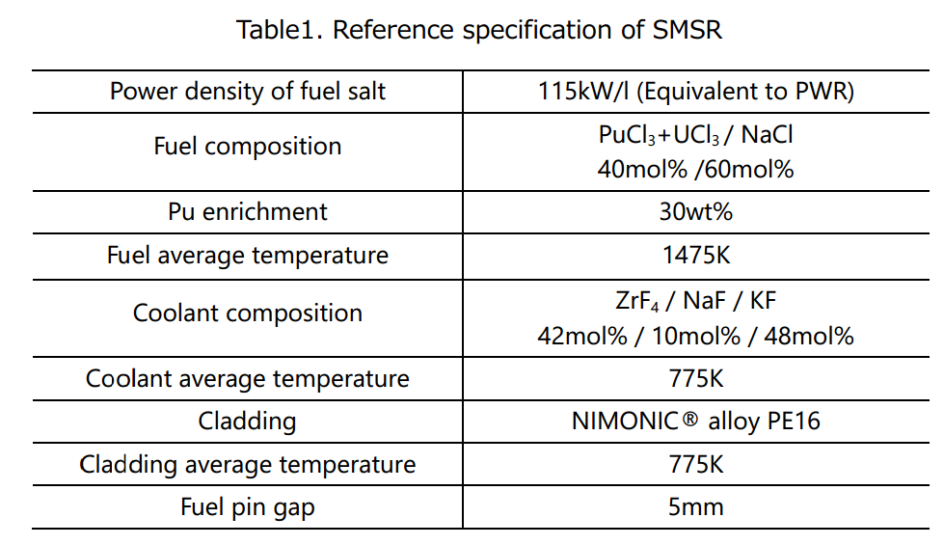
Core specifications of SMSR

Slide 20
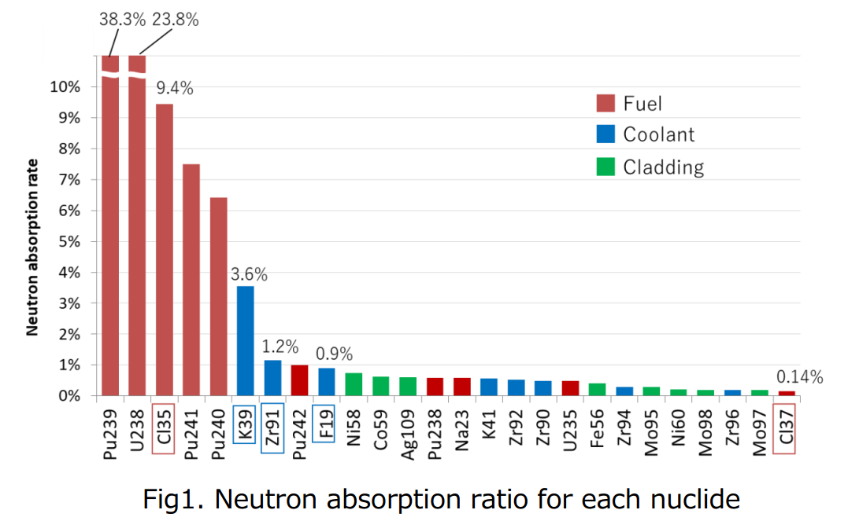
Parasitic neutron absorbers

Slide 21
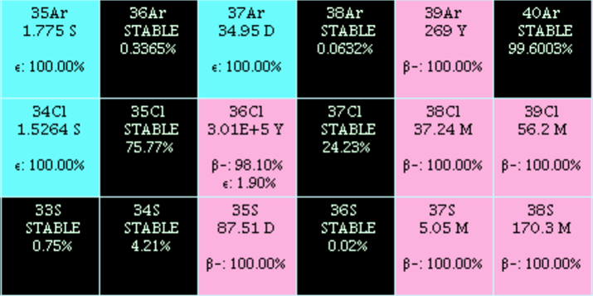
Modifications to SMSR
Chlorine composition : Natural → Enriched Cl-37
(to reduce absorption)
Coolant material : Fluoride salt → Sodium (to mitigate spectrum softening)
Cl-37 enriched + Na cooled core
Pu enrichment： 15wt%
Z
18
17
16
Cl-37 enriched core
Pu enrichment： 27wt%
Reference core (SSR)
Pu enrichment： 30wt%

Slide 22
Performances

Slide 23
Contents
Why thorium breeder?
Three concepts
  D₂O cooled thorium thermal breeder (CANDU type)
  D₂O cooled thorium fast breeder (PWR type)
  Static molten salt breeder (Moltex type)
Proliferation concerns
Conclusions

Slide 24
Proliferation Concerns of U-233
 | Gamma dose | Critical mass | Enrichment technology | Implosion technology | Heat production
U-235 | None | 48kg | Required | Not required | None
Pu (Weapon grade) | Low | 10kg | Not required | Required | Low
U-233 (Low grade) | High | 16kg | Not required | Not required | Low

Slide 25
Conclusions
CANDU type thorium thermal breeder is the most promising for near term introduction if commercial reprocessing technology is developed.
PWR type thorium fast breeder base on proven technologies can be deployed as dominant energy sources within a century.
Static molten salt reactor requires Cl-37 enriched fuel salt and sodium coolant to be a breeder.

Slide 26

What I want to share
Breeding is the key for sustainable society.
Thorium shows some preferable characteristics but is not magic fuel, basically the same as uranium.
Thorium reactor produces similar nuclear wastes if the cycle is not closed.
Closing cycle just minimizes the wastes and maximize the resources regardless of U or Th.

