Slide 1

environmentalprogress.org
Alan Medsker, Illinois Coordinator

Slide 2
OUR MANTRA:

Slide 3
DEFEND
DEPLOY
DEMONSTRATE
DEVELOP

Slide 4

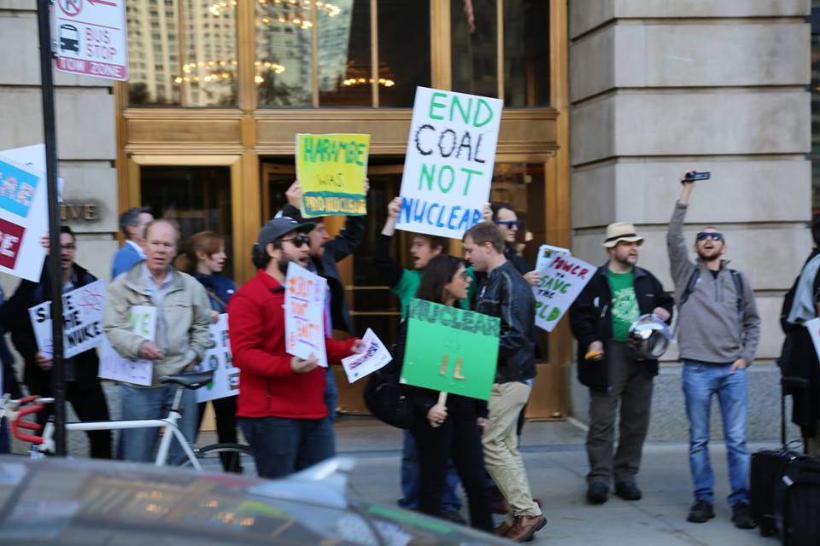


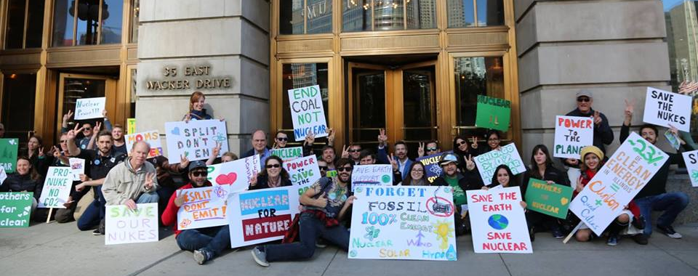
DEFEND

Slide 5
DEFEND
Illinois
California
New York
Ohio
Pennsylvania
Connecticut
Massachusetts
South Korea
Germany
France
MORE!

Slide 6
DEFEND
Why defend 50-YO nuclear designs…?
Next Generation Technologies are not likely to emerge from dead or dying industries.

Slide 7
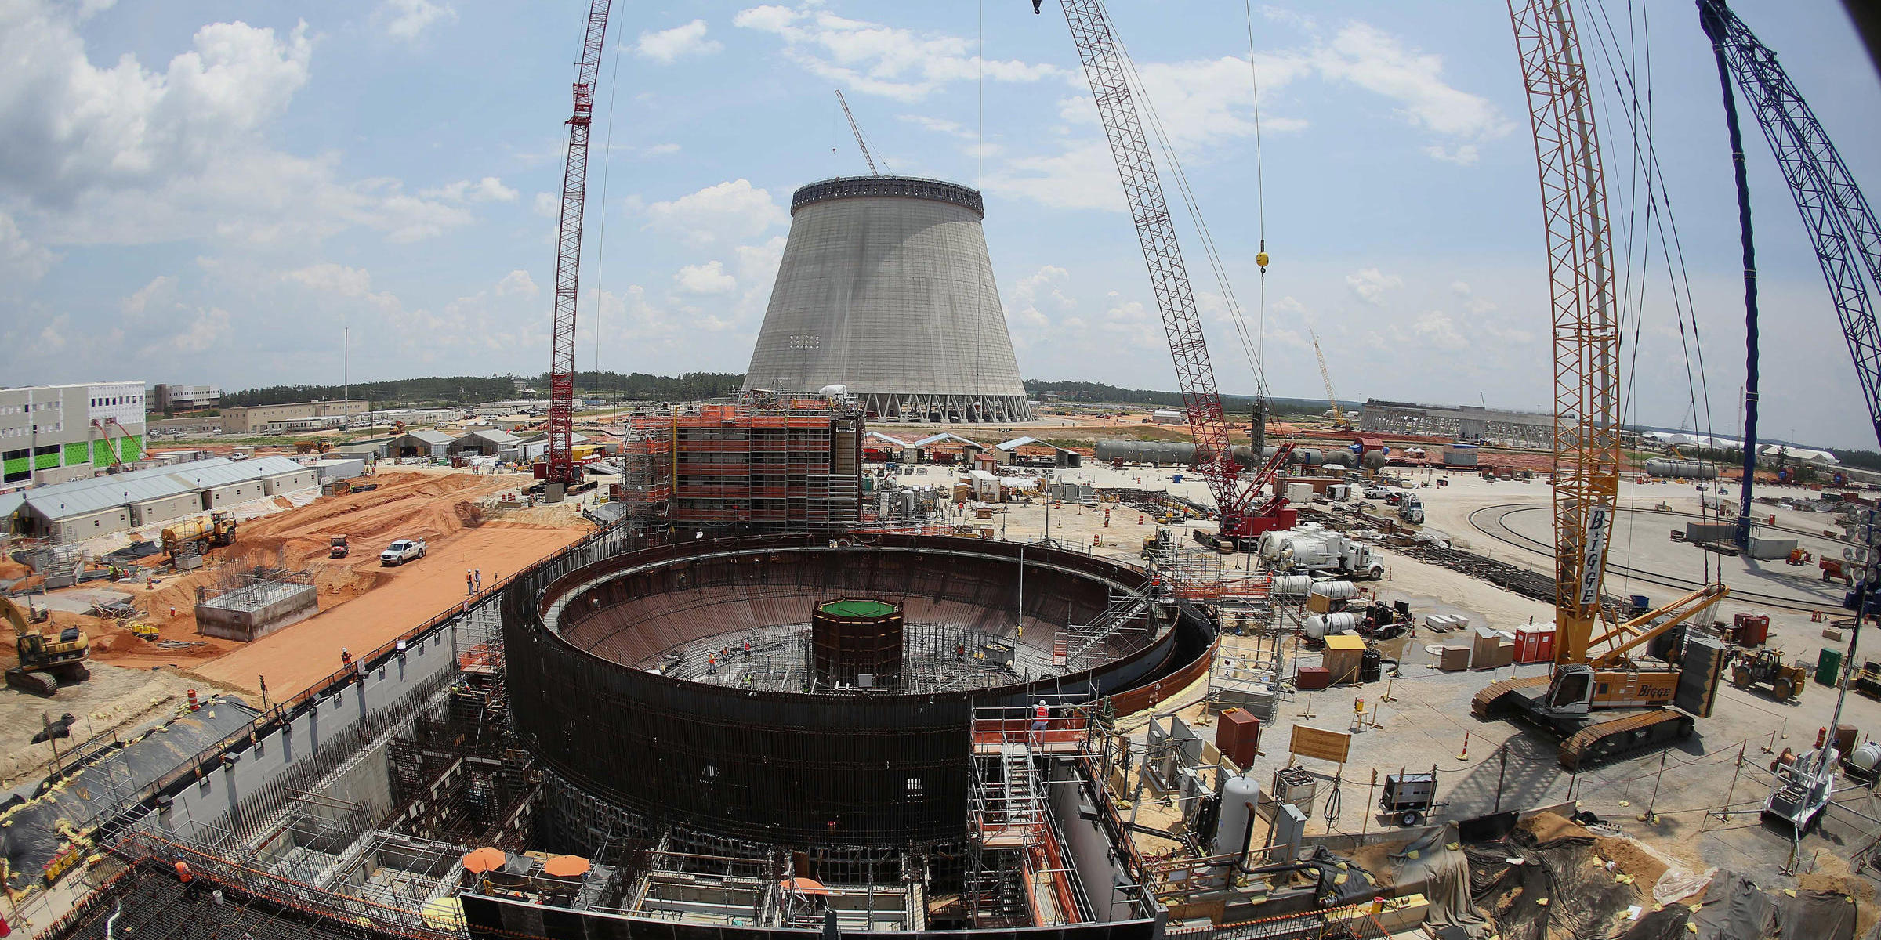
DEPLOY

Slide 8
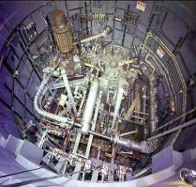
DEMONSTRATE

Slide 9
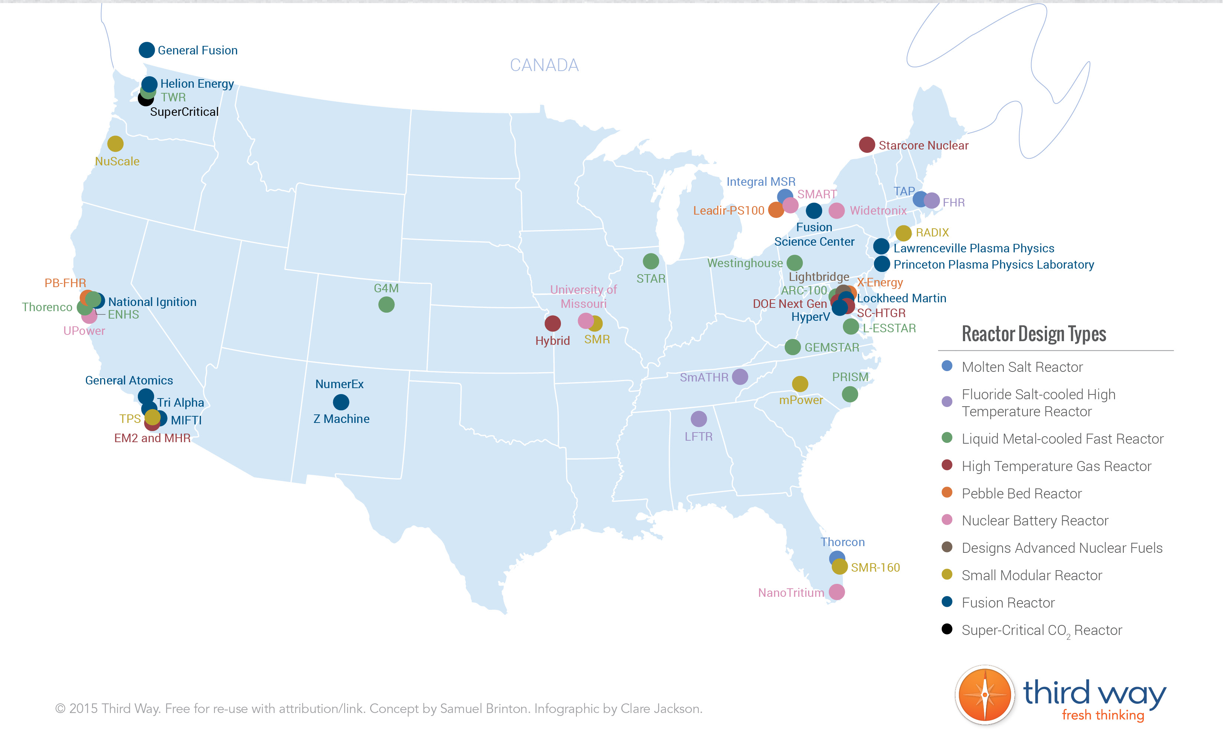







DEVELOP

Slide 10
environmentalprogress.org

