Slide 1
ThorCon Molten Salt Reactor (TMSR-500) Technology for Indonesia
Dane Wilson, ThorCon Intl
October 01,2019
Thorium Energy Alliance TEAC10
Pollard Technology Conference Center Oak Ridge Tennessee
Two 500 MW ThorCon liquid fission power plants

Slide 2
Prototype Built In A Hull, Pretested, Towed To Indonesia, Settled Shoreside, And Powered Up. A 174x67m Complete 500 MWe Power Plant

Slide 3
Each 557 MWt Power Module Has An Active And A Cooldown Can

Slide 4
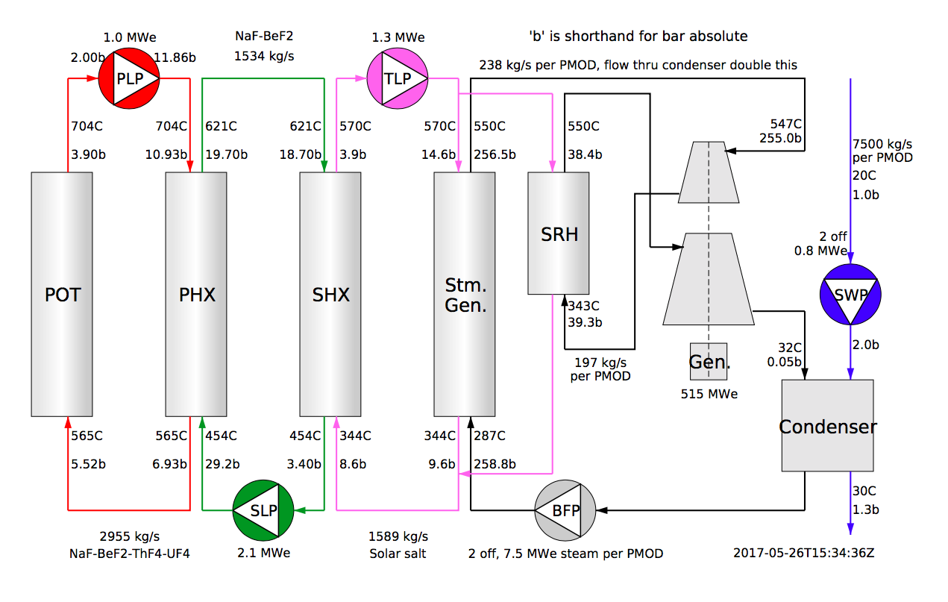
ThorCon Employs Three Salt Loops
47.7% thermal efficiency @ 20C
46.4% thermal efficiency @ 30C

Slide 5
Replaceable Can Unit Housed Within Cold Wall
Reactor Pot contains the graphite moderator with channels for molten salt flow
Freeze valve melt drains salt to drain tank
Cold wall absorbs heat radiated from drain tank
Cold wall is cooled by natural water circulation

Slide 6
Cold Wall Is Cooled By Natural Convection To Condenser In Cooling Pond
Cooling pond

Slide 7
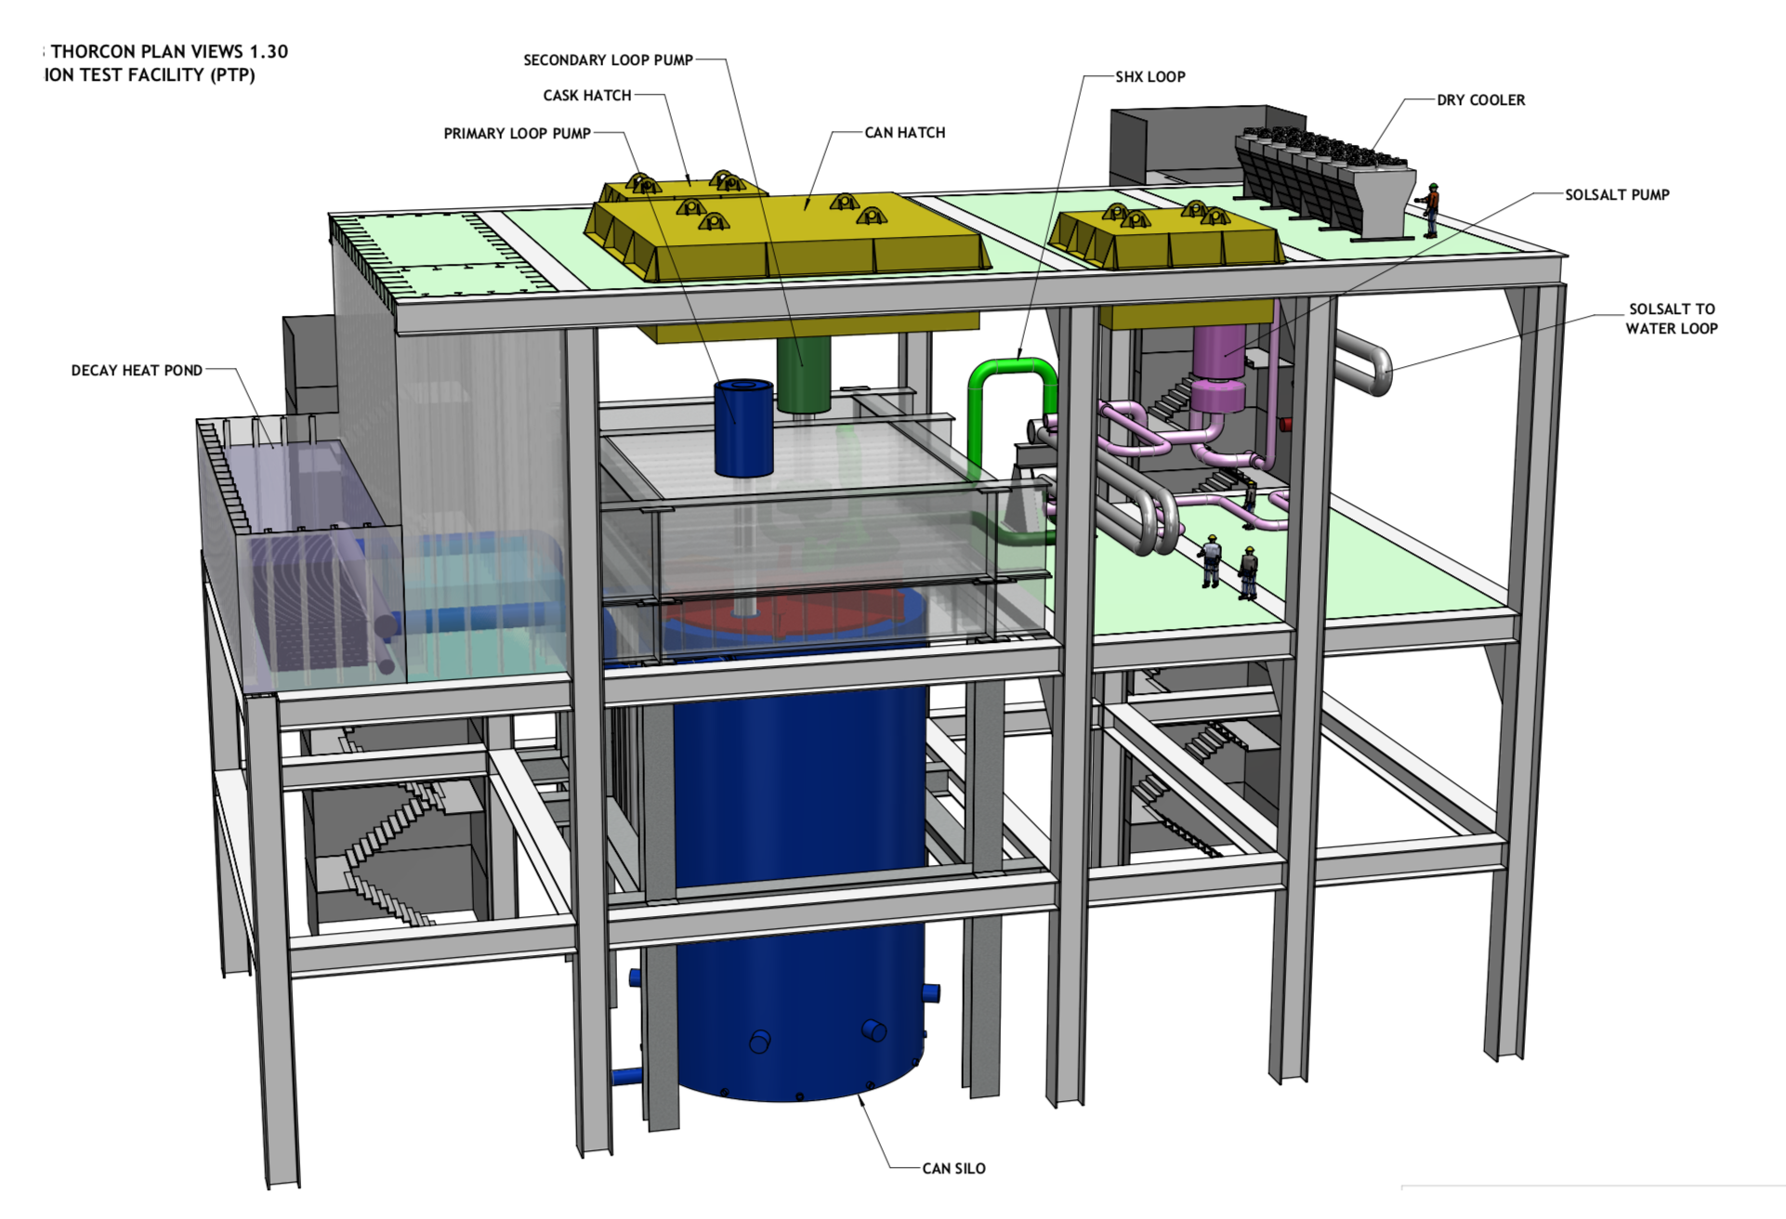
Next Step Is A Pre-fission Test Plant

Slide 8
ThorCon Recent Actions Include:
System simulations show Fukushima like accidents do no harm
Design and simulations by top Korean ship safety firm show ThorConIsle can handle a North Atlantic storm and aircraft engine strike. Seismic analysis started.
GAIN project (ANL): Salt properties measurement begun
GAIN project (ANL): Electro-chemical sensors for in-situ redox, salt level, and plutonium concentration is underway
Indonesian P3Tek study to validate ThorCon claims for safety, cost, and supply chain completed
Recommendation to be sent to the Indonesian president

Slide 9
Thorcon Fukushima Response:
Earthquake sensors - initiate fuelsalt drain - drop shutdown rods (SCRAM) - fission stops
Then, all power and primary cooling path lost
Reactor in safe state with fuelsalt in passively cooled drain tank.
Fuelsalt temperature max 750°C
Worse - instant SBO max 850°C
Worst - SBO+triple shutdown rod fail 1000°C w/ 0.5% creep damage
Power
Temperature
Reactivity

Slide 10
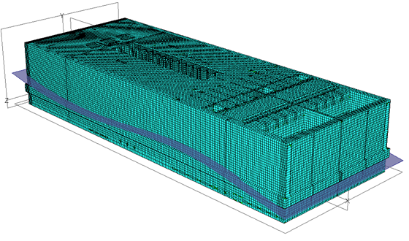
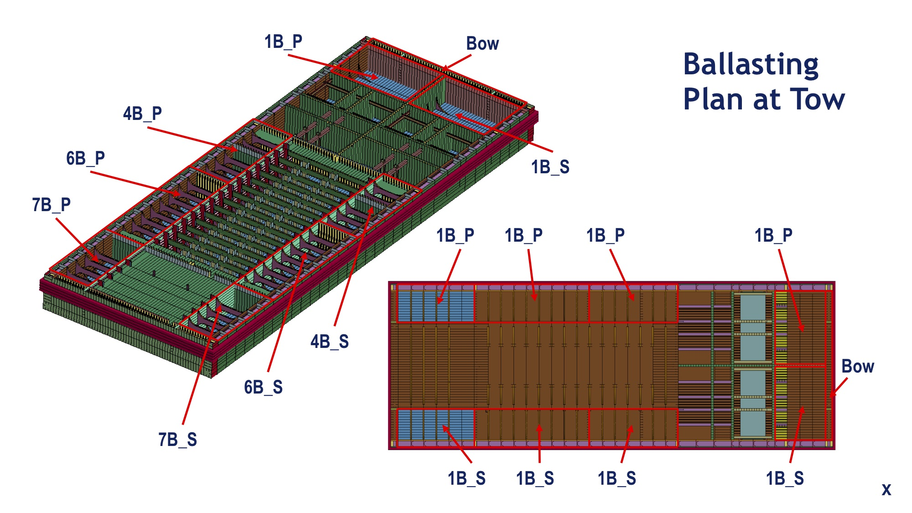
ThorCon Hull Towed Through North Atlantic Storm Seas Accepts 1 g Forces

Slide 11
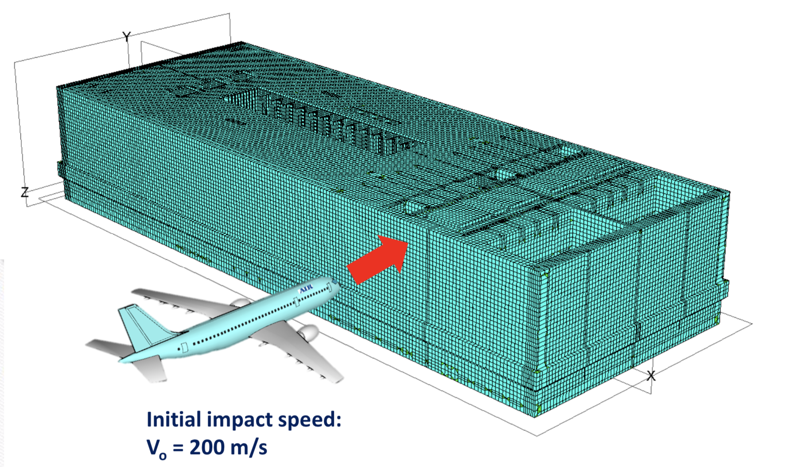
Scenario: 8 t Aircraft Engine Strikes Sand-filled Sandwich Wall At 200 m/s
Max penetration 200 mm
Max inner wall deflection 300 mm
No effect on
Silo (which surrounds)
Cold wall (which is around)
Can (which contains)
Primary loop containing radioactive fuelsalt
Impact Crashworthiness of a Floating Nuclear Power Plant Hull Structure in an Aircraft Strike
by Jae Hyeong Park and Jeom Kee Paik

Slide 12
In Summary,
ThorCon Is Moving On The Winding Path Forward
http://thorconpower.com/

