Slide 1
Investigation of U.S. Mineral and Metal Import Reliance Comparing U.S. Geological Survey Mineral Commodity Summaries (MCS) reporting data—to actual rare earth resource imports
Ned Mamula
Geoscientist, Adjunct Scholar
Center for the Study of Science
Cato Institute
(formerly with U.S. Geological Survey)

Slide 2
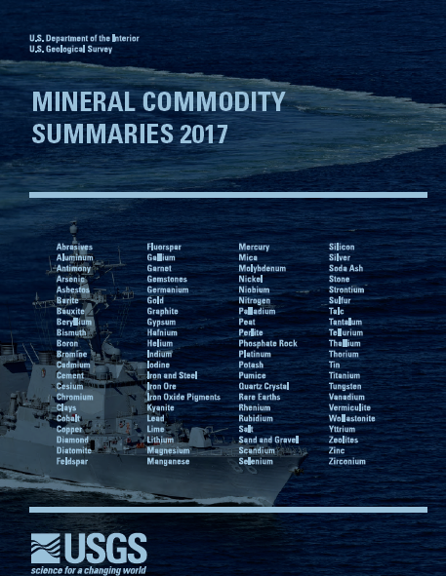

Slide 3
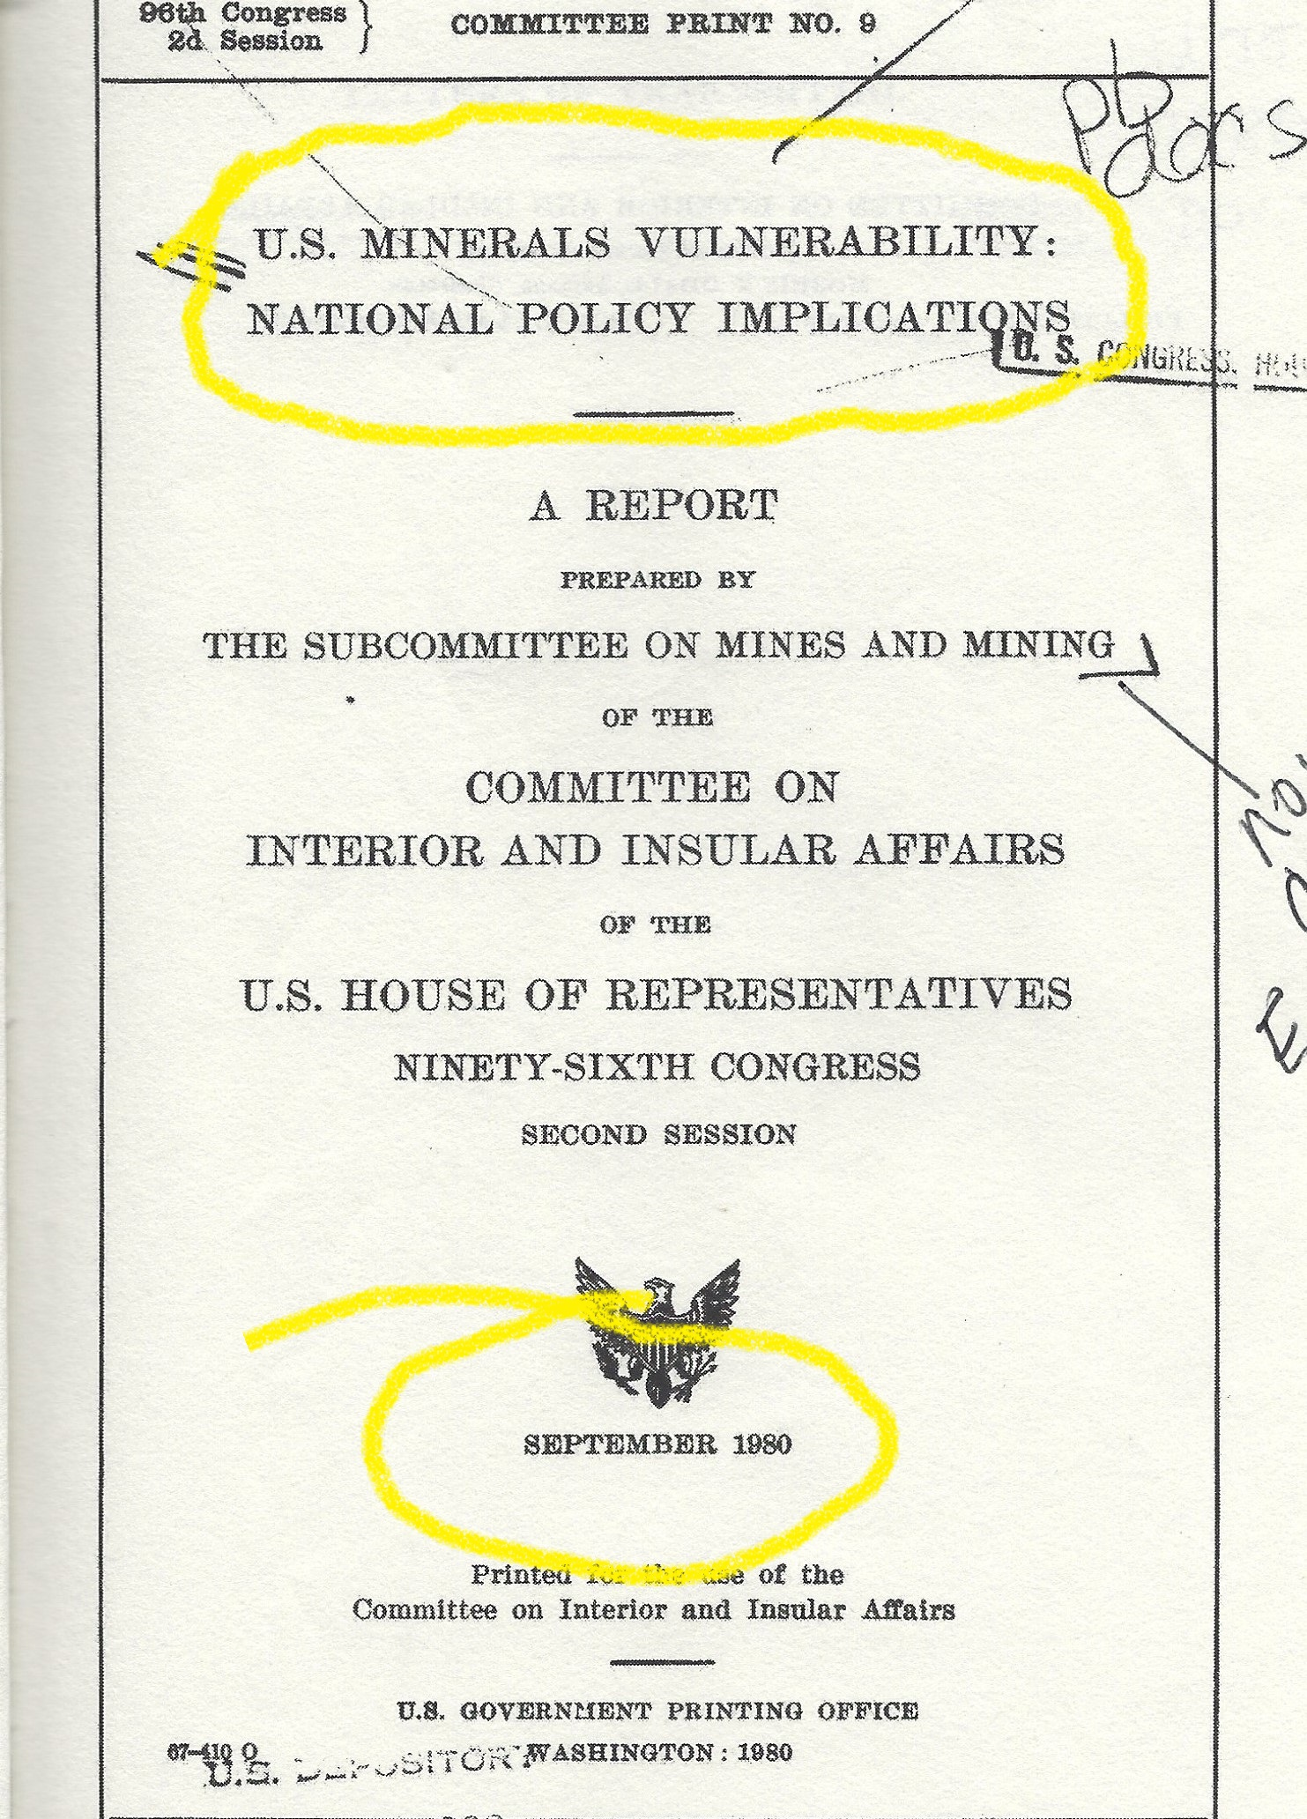
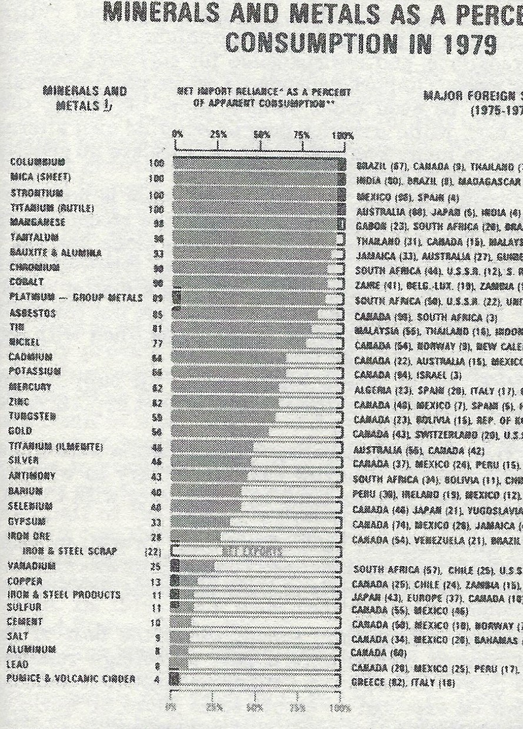
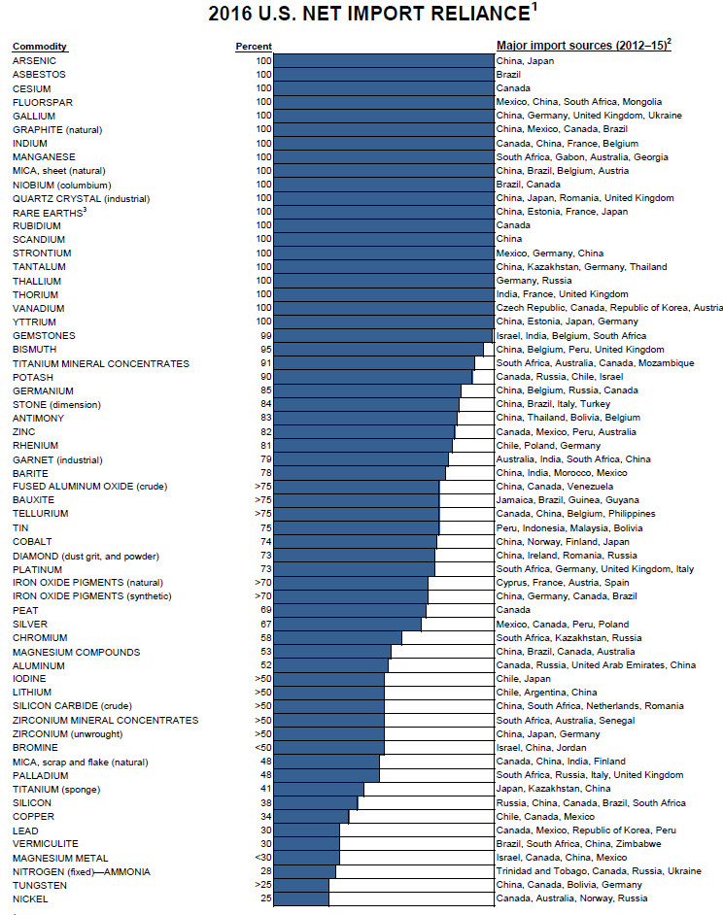
U.S. Mineral Import Dependence—1980 vs 2016
In 1980 Congress Found Reason to Report on “U.S. Mineral Vulnerability”

Slide 4
Circa 1980—Miracle of REE Metallurgy Beyond the Horizon
Then:
No major military, industrial, commercial REE applications
NdFeB magnets, personal computers not in common use
NRC and IAEA effectively regulated all Western heavy rare earth resources as “source material” due to the companion element Thorium
Result: regulation essentially “terminated” Western heavy rare earth production
Now:
Relocation of REE metallurgical value-adding technology to China
USGS MCS still reports 16 REE as “Rare Earths”, “Scandium” and “Yttrium”

Slide 5
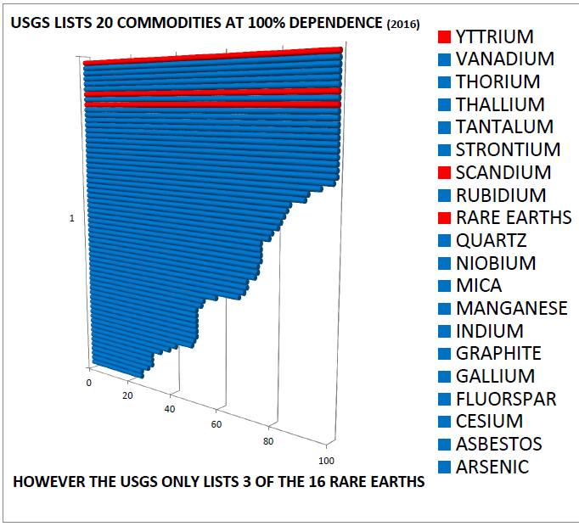
U.S. Import Dependence
reported in 2016 USGS MCS

Slide 6
Mineral Commodity Summaries (MCS)…Mineral Accounting Practices
Includes individual commodities listed as concentrates, oxides, sponge, metals—regardless of quantity imported and later used
Example: aluminum is listed as bauxite, concentrate, and metal
Mineral use as low as 41,000 kg per year (e.g. Rhenium)—still listed in MCS Import data
USGS lists Scandium, Yttrium and Rare Earths….but….
The 14 commercial Lanthanides and rare earth oxides are not listed
If USGS ‘standards’ for listing minerals in MCS were applied to REE oxides and metals—the MCS Import Reliance list would be much larger!

Slide 7
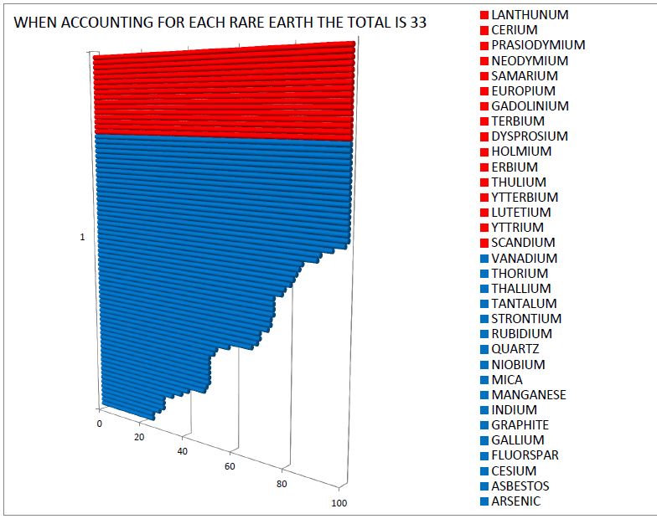
VALUE CHAIN PROBLEM
USGS MCS only lists REE oxides, but not metals or finished parts
REE oxides by themselves have no significant military or technology application
Even if mined in U.S. these materials would need to pass through China to be converted into something useful

Slide 8
U.S. REE Oxide Import Reliance at 100 Percent (2016)

Slide 9
REE Oxides Alone Have No Significant Technical or Defense Application
REE must be converted into metals, alloys, magnets, other products first!
According to CRS, imported metallized REE must be processed in China
China has the only fully integrated value chain in the world
Therefore, measuring REE dependence or developing U.S. rare earth mines is pointless without a corresponding U.S. based supply chain

Slide 10
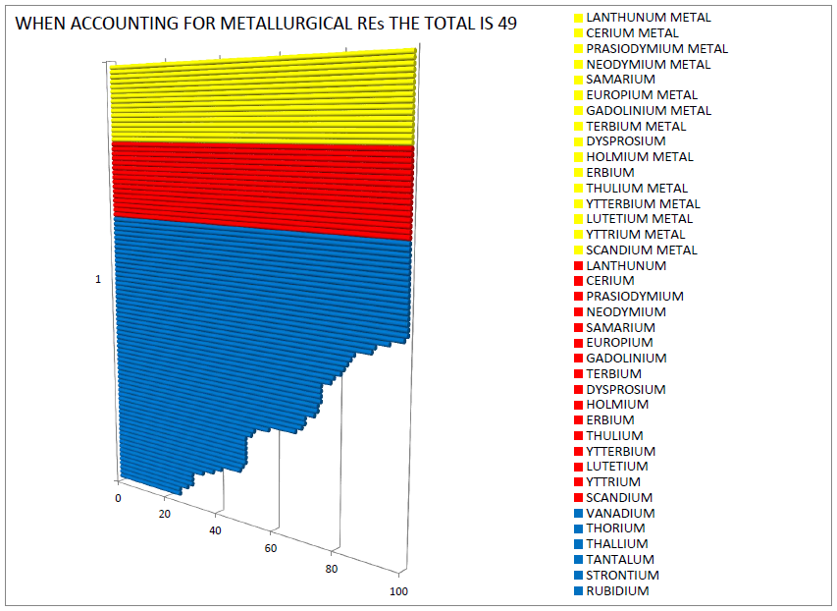
U.S. is 100% reliant on China for all REE
China has world’s only fully integrated REE value chain
Defense, tech, and “green” industries require RE metals and other post-oxide materials

Slide 11
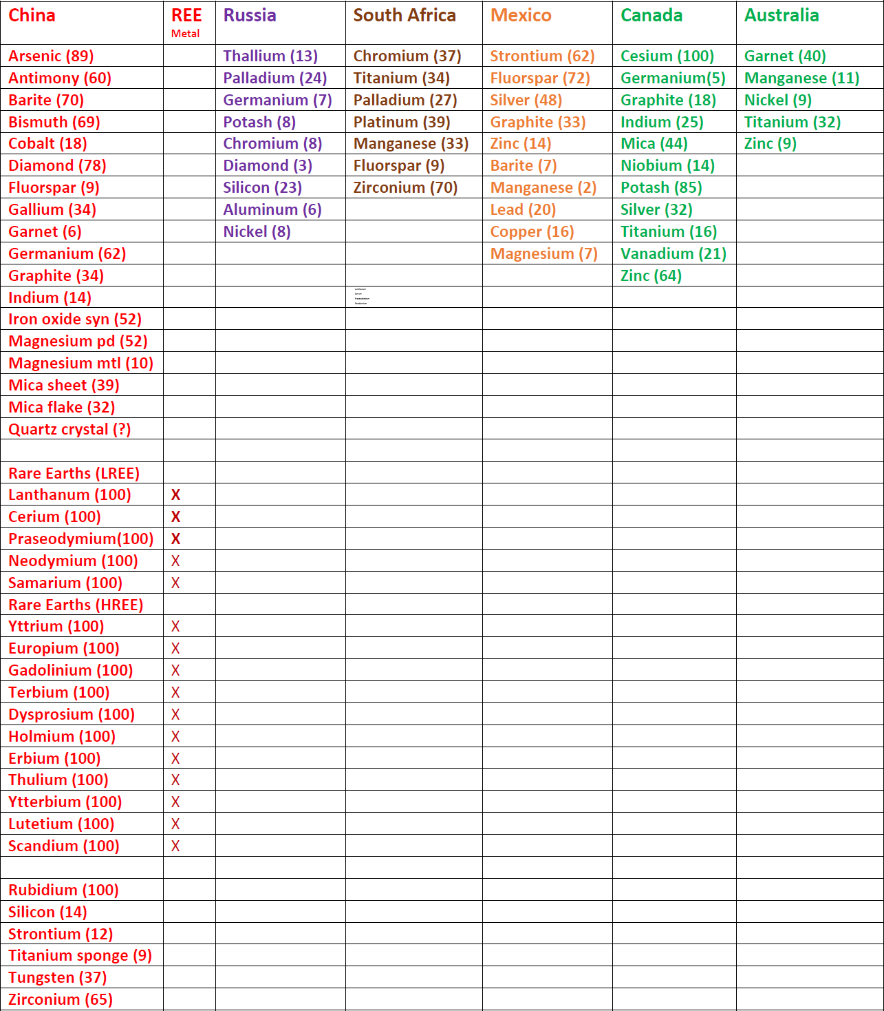
Largest Suppliers of U.S. Mineral Imports (2016)
Six major mining country suppliers
Minerals they provide alphabetical
Percent of U.S. import
REE oxides and metals included
Relative “import risk” of each country color coded
Data used for “analysis” of mineral imports/graphs
Real analysis not possible with MCS

Slide 12
Largest Suppliers of U.S. Mineral Imports at Greater than 50 Percent (2016)

Slide 13
U.S. Rare Earth Oxide Import Reliance at 100 Percent (2016)

Slide 14
U.S. Rare Earth Oxide & Metal Import Reliance at 100 Percent (2016)
Lanthanum
Cerium
Praseodymium
Neodymium
Rare Earth Oxides

Slide 15
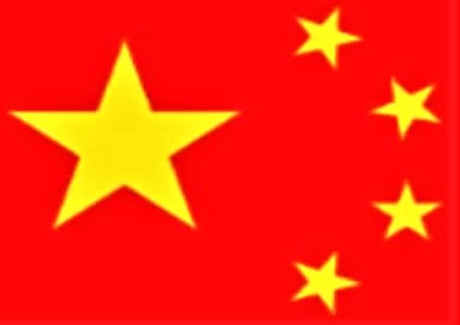
The Geopolitics of U.S. Rare Earth Import Reliance at 100 Percent !
Lanthanum
Cerium
Praseodymium
Neodymium
RE Oxide Import Dependence | RE Metallurgical Import Dependence

Slide 16
Conclusions
“Washington…we have a problem”
Chinese monopoly on world’s REE oxides and metals
REE “reporting” problem dates back to 1980…not good for policy!
Mineral import dependence/vulnerability grows each year
Current administration must act now!

Slide 17
Contact Information
Ned Mamula
Geoscientist, Adjunct Scholar
Center for Study of Science
Cato Institute
middleburg@mindspring.com
540-454-3057

