Slide 1
Enhanced High Temperature Nuclear Plant Economics through Maximal Capacity Utilization
Cogeneration of Electrical Power and Synthetic Fuel with Fully Flexible Product Selection
John R. Bucknell
Independent Researcher
Thorium Energy Alliance Conference, 21-22 August 2017, St. Louis MO

Slide 2
Enhancing Economics
Index
  Introduction
  World Energy Consumption by Type
  Capacity Factors and Solar Power
  Levelized Cost of Energy with Varying Capacity Factors
  High Temperature Reactors with Cogeneration of Synthetic Fuel
  Conclusion
Notes:
A new energy conversion cycle is proposed that enhances the economics of high temperature nuclear power plants. Molten salt cooling for either actinide burning or thorium breeding reactors have several synergistic characteristics: safety features such as passive temperature regulation and operational enhancements such as on-line refueling (as a fuel-bearing coolant) as well as high temperature that enhances the efficiency of thermodynamic cycles. These molten salt characteristics promise to lower costs of power production relative to existing reactors, both by reducing the capital cost burden per unit capacity as well as improving operating costs through lower fuel costs and improved capacity utilization. High capital costs of nuclear power plants have made high capacity utilization a necessity for adequate economics - typically installed as base load power. Base load can be half or less of peak demand on a daily basis with great seasonal variation at high latitudes, and in the presence of intermittent sources such as wind and solar implies the need for “dispatchable” power to meet demand (typically gas-fired aero-derived turbines). These realities narrow the economic application of nuclear power to a fraction of the power market. At least one proposal attempts to address the daily demand variation by storing heat energy and supplementing with fuel-firing for lower capital costs as compared to non-integrated solutions. The new proposed conversion cycle attempts to address both the daily and seasonal variation by providing a mechanism to operate a high temperature nuclear plant at a capacity equal to peak demand continuously and actively diverting thermal energy into electricity or synthetic fuel production or any combination of either. The synthetic hydrocarbon fuel is carbon-neutral as CO₂ is preferentially sourced from sea water, and the synfuel process can economically yield any product stream from gaseous hydrogen to methanol given a low-cost energy source. Methanol is preferred as an energy storage medium as it can be easily stored and transported and is also a feedstock to many chemical processes and can also be easily upgraded to higher order hydrocarbons. Therefore the synfuel is widely applicable to consumers representing over 85% of current world energy consumption (ensuring a large market for the foreseeable future). In this fashion capital costs per unit power is minimized providing most economical energy production.
called Nuclear Air-Brayton Combined Cycle (NACC) with Firebrick Resistance Heating Energy Storage (FIRES)

Slide 3
Introduction
Safe, low cost energy is vital to future of human prosperity
Distributed sustainable energy in conjunction with the above ensures ongoing prosperity for all
Nuclear Power has the potential to provide both
Addressing all energy sector needs with Nuclear Power with best economics is the subject matter
A new paradigm of fully flexible production of electricity and synthetic chemical energy storage with large installed capacity is introduced
Notes:
A new energy conversion cycle is proposed that enhances the economics of high temperature nuclear power plants. Molten salt cooling for either actinide burning or thorium breeding reactors have several synergistic characteristics: safety features such as passive temperature regulation and operational enhancements such as on-line refueling (as a fuel-bearing coolant) as well as high temperature that enhances the efficiency of thermodynamic cycles. These molten salt characteristics promise to lower costs of power production relative to existing reactors, both by reducing the capital cost burden per unit capacity as well as improving operating costs through lower fuel costs and improved capacity utilization. High capital costs of nuclear power plants have made high capacity utilization a necessity for adequate economics - typically installed as base load power. Base load can be half or less of peak demand on a daily basis with great seasonal variation at high latitudes, and in the presence of intermittent sources such as wind and solar implies the need for “dispatchable” power to meet demand (typically gas-fired aero-derived turbines). These realities narrow the economic application of nuclear power to a fraction of the power market. At least one proposal attempts to address the daily demand variation by storing heat energy and supplementing with fuel-firing for lower capital costs as compared to non-integrated solutions. The new proposed conversion cycle attempts to address both the daily and seasonal variation by providing a mechanism to operate a high temperature nuclear plant at a capacity equal to peak demand continuously and actively diverting thermal energy into electricity or synthetic fuel production or any combination of either. The synthetic hydrocarbon fuel is carbon-neutral as CO₂ is preferentially sourced from sea water, and the synfuel process can economically yield any product stream from gaseous hydrogen to methanol given a low-cost energy source. Methanol is preferred as an energy storage medium as it can be easily stored and transported and is also a feedstock to many chemical processes and can also be easily upgraded to higher order hydrocarbons. Therefore the synfuel is widely applicable to consumers representing over 90% of current world energy consumption (ensuring a large market for the foreseeable future). In this fashion capital costs per unit power is minimized providing most economical energy production.
called Nuclear Air-Brayton Combined Cycle (NACC) with Firebrick Resistance Heating Energy Storage (FIRES)

Slide 4
World Energy Consumption
Primary*
Final**
85%
65%
*Data from Energy Information Administration, 2017
**Data from European Environmental Agency, 2017

Slide 5
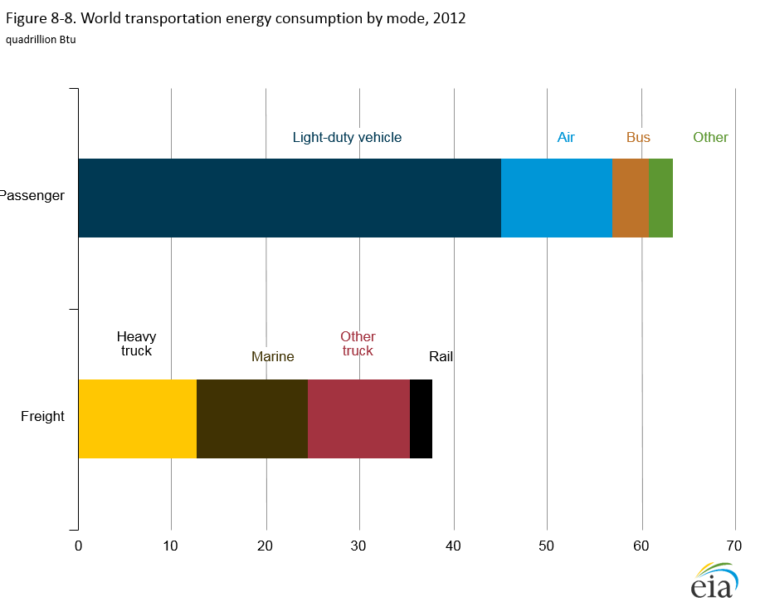
World Energy Consumption - Transport
Final by Sector**
Challenge
Challenge
*Data from Energy Information Administration, 2017
**Data from European Environmental Agency, 2017
Notes:
100-150 of 550 Quads is used in Transport, nearly 50% of which has no electrification possibility

Slide 6
Generating Operation (Summer)
Peaking: 57% Capacity Factor
Peaking
Electricity
Baseload: 81% Capacity Factor
Baseload

Slide 7
Generating Operation (Summer) – With 10% Solar Energy
Peaking: 28% Capacity Factor
Solar
Peaking
Baseload: 60% Capacity Factor
Electricity
Baseload

Slide 8
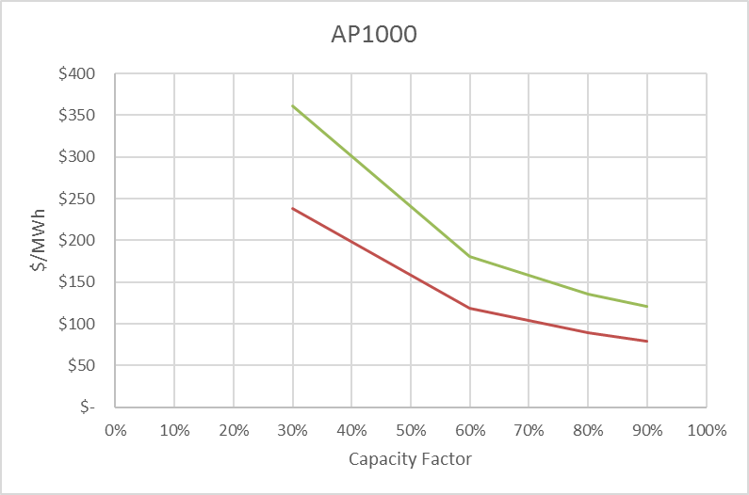
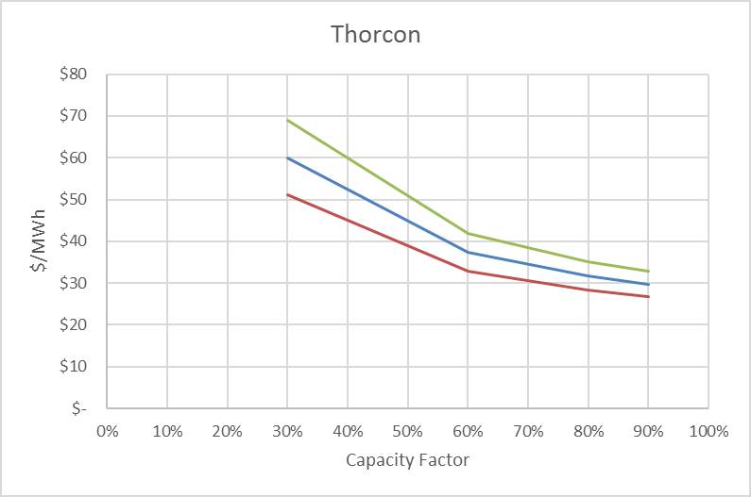
Levelized Generation Costs – Gen III vs Gen V Nuclear
20yr Finance Period with 10% Cost of Capital
*Data from “Capital Cost Estimates for Additional Utility Scale Electric Generating Plants”, EIA 2017
**Data from “Thorcon Executive Summary”, 2015

Slide 9
High Quality Heat to Chemical Energy Storage

Slide 10
Fully Renewable Fuels via CO₂ Recycling

Slide 11
Sulphur-Iodine Hydrogen Production with Heat Pump
Hot Helium
MSR
Turbo Inductor Heat Pump

Slide 12
Cogeneration Process Schematic
95% Efficient
Methanol Synthesis Plant
51% Efficient
S-I Hydrogen Plant
51% Efficient MSR
Electric Plant

Slide 13
Process Schematic – MSR with Brayton+Rankine Cycle
Heat

Slide 14
Process Schematic – Hydrogen Generation
H2
1000°C
Heat

Slide 15
Process Schematic – CO2 Extraction and Methanol Synthesis
Methanol
Fresh Water
Desalination Plant
Waste Heat

Slide 16
Estimated Costs of Product Streams
 | Electricity | Energy Storage
Product | Electricity | Hydrogen | Methanol | Gasoline
Capacity Factor | Levelized Costs
90% | $29.77/MWh | ~ | ~ | ~
60% | $29.77/MWh | $72.37/MWh | $86.02/MWh | $93.51/MWh
30% | $29.77/MWh | $39.41/MWh | $69.37/MWh | $75.36/MWh
0% | ~ | $28.43/MWh | $53.09/MWh | $57.70/MWh
Prices: May 2017 | $110/MWh* | $419/MWh** | $74.41/MWh*** | $49.61/MWh****
 | ~ | $14.26/kg** | $1.23/gal*** | $1.67/gal****
Plant finance period 20 yr, 10% cost of capital. Energy costs w/o amortization -> Elec: $14.74, H2: $6.45, MeOH: $12.92 MWh
*Data from “Lazard’s Levelized Cost of Energy Analysis – v10.0”, December 2016
**Data from “Comparison of conventional vs. modular hydrogen refueling stations, and on-site production vs. delivery”, Sandia National Labs 2017
***Data from “Methanex Monthly Average Regional Posted Contract Price History”, July 2017
****Data from Energy Information Administration: Wholesale Average Gasoline Cost in USA, August 2017
Notes:
$3.22/MMBtu Natural Gas in May 2017 or $10.98/MWh at Henry Hub, vs $5.21/MMBtu in Europe or $17.77/MWh

Slide 17
Conclusion
Nuclear energy can and should be part of our prosperous future.
Low energy costs are the greatest lever for universal prosperity.
To supplant the majority of end-user energy consumption, Nuclear must be capable of economical production of product streams that drop in to existing energy pathways.
The proposed flexible cogeneration plant will be able to produce product streams at or below current energy costs, with four out of five installations likely strictly replacing fossil fuels – with costs dropping radically as plants are fully capitalized.

Slide 18
Thank You!
Questions?
Contact info:
john_bucknell@yahoo.com

