Slide 1
Copper Crunch
We want a clean energy future but can we build it?

Slide 2
WRITTEN THREE BOOKS
Runs a YouTube Channel
MY FAMILY

Slide 3
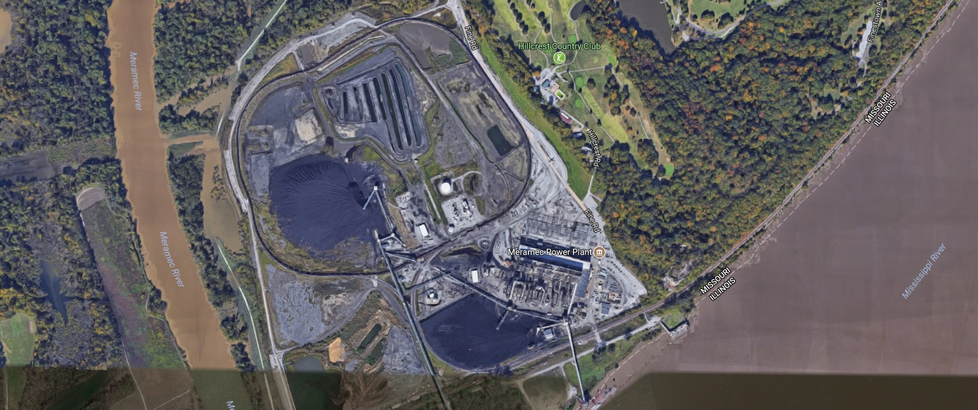
Meramec Coal Fired Power Plant

Slide 4
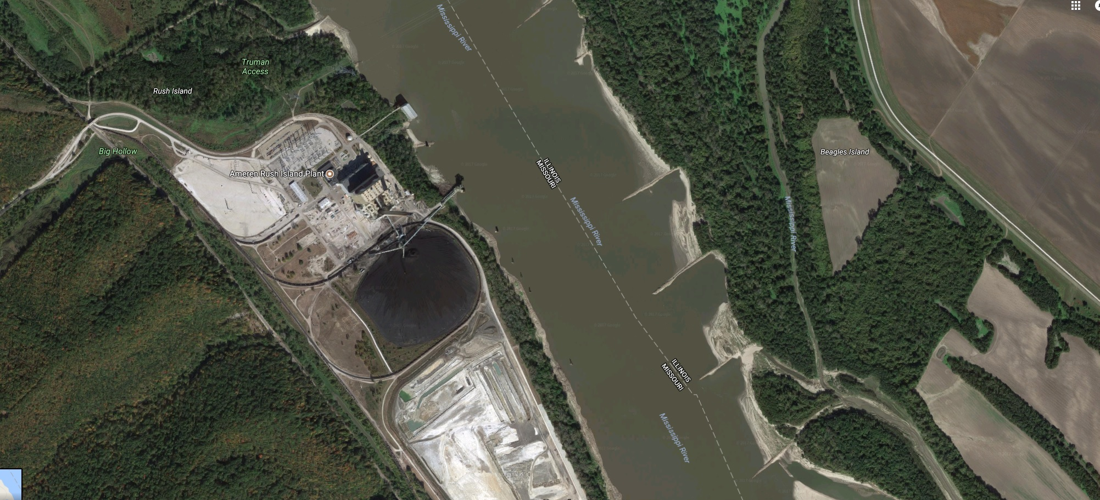
Ameren Rush Coal Fired Power Plant

Slide 5
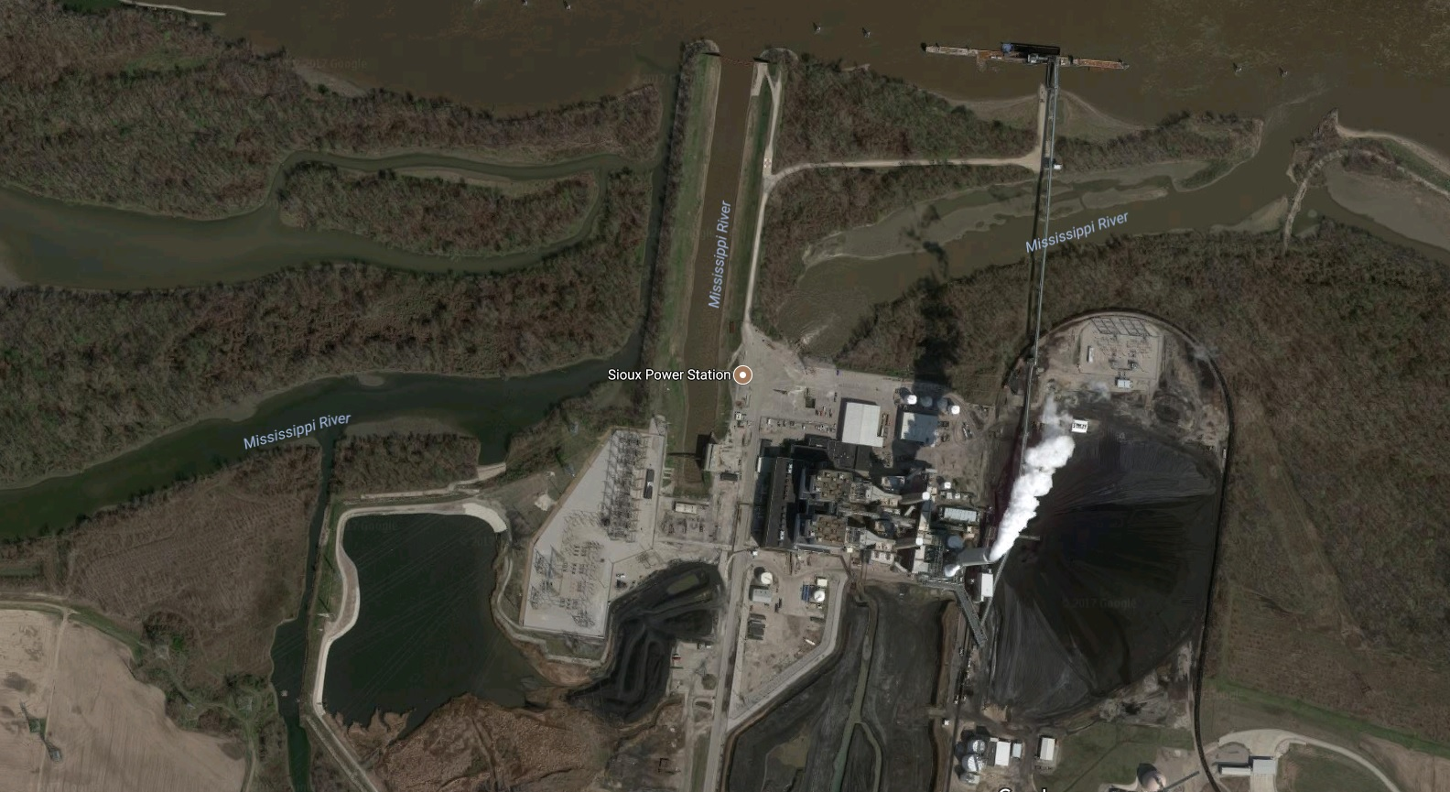
Sioux Coal Fired Power Plant

Slide 6
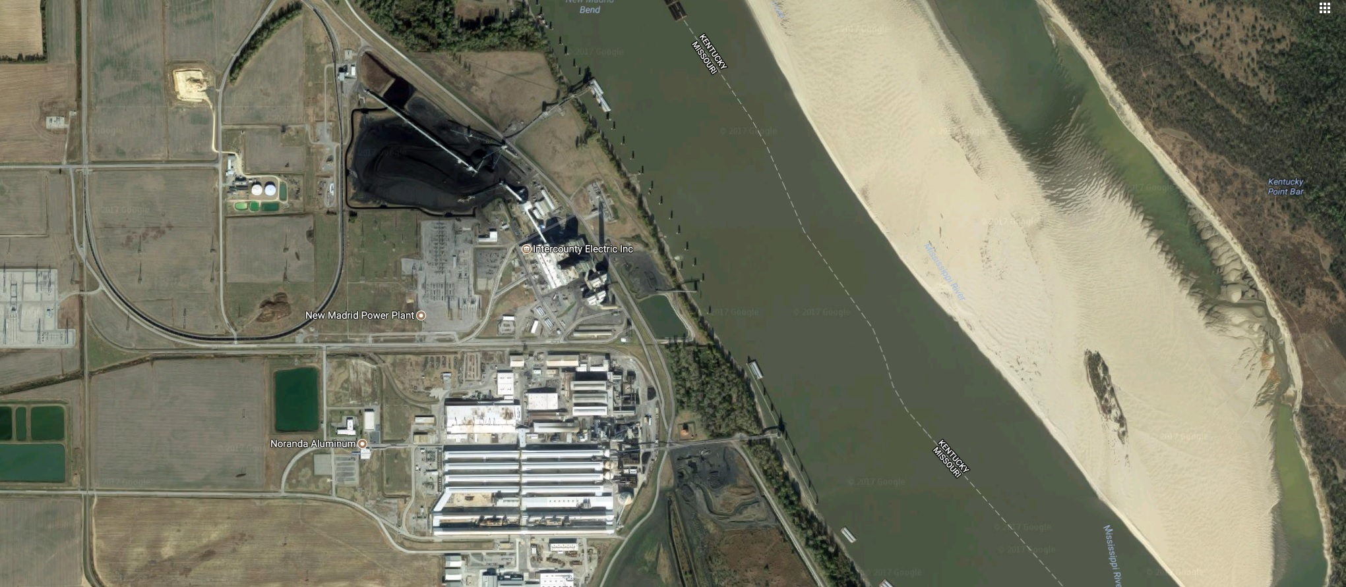
New Madrid Coal Fired Power Plant
Aluminium Production Facility

Slide 7
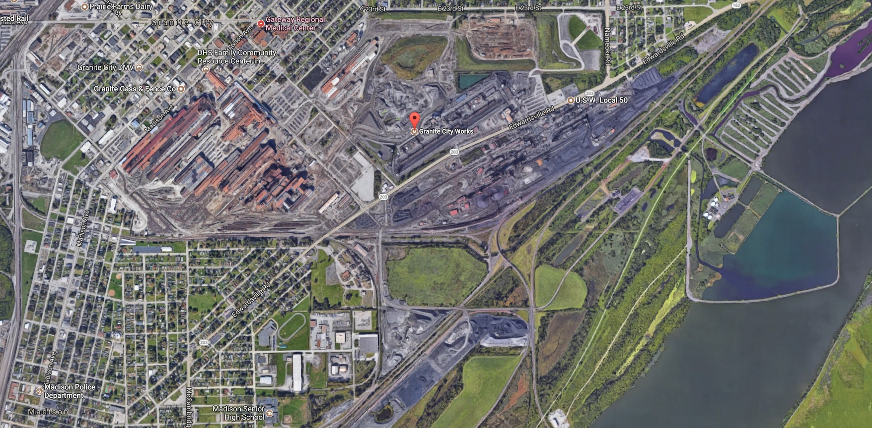
Granite City Works
Steel Fabrication Tailings

Slide 8
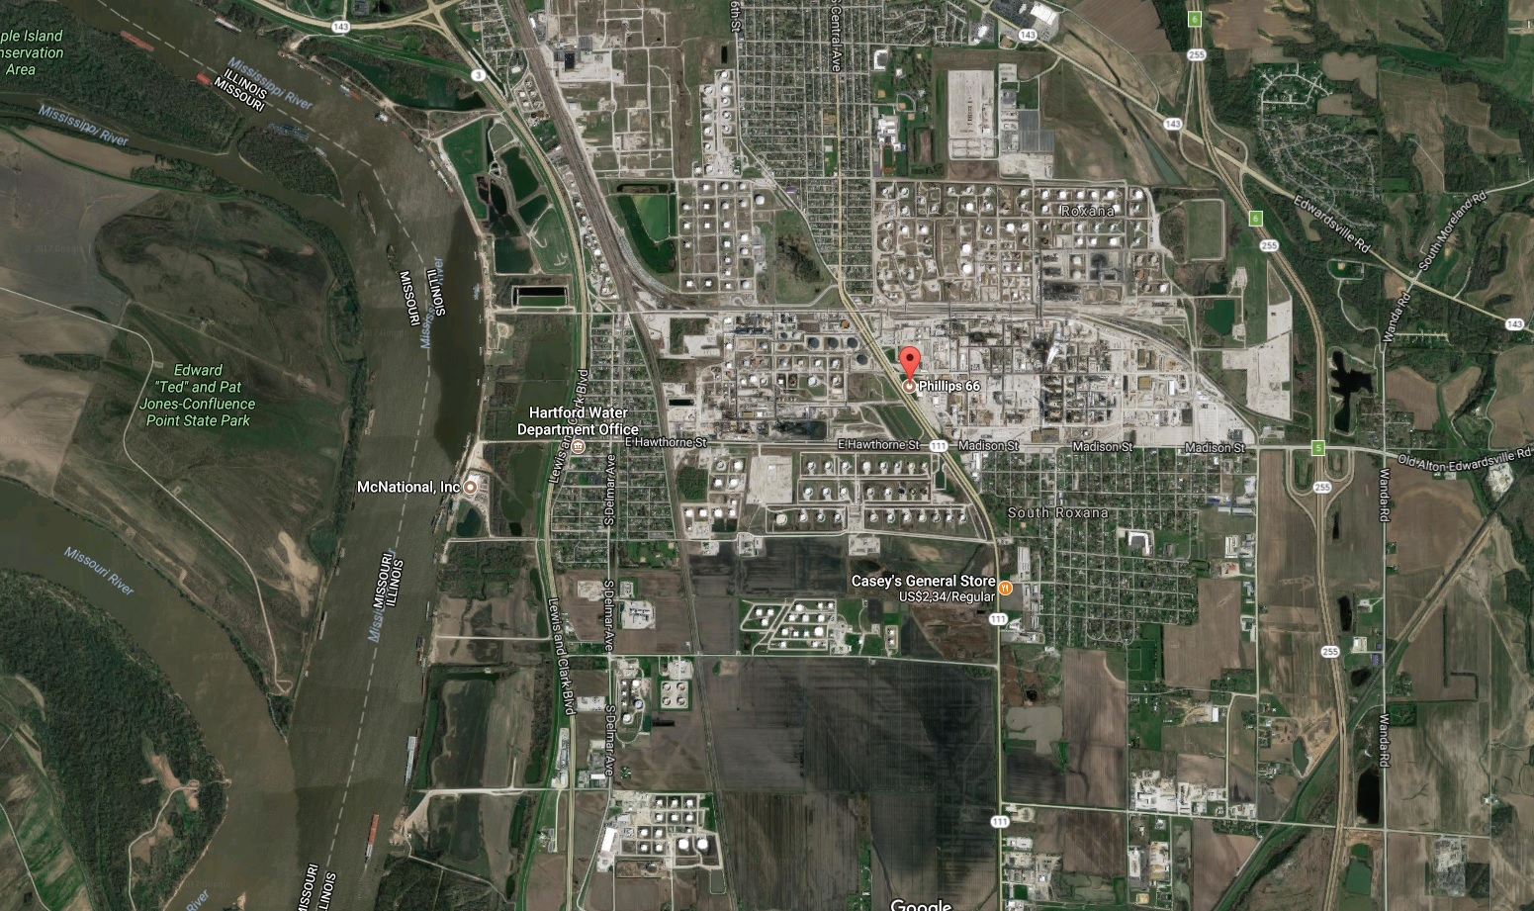
Philips 66 Refinery

Slide 9
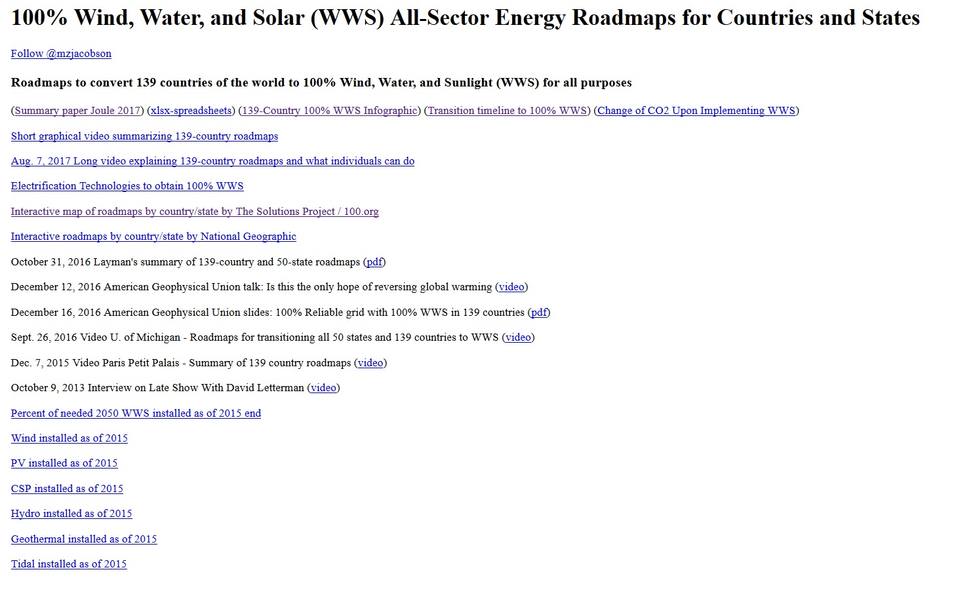
Jacobson’s 100% WWS hypothesis

Slide 10
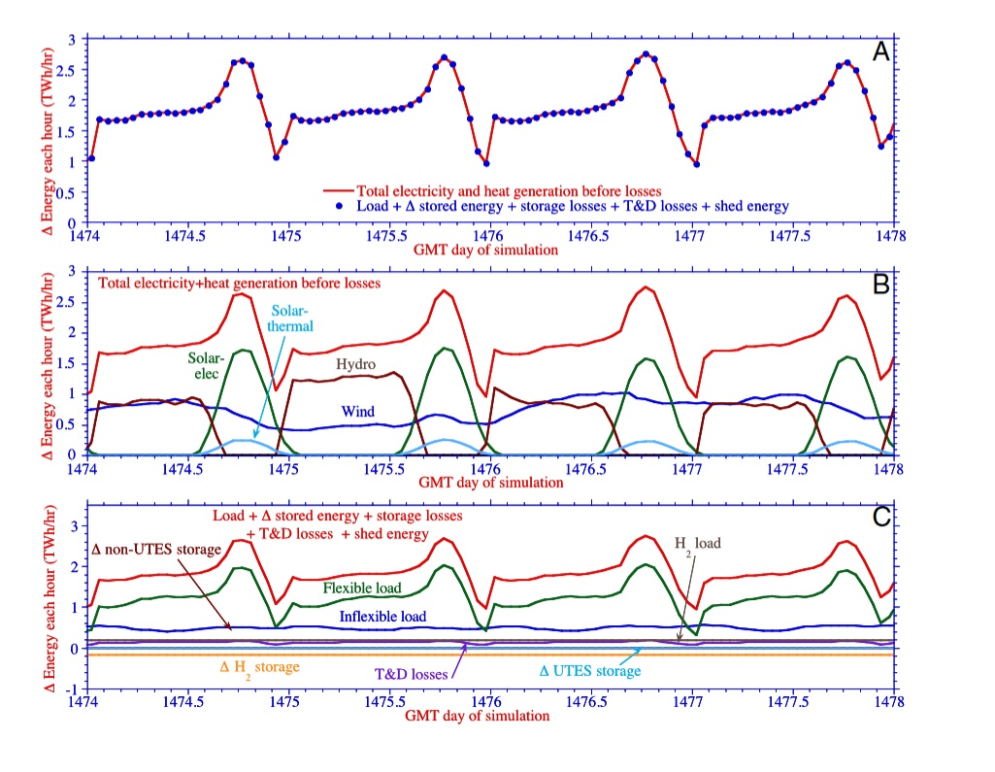
HYDRO DELTA REQUIRED – 1.3 TWh/h

Slide 11
CLACK et.al 2017
HEARD et.al 2017

Slide 12
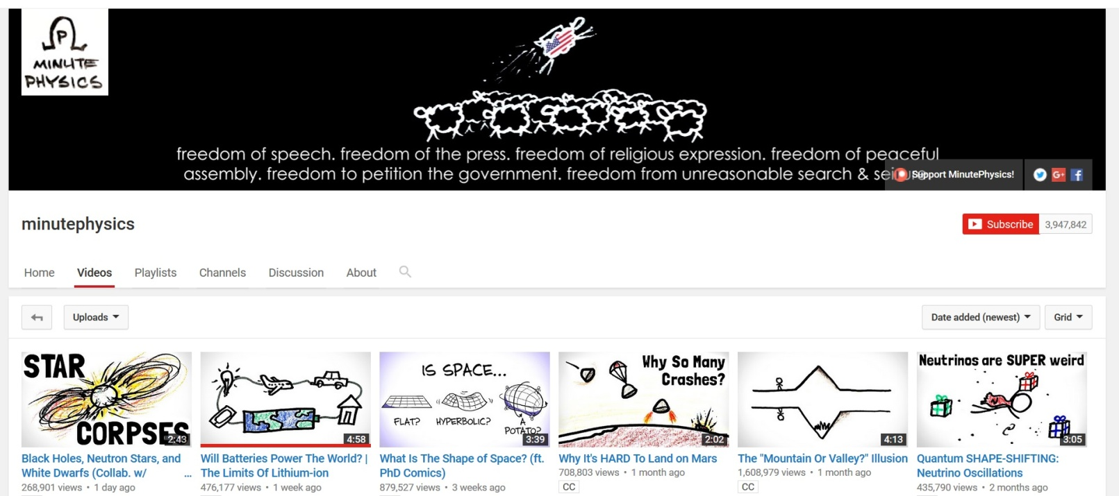
FOUR MILLION SUBSCRIBERS

Slide 13
Lithium Crunch?
2015 pure Li production : 36,000 Metric Tons
2015 Battery Production : 43 GWh
Percentage of Li used for batteries ~ 31%
(36,000 x 0,31) / 43 = 259 Tons / GWh
10,000 * 259 = 2,590,000 Tons
100 GigaFactories running @ 100% Production consume 71 times more Li than we currently produce per year

Slide 14
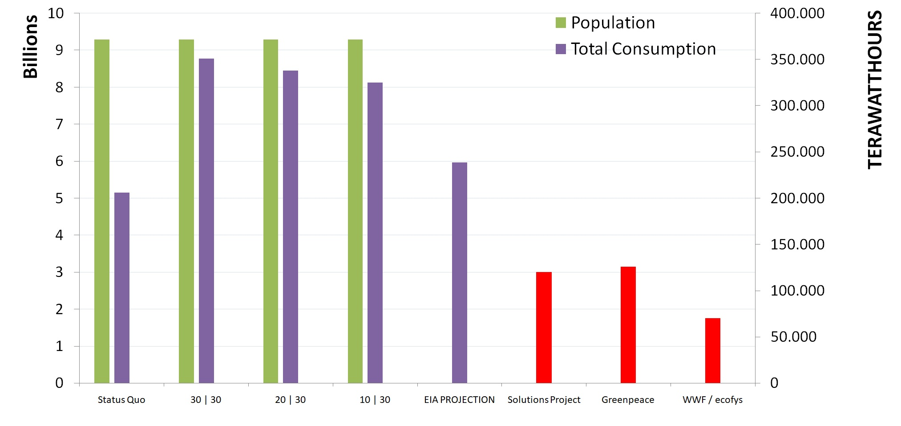
Different decabonization pathways
Much uncertainty whether we can actually electrify everything
IE conflicting assumptions / big discrepancies

Slide 15
How much copper is needed / MW
Estimates average between 4,5 Tons / MW and 7.5 Tons / MW
World Copper Association assumes about 5.5 Tons / MW
Let’s find out how much copper would be needed in a 50/50 Wind/Solar energy mix

Slide 16
Three hypothetical outcomes of energy growth by 2050
150,000 TWh Energy = 48.9 TW w+s Capacity
200,000 TWh Energy = 65.2 TW w+s Capacity
250,000 TWh Energy = 81.5 TW w+s Capacity
Starting point @ 0.5 TW of wind and solar capacity @ 2017 NO PROVISIONING FOR BACKUP OF ANY KIND

Slide 17
First Glance Cu / TW
5.5 Tons / MW = 5.5 Million Tons / TW
250,000 TWh = 81.5 TW
81.5 TW x 5.5 Million Tons = 445,5 Million Tons
Currently Economically Recoverable = 720 Million Tons of Cu https://minerals.usgs.gov/minerals/pubs/commodity/copper/mcs-2017-coppe.pdf

Slide 18
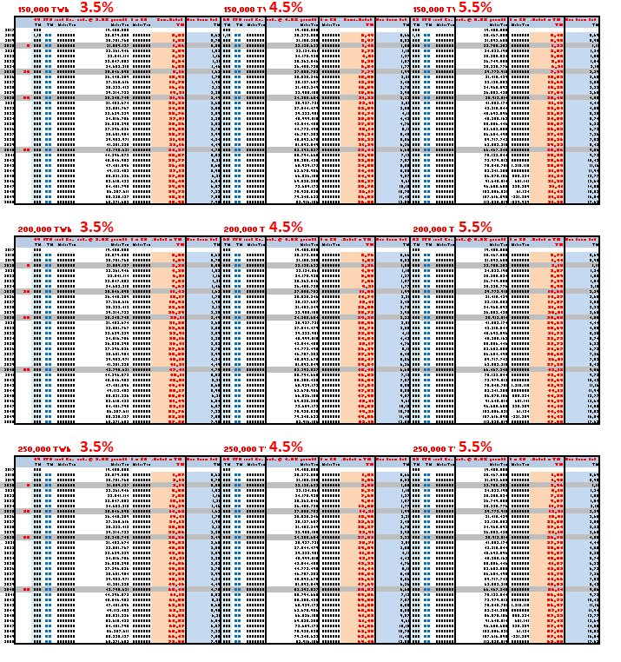
MODELS based on 3.5 / 4.5 / 5.5 % CU Production Growth Ratio
110 ROWS
23 Colums
2300 Data Points

Slide 19
RESULTS by 2050
 | 150K TWh/y 48.9 TW | 200K TWh/y 65.2 TW | 250K TWh/y 81.5 TW
3.5% | 8 TW 41 TW | 8 TW 57 TW | 8 TW 74 TW
4.5% | 12 TW 37 TW | 12 TW 53 TW | 12 TW 69 TW
5.5% | 18 TW 32 TW | 18 TW 48 TW | 18 TW 64 TW
RED = DEFICIT

Slide 20
CONCLUSION
100% renewable shouldn’t even be a thing. Not in science, nor in politics.
Have 100% renewable proponents attempted to create such models?
How did this pass peer-review?
Reviewers must be knuckleheads!!!

Slide 21
CLOSING REMARKS
ALL – UTONIUM?
A – LOT – ONIUM?
A – LOT – ANIUM?

Slide 22
LET’S GET BUILDING
MATHIJS BECKERS AKA THE NUCLEAR HUMANIST

