Slide 1
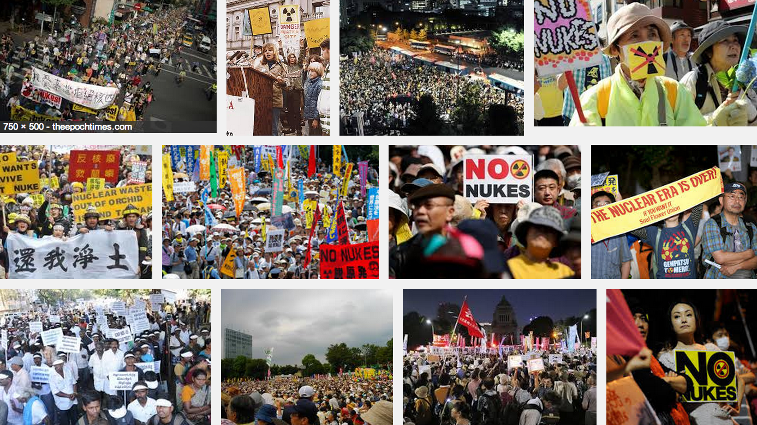
Radiation Limits to Innovation
Aug 21, 2017 Robert.Hargraves@gmail.com

Slide 2
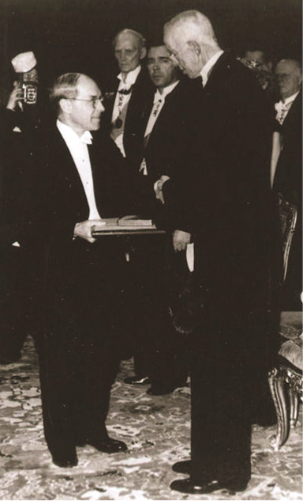
In 1946 the Nobel Committee gave Muller its prize for discovery of X-ray induced mutations. Why?
…these principles have been extended to total doses as low as 400 r, and rates as low as 0.01 r per minute, with gamma rays. They leave, we believe, no escape from the conclusion that there is no threshold dose, and that the individual mutations result from individual "hits", producing genetic effects …”
→ LNT
Notes:
Just after Hiroshima and Nagasaki, Nobel committee wanted to focus attention on the dangers of radiation.
Muller was awarded the Nobel prize.
He was active in countering the cold war weapons build-up.
http://www.nobelprize.org/nobel_prizes/medicine/laureates/1946/muller-lecture.html
In the following years, he began publicizing the likely dangers of radiation exposure in humans (such as physicians who frequently operate X-ray equipment)

Slide 3
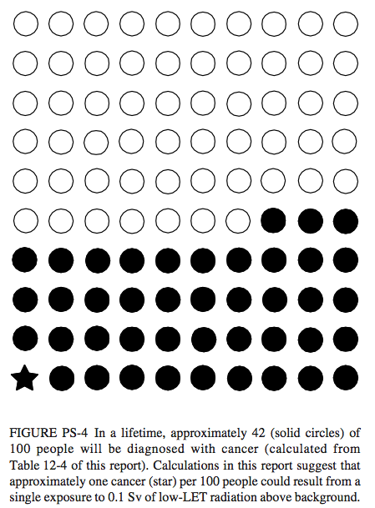
National Academy of Sciences endorsed LNT, yet again, in 2006.
Graphic from NAS Biological Effects of Ionizing Radiation VII
In 100 people’s lives 42 cancers are normally expected.
Claim:
100 mSv dose to 100 people causes 1 more cancer →
Notes:
http://www.nap.edu/catalog.php?record_id=11340
NRC = National Research Council

Slide 4
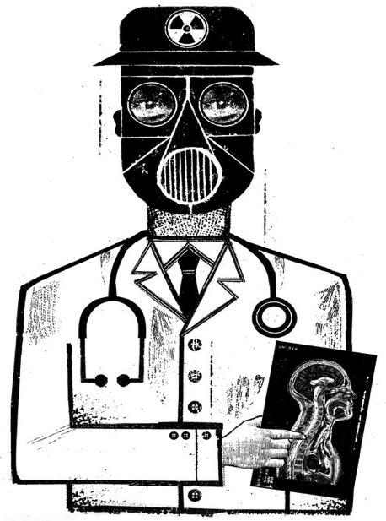
New York Times printed radiation scares.
“a 2009 study from the National Cancer Institute estimates that CT scans conducted in 2007 will cause a projected 29,000 excess cancer cases and 14,500 excess deaths over the lifetime of those exposed.”
Notes:
http://www.nytimes.com/2014/01/31/opinion/we-are-giving-ourselves-cancer.html
http://atomicinsights.com/ct-scans-save-lives/ response by scientists
http://www.ncbi.nlm.nih.gov/pubmed/26402399 value of CT
http://www.mayoclinicproceedings.org/cms/attachment/2037659391/2052032946/mmc1.pdf
http://www.mayoclinicproceedings.org/article/S0025-6196(15)00591-1/pdf

Slide 5
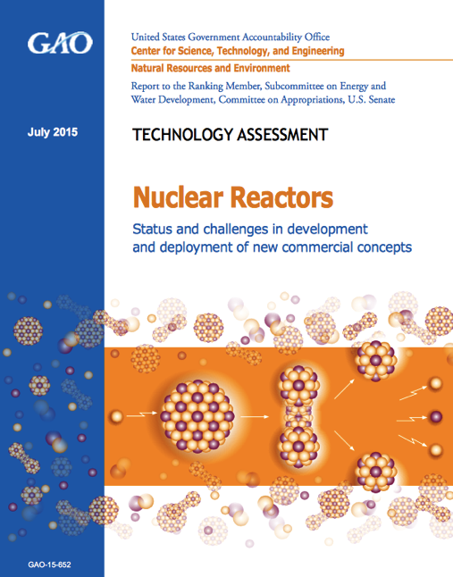
US NRC certification of an advanced reactor design costs $1 billion.
“It is a multi-decade process, with costs up to $1 billion to $2 billion, to design and certify or license the reactor design, … ”
GAO, July 2015
…and then you may be allowed to build and test it.
Notes:
http://www.gao.gov/assets/680/671686.pdf
http://www.technologyreview.com/news/542411/advanced-nuclear-industry-to-regulators-give-us-a-chance/ “way it should be” Macfarlane

Slide 6
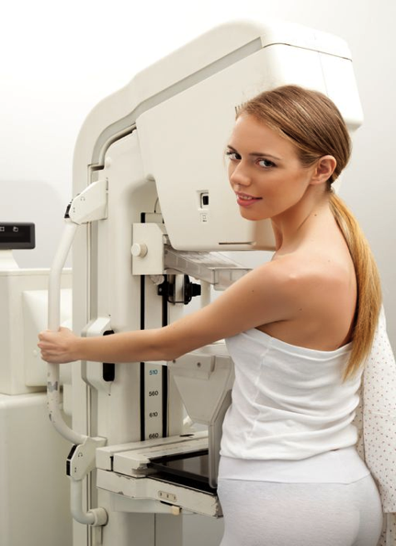
Radiation dose is the energy transferred to body tissue.
Example dose
X-ray mammography
2 mSv (millisievert)
= 0.002 Sievert
= 0.002 Gray (for X-rays)
= 0.002 joule per kilogram
= 0.002 watt-second per kg
Notes:
http://www.conciergeradiologist.com/mammogram-guidelines.html

Slide 7
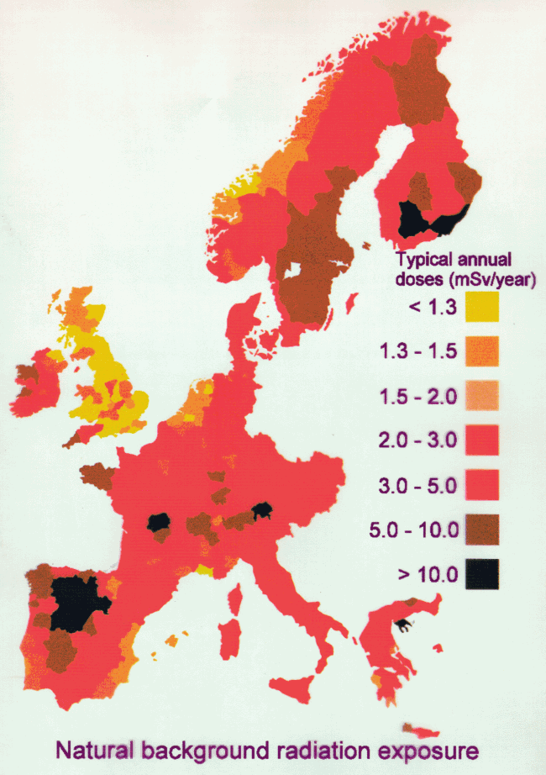
Natural background radiation dose rates are 1-10 mSv/year.
Sources
Radon
Cosmic rays
Food
Granite
Places Ave dose rate
US 3 mSv/y
Denver 4
Finland 7
Notes:
http://www.world-nuclear.org/info/Safety-and-Security/Radiation-and-Health/Naturally-Occurring-Radioactive-Materials-NORM/
http://en.wikipedia.org/wiki/Ramsar,_Mazandaran

Slide 8
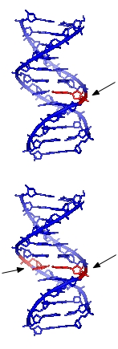
DNA strand breaks occur frequently, by ionized oxygen molecules from metabolism.
Single strand breaks occur 10,000 times per day per cell.
100 mSv/y radiation adds 12 per day.
Double strand breaks occur 10 times per day per cell.
100 mSv/y radiation adds 1 per year.
Notes:
http://en.wikipedia.org/wiki/DNA_repair
Feinendegen et al http://dl.dropboxusercontent.com/u/119239051/Feinendegen-2012_Hormesis-by-LDR_Therapeutic-Nucl-Med.pdf
“at background radiation level, the probability of a radiogenic DSB to occur per day was calculated to be on average only about 1 in 10,000 cells”
Costes “Double strand breaks occur one to 10 times per day per cell. (based on measurements made at Exogen with our finger prick kit) ”
Costes “

Slide 9
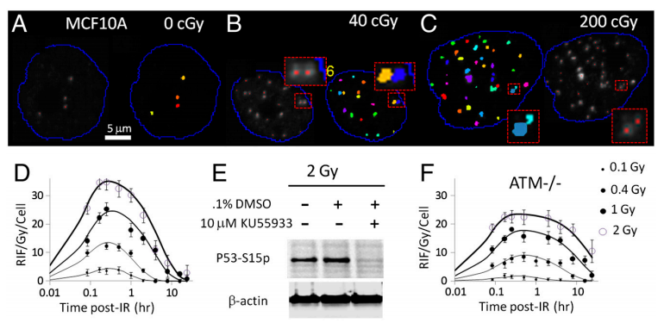
DNA repair times are ~ 1 hour.
Notes:
http://www.pnas.org/content/early/2011/12/16/1117849108.full.pdf
http://phys.org/news/2015-09-time-lapse-analysis-cells-dna.html time lapse video

Slide 10
Nobel prize in chemistry New York Times Oct 7, 2015
Modrich: how cells correct errors that occur when DNA is replicated during cell division.
Sancar: mapping the mechanism cells use to repair ultraviolet damage to DNA.
Lindahl: excision repair — the cellular mechanism that repairs damaged DNA during the cell cycle.
Notes:
http://www.nytimes.com/2015/10/08/science/tomas-lindahl-paul-modrich-aziz-sancarn-nobel-chemistry.html

Slide 11
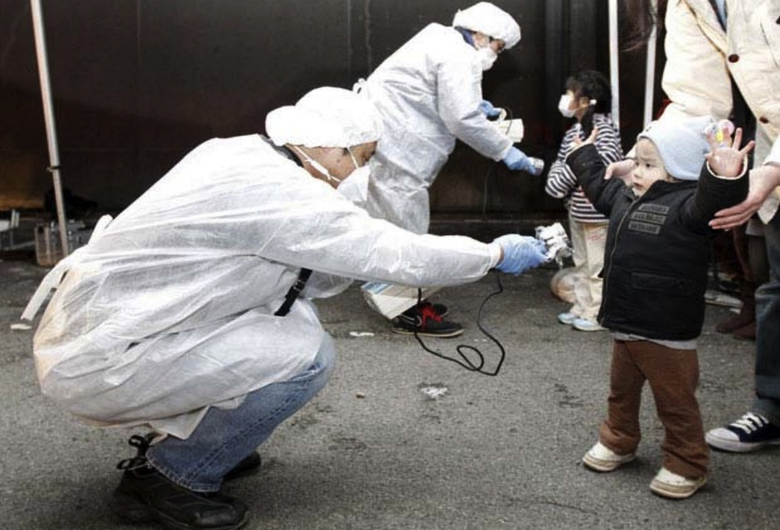
Fukushima evacuation-related deaths exceed 1600.
Notes:
300,000 homeless from tsunami
1,656 people living in Fukushima Prefecture have died from stress and other illnesses related to the disaster, compared with 1,607 who were killed in the initial calamity.
http://www.japantoday.com/category/national/view/post-tsunami-deaths-due-to-stress-illness-outnumber-disaster-toll-in-fukushima
http://earthquake-report.com/2012/03/10/japan-366-days-after-the-quake-19000-lives-lost-1-2-million-buildings-damaged-574-billion/
http://euanmearns.com/who-killed-hamako-watanabe/

Slide 12
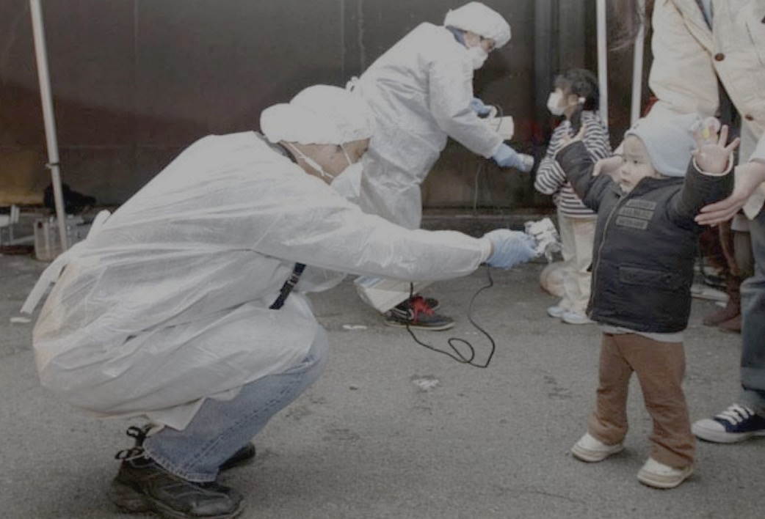
Fukushima radiation was harmless.
"Radiation exposure following the nuclear accident at Fukushima-Daiichi did not cause any immediate health effects. It is unlikely to be able to attribute any health effects in the future among the general public and the vast majority of workers”
UN Scientific Committee on the Effects of Atomic Radiation
Notes:
Evacuation stress killed over 100 people.
1,656 people living in Fukushima Prefecture have died from stress and other illnesses related to the disaster, compared with 1,607 who were killed in the initial calamity.
http://www.japantoday.com/category/national/view/post-tsunami-deaths-due-to-stress-illness-outnumber-disaster-toll-in-fukushima
http://www.japantimes.co.jp/news/2015/09/12/national/science-health/nursing-home-evacuation-fukushima-accident-higher-radiation-risk-study/#.VfRE_HhgJnG

Slide 13
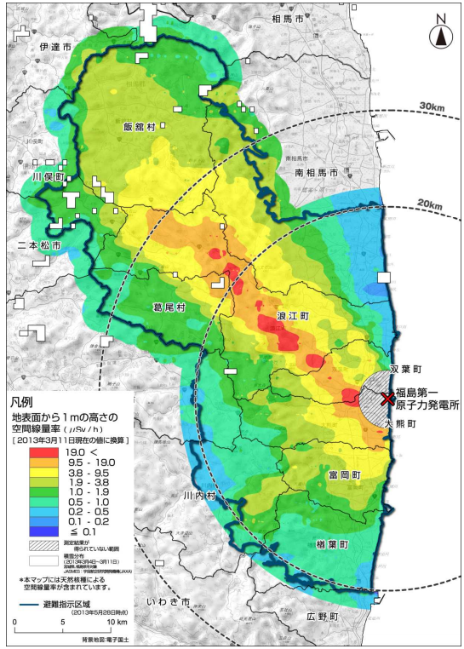
Japan evacuated the black-lined area.
IAEA published recommendation: evacuate the red area.
Notes:
http://radioactivity.nsr.go.jp/ja/contents/8000/7480/24/362_0513_11.pdf
19 microSv/hr = 166 mSv/yr -- even less than IAEA recommendation
Radiation diminishes, to 20 mSv/y, in time.
85,000 mandated evacuees receiving compassion payments of $7,500/month = $3.5 billion
300,000 tsunami homeless receiving little.
http://news.mit.edu/2012/prolonged-radiation-exposure-0515

Slide 14
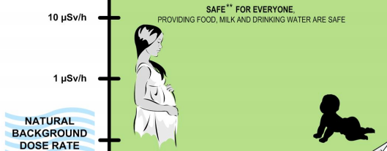
IAEA: 25 µSv/hour is safe for everyone.
25 µSv/hour = 220 mSv/year
… even based on LNT !
Notes:
Assumes that 220 mSv/y will diminish with time so cumulative exposure for one year will be < 100 mSv

Slide 15
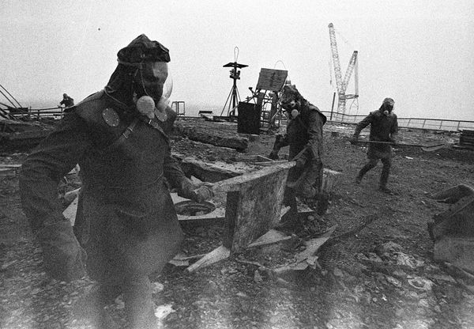
Chernobyl
28 emergency workers died from radiation.
15 children died of thyroid cancer.
“possible increase in cancer mortality … might represent up to 4000 fatal cancers.” Chernobyl Forum
Notes:
http://news.nationalgeographic.com/news/energy/2011/04/110426/chernobyl-25-years-liquidators-pictures/#/chernobyl-25th-anniversary-liquidators-firefighters-roof_35076_600x450.jpg
https://www.iaea.org/sites/default/files/chernobyl.pdf

Slide 16
Chernobyl survivors have fewer cancers.
Dr. Zbigniew Jaworowski, MD PhD DSc, former Chairman of the United Nations Scientific Committee on the Effects of Atomic Radiation (UNSCEAR) stated:
“What is really surprising, however, is that data collected by UNSCEAR and the Forum show 15% to 30% fewer cancer deaths among the Chernobyl emergency workers
and about 5% lower solid cancer incidence among the people in the Bryansk district (the most contaminated in Russia) in comparison with the general population. In most irradiated group of these people (mean dose of 40 mSv) the deficit of cancer incidence was 17%.”
Notes:
http://db.world-nuclear.org/reference/jaworowski-ipn0406.html
Also see BEIR VII p 216
P 14 Jaworowski http://www.belleonline.com/newsletters/volume15/vol15-2.pdf

Slide 17
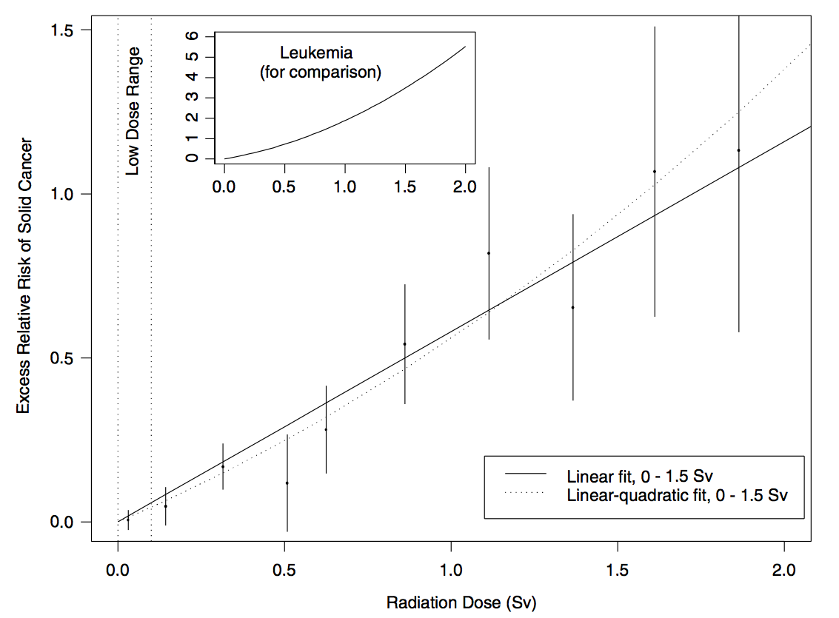
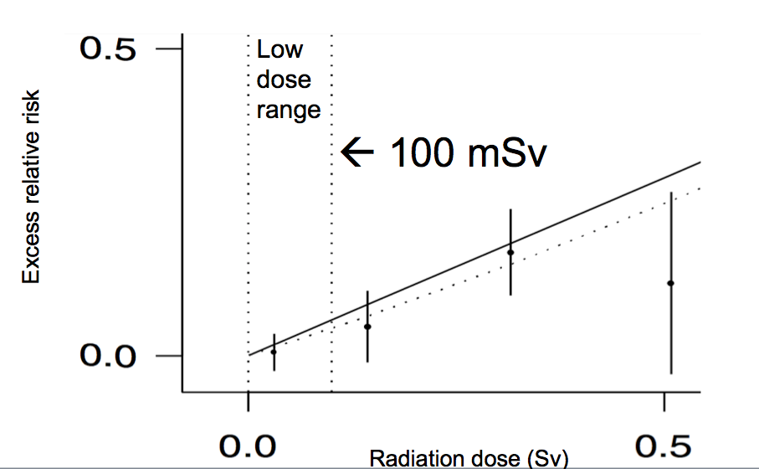
NAS reports A-bomb cancer risk proportional to radiation dose.
..even at low dose!?
Notes:
http://www.nap.edu/catalog.php?record_id=11340

Slide 18
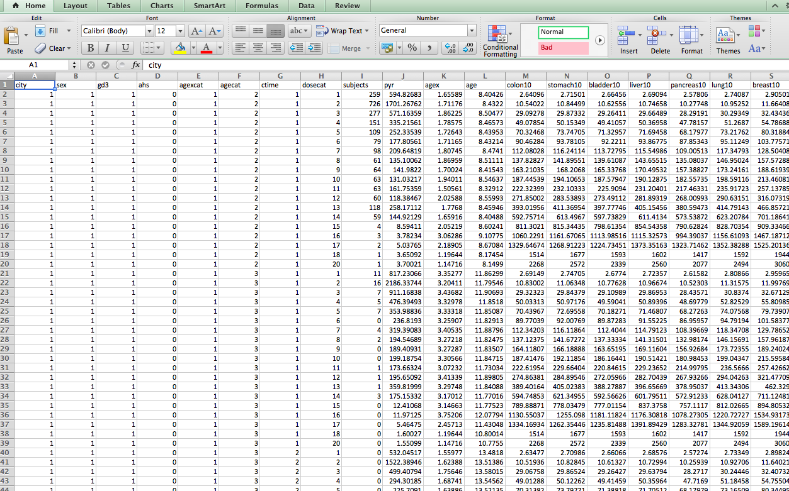
Atomic-bomb LSS data is public.
http://www.rerf.or.jp/index_e.html
Notes:
http://www.rerf.or.jp/library/dl_e/index.html

Slide 19
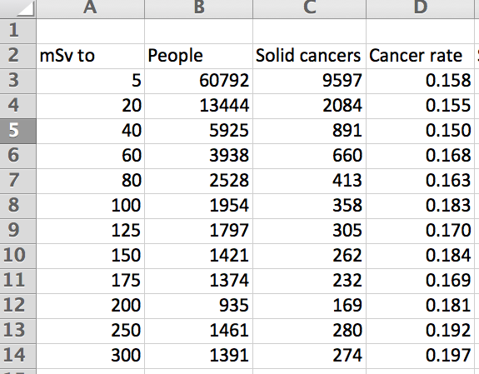
Add it up to get low-dose cancer rates.

Slide 20
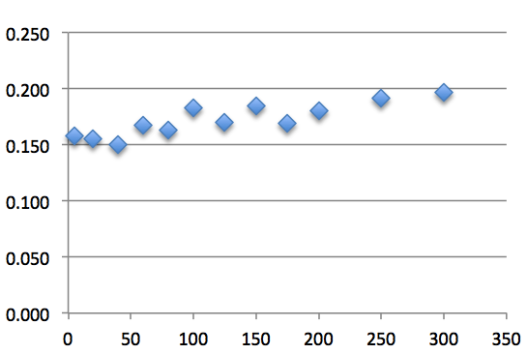
Atom bomb survivor exposures of 5-40 mSv lowered observed cancer rates.
Cancer rate
Linear response
20-40 mSv
5-20 mSv
Radiation dose (mSv)
Notes:
19,369 observations in the range 5-40 mSv 3X more than all in higher dose ranges combined (6411)
60mSv acute dose may show effect

Slide 21
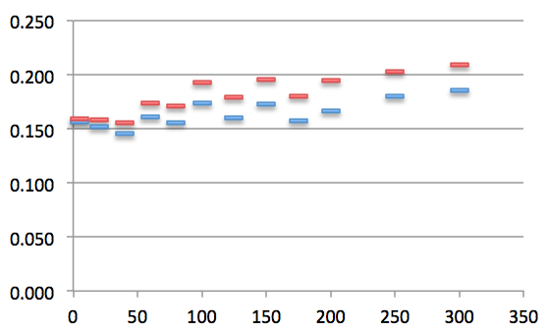
The decrease in cancers below 40 mSv dose is significant.
Cancer rate
6,411 people exposed to >40 mSv
20-40 mSv n=891
19,369 people exposed 5-40 mSv
5-20 mSv n=2084
Radiation dose (mSv)
Notes:
http://www.ncbi.nlm.nih.gov/pmc/articles/PMC2592990/ Luckey
http://www.ncbi.nlm.nih.gov/pubmed/24298226 Doss
http://www.ncbi.nlm.nih.gov/pubmed/23304106 Doss
http://www.thenewamerican.com/tech/environment/item/6932-the-effects-of-low-dose-radiation Hiserodt
Over 18,000 observations in tis range
60mSv acute dose may show effect

Slide 22
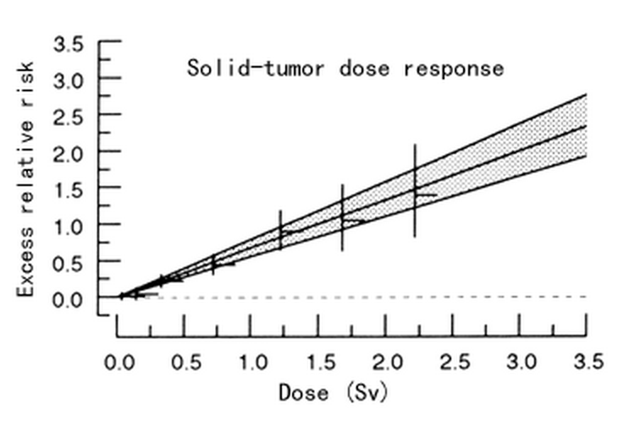
Atomic bomb Long-term Survivor Studies do not publish the details of doses < 100 mSv.
Extrapolating Life Span Study Cancer Risk Estimates to Low-dose Radiation Exposures
100 mSv
Notes:
http://www.rerf.or.jp/library/update/rerfupda_e/factfig/vaeth.html
“hides” data?

Slide 23
Medical diagnostic radiation doses are low.
Dental X-ray 0.001 mSv
CT Scan 20 mSv
Therapeutic radiation doses are high…
Notes:
http://www.ncbi.nlm.nih.gov/pubmed/26402399

Slide 24
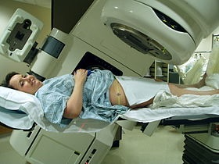
A rotating X-ray beam focused on cancer tissue delivers up to 80,000 mSv.
To minimize the risk* of causing cancer in nearby tissue
radiologists divide the radiation dose into fractions
administered daily rather than all at once
giving healthy tissue time to recover.
* secondary malignancies are seen in a very small minority of patients
If LNT were true, fractionated radiation therapy wouldn’t work.
Notes:
https://en.wikipedia.org/wiki/Radiation_therapy

Slide 25
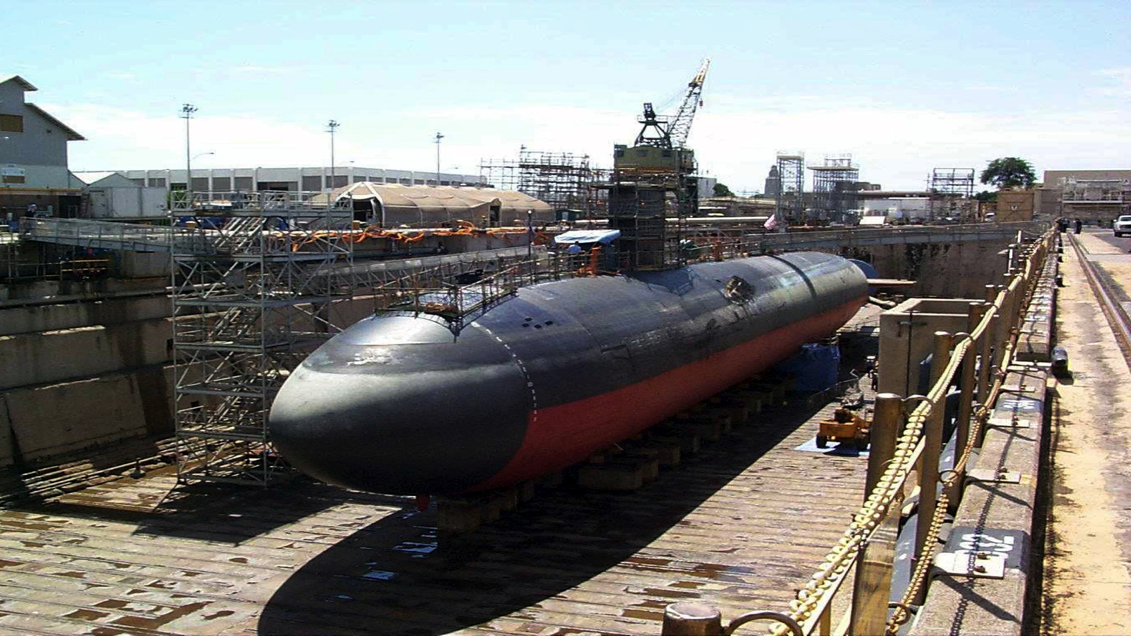
Notes:
http://upload.wikimedia.org/wikipedia/commons/9/94/USS_Greeneville_(SSN_772)_-_dry_dock_Pearl_Harbor_(1).jpg

Slide 26
28,000 nuclear shipyard workers exposed to ~8 mSv had a 24% lower death rate.
Neutron-activated Co-60 was deposited in pipes and valves of reactor cooling system.
Age-matched, job-matched control group eliminated healthy-worker bias.
1991 report did not include observed 24% lower death rate.
Notes:
http://www.orau.org/ptp/PTP%20Library/library/Subject/Risk/shipyard.pdf
Largest ever such study 3 years before 1991 report submitted Why?
http://www.probeinternational.org/low-dose-NSWS-shipyard.pdf
http://pubs.rsna.org/doi/full/10.1148/radiol.2291030291 Cameron, Longevity

Slide 27
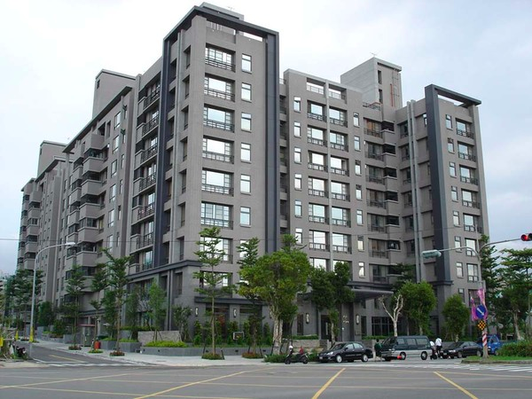
Notes:
1983 20,000 tons of Co-60 contaminated steel in 200 buildings
http://m1.behance.net/rendition/modules/38853637/disp/665bd4a87b802078a6df93acf284dc7b.jpg a Taiwan apt building of the right age

Slide 28
7,271 Taiwan apartment dwellers exposed to ~48 mSv had fewer cancers.
Cancers observed 95
Cancers expected normally 115
…plus 35* LNT-predicted cancers 150
* 7,271 x 48 / 10,000 = 35
LNT discrepancy = (150 - 95) / √150 = 4.5 standard deviations
Probability {LNT is true} ~ 7-in-a-million.
Notes:
http://www.ncbi.nlm.nih.gov/pmc/articles/PMC2477708/
http://www.ncbi.nlm.nih.gov/pubmed/17178625
http://www.ncbi.nlm.nih.gov/pubmed/18666807
http://taiwan-apt-cancer-data-analysis.blogspot.com/

Slide 29
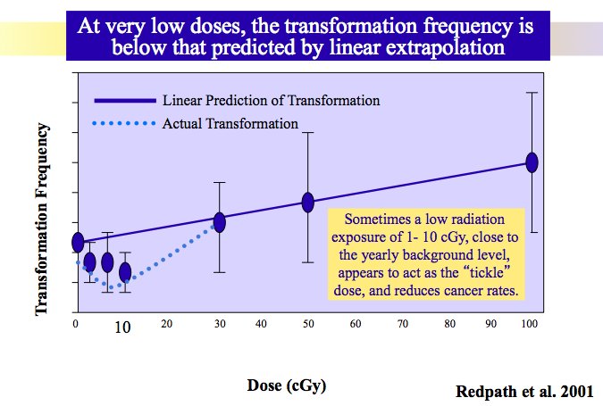
The US defunded low-dose radiation studies, which were disproving LNT. [and removed this web doc]
100 mSv
Notes:
http://lowdose.energy.gov/radiobio_slideshow.aspx
http://atomicinsights.com/low-dose-radiation-research-program-defunded-2011/

Slide 30
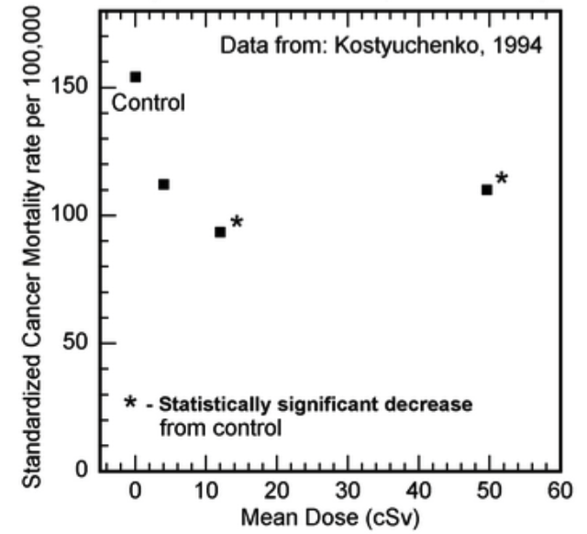
1957 Mayak weapons plant contamination exposed 7854 people up to 500 mSv but reduced cancer mortality.
Significantly reduced cancer mortality rates in the 120 mSv and 500 mSv cohorts in villages near Mayak nuclear weapons facility
Notes:
Compelling Reasons for a Paradigm Shift in Radiation Safety and Revised Health Physics Goals https://drive.google.com/file/d/0B6XPKnvfFRDJX1JVXzZlYW1FWVE/view
Long-term irradiation effects in the population evacuated from the East-Urals radioactive trace area, V.A. Kostyuchenko, L.Yu. Krestinina, 1994
http://www.sciencedirect.com/science/article/pii/0048969794900809

Slide 31
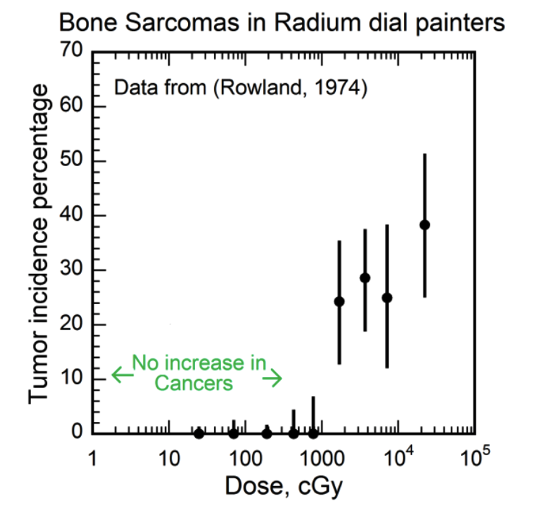
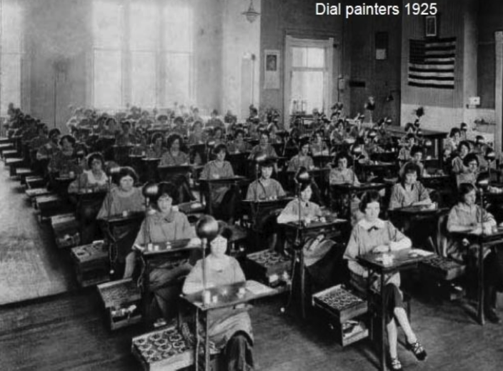
Radium dial painters’ bone sarcomas occurred at a threshold over ~ 10,000 mGy.
Notes:
http://journals.lww.com/health-physics/Abstract/1974/11000/Radium_in_Man_.10.aspx
Dose-response relationships for radium-induced bone sarcomas., Rowland RE, Stehney AF, Lucas HF. 1983. http://www.ncbi.nlm.nih.gov/pubmed/6862895
Radiation Hormesis and the Linear-No-Threshold Assumption, Charles L. Sanders - 2009, page 44, http://books.google.com/books?isbn=3642037208

Slide 32
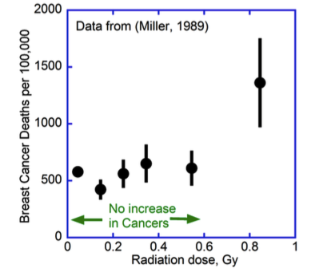
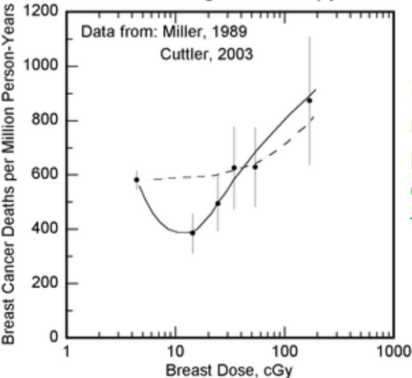
Breast cancer mortality was reduced for Canadian TB patients exposed to ~150 mSv.
Notes:
Mortality from breast cancer after irradiation during fluoroscopic examinations in patients being treated for tuberculosis. Miller et al. 1989 http://www.ncbi.nlm.nih.gov/pubmed/2797101
Can Cancer Be Treated with Low Doses of Radiation?Cuttler & Pollycove 2003 http://www.jpands.org/vol8no4/cuttler.pdf
http://www.ncbi.nlm.nih.gov/pubmed/2797101

Slide 33
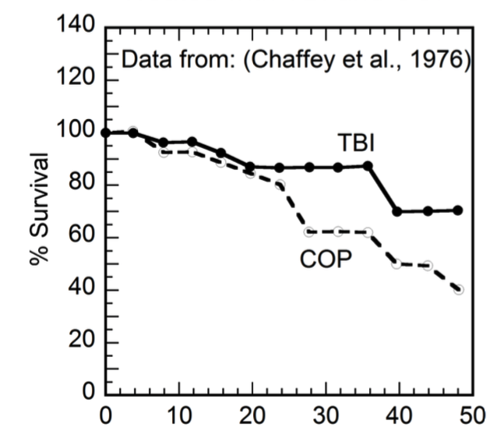
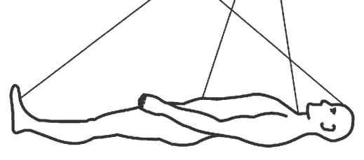
Total body irradiation (TBI) of 150 mSv x 10 weeks improved lymphosarcoma survival rates, compared to chemotherapy.
months
Notes:
Total body irradiation as treatment for lymphosarcoma. , Chaffey et al., 1976. http://www.ncbi.nlm.nih.gov/pubmed/823140
Compelling Reasons for a Paradigm Shift in Radiation Safety and Revised Health Physics Goals https://drive.google.com/file/d/0B6XPKnvfFRDJX1JVXzZlYW1FWVE/view
http://www.jpands.org/vol8no4/cuttler.pdf

Slide 34
Bad science is the root cause of LNT, ALARA and resistance to nuclear power.
Muller’s deception
Hiding low-dose A-bomb LSS data
Ignoring inconvenient truths of occupational and environmental data
Reluctance to admit past errors
Searching for harm, not benefit

Slide 35
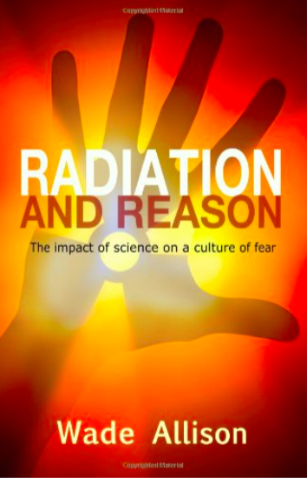
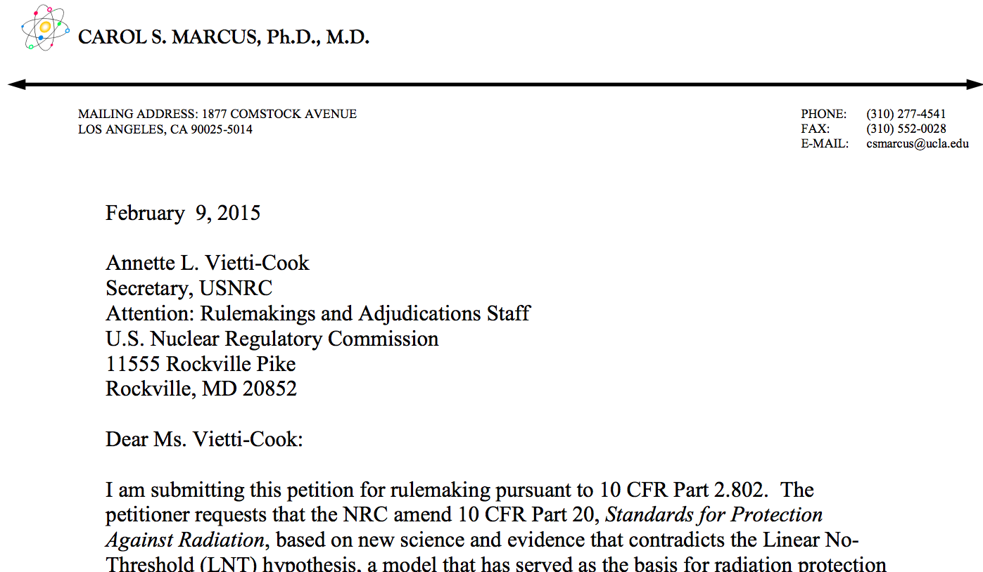
Scientists for Accurate Radiation Information (SARI) petitions NRC to end LNT and ALARA.
Notes:
radiationeffects.org SARI website
http://www.amazon.com/Radiation-Reason-Impact-Science-Culture/dp/0956275613/ref=sr_1_1?ie=UTF8&qid=1439724889&sr=8-1&keywords=allison+radiation+and+reason
http://pbadupws.nrc.gov/docs/ML1505/ML15051A503.pdf Marcus letter
http://pbadupws.nrc.gov/docs/ML1505/ML15057A349.pdf Miller letter
http://pbadupws.nrc.gov/docs/ML1528/ML15287A494.pdf draft NRC ACMUI response
http://pbadupws.nrc.gov/docs/ML1528/ML15287A494.pdf draft NRC subcommittee recommendations

Slide 36
NRC Counsel for Special Projects (retired) Peter Crane
pleads to retain LNT.
“Mainstream science regards hormesis as pseudoscientific claptrap…”
“Hormesis has won the support of such notable thinkers as Lyndon LaRouche…”
“this is all too goofy for words… ”
“From the agency’s perspective, however, to declare that it was seceding from the international scientific consensus and raising the banner of hormesis would be ruinous for its reputation in the world radiation protection community. ”
Notes:
http://pbadupws.nrc.gov/docs/ML1527/ML15275A054.pdf retired NRC counsel Crane

Slide 37
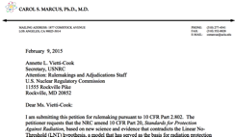
NRC may deny Marcus petition.
NRC Advisory Committee on the Medical Uses of Isotopes, Oct 14, 2015:
“However, in the absence of definitive refutation of the LNT model and while strongly encouraging continued investigation critically comparing alternative models, regulatory authorities should exercise prudent (though not excessive) conservatism in formulating radiation protection standards. The ACMUI therefore recommends that, for the time being and subject to reconsideration as additional scientific evidence becomes available, the NRC continue to base the formulation of radiation protection standards on the LNT model.”
Notes:
http://pbadupws.nrc.gov/docs/ML1528/ML15287A494.pdf draft NRC ACMUI response
http://pbadupws.nrc.gov/docs/ML1528/ML15287A494.pdf draft NRC subcommittee recommendations

Slide 38
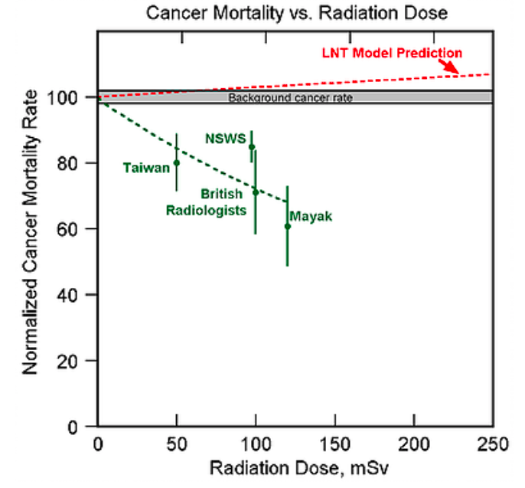
X-LNT Foundation works to end LNT.
~20% of cancer deaths could have been prevented, had radiation hormesis been studied in 1980s.
x-lnt.org
Notes:
https://www.x-lnt.org/reasons-to-eliminate-the-lnt-model

Slide 39
Set limits to radiation, not innovation.
Limit | Recommendation
150 mSv | Feinendegen: No increase in cancer incidence following low-level exposure to ionizing radiation, below about 150 mGy or mSv
100 mGy | Welch/Siegel/Sachs: Regulatory agencies should reject LNT/ALARA
100 mSv/y | Marcus: ALARA should be removed entirely from the regulations
Barriers
We refute; they ignore
Search for harm not health
Politicized science
Self-appointing bodies
Overlapping membership
LNT proclaimers can’t recant
Radiation protection industry
robert.hargraves@gmail.com
August 21, 2017
Notes:
https://www.researchgate.net/publication/44807134_Low-Dose_Cancer_Risk_Modeling_Must_Recognize_Up-Regulation_Of_Protection
https://www.heighpubs.org/jro/jro-aid1007.php
http://oatext.com/Time-to-Eliminate-LNT-The-NRC-Needs-to-Adopt-LT-and-Eliminate-ALARA.php

Slide 41
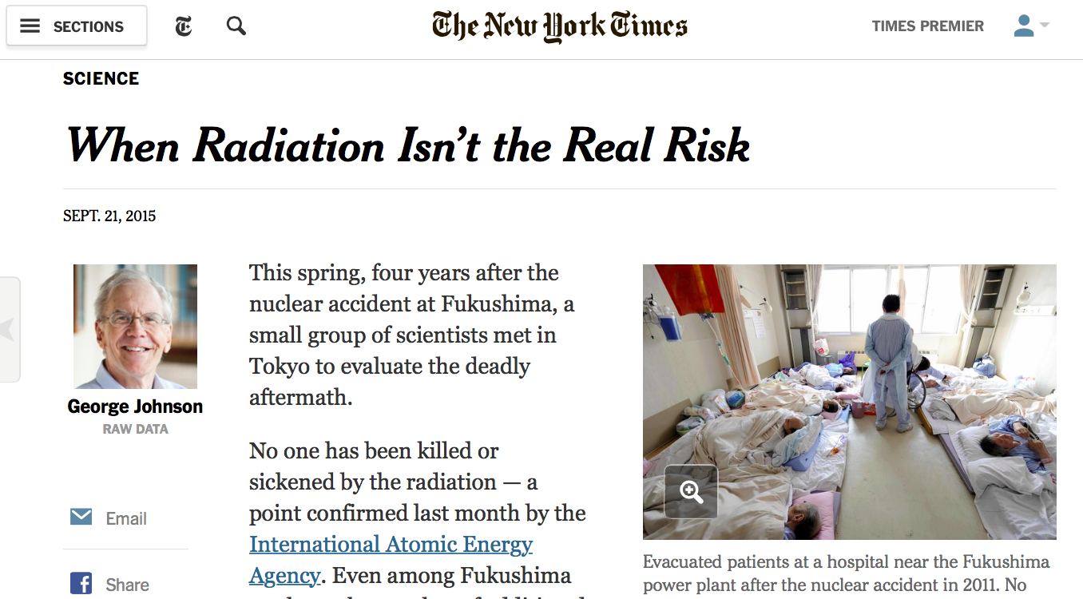
Progress: NY Times article on real radiation effects
Notes:
http://www.nytimes.com/2015/09/22/science/when-radiation-isnt-the-real-risk.html

Slide 42
Acknowledgement of RERF data
This report makes use of data obtained from the Radiation Effects Research Foundation (RERF), Hiroshima and Nagasaki, Japan. RERF is a private, non-profit foundation funded by the Japanese Ministry of Health, Labour and Welfare and the U.S. Department of Energy, the latter through the National Academy of Sciences. The conclusions in this report are those of the authors and do not necessarily reflect the scientific judgment of RERF or its funding agencies.
Please send a copy of any reprints that make use of these data to:
Archives Unit, Library and Archives Section
Department of Information Technology
Radiation Effects Research Foundation
5-2 Hijiyama Park
Minami-ku Hiroshima, 732-0815 JAPAN

