Slide 1
The Discovery of Bonded Neodymium-Iron-Boron (NdFeB) Permanent Magnets
Dr. John J. Croat

Slide 2
Introduction to Rare Earths
Introduced to the interesting world of rare earths at the Ames Laboratory, Iowa State University.
Ames Laboratory was part of the Chemistry Division of the Manhattan Project, headed by Dr. Frank Spedding.
Developed technology for producing metallic U and Pu.
Provided roughly half of the uranium metal for the first controlled fission reactor at the Univ. of Chicago – Dec. 2, 1942.
Following WWII, the Ames Laboratory became part of the Atomic Energy Commission (AEC)
Dr. Spedding invented the ion exchange process for separation of the rare earths and actinides.
Ames Laboratory became the major center for rare earth research and development in the world.
Obtained PhD in Metallurgy.
Preparation and magnetic properties of rare earth metals.
Major advisor was Dr. Frank Spedding. I was his last PhD student.

Slide 3
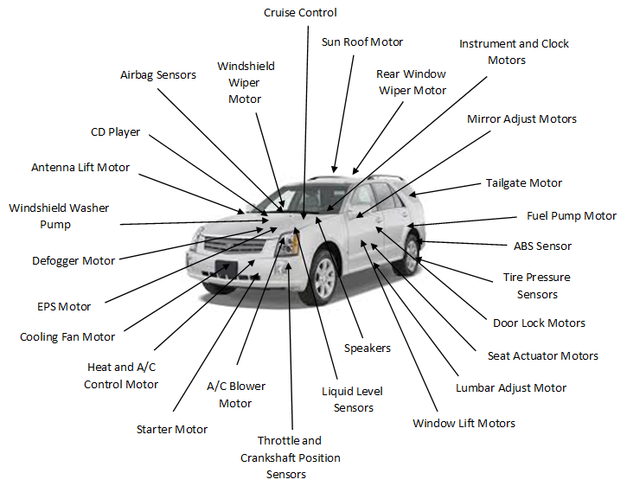
Introduction to Permanent Magnets
Hired by Magnetic Materials Group, Physics Dept. GM Research Labs
Why was General Motors interested in permanent magnets?
In the 1970s GM was by far the world’s largest automobile producer.
Automobiles are by far the largest users of permanent magnets.

Slide 4
General Motors and permanent magnets – Historical setting?
First OPEC oil embargo occurred in 1973- Price of gasoline in USA soared.
Intense effort in GM and other automotive companies to improve fuel economy of automobiles.
One way to reduce weight was to reduce weight of size of the many motors used on the automobile by using a higher performance magnet.
Samarium-cobalt (SmCo₅) permanent magnets had been discovered but were too expensive for automotive use.
Mission of Magnetic Materials Group: Develop a lower cost, high performance rare earth-iron (no cobalt) permanent magnets.
However, there was a serious technical problem in developing a RE-Fe permanent magnet.

Slide 5
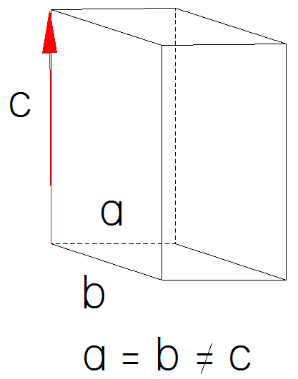
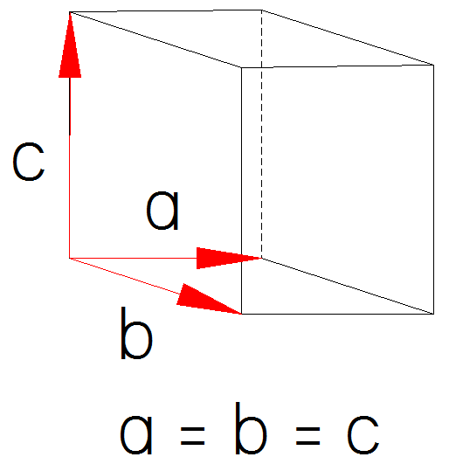
Problem was the lack of a suitable intermetallic compound
Permanent magnets requires a suitable intermetallic compound like SmCo₅.
Intermetallic phase must be ferromagnetic (magnetically ordered) with a uniaxial crystal symmetry.
Hexagonal, tetragonal or rhombohedral.
Cannot be cubic: No magnetic hardening (no coercive force) since all axis are energetically the same.
Cubic
Notes:
The basis problem was the complete lack of a suitable intermetallic compound

Slide 6
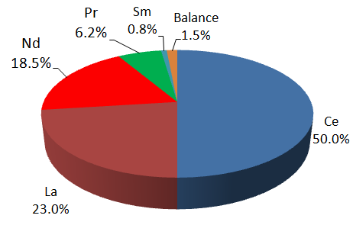
Development of R-Fe based permanent magnet
Must have a reasonably high Curie temperature (> 250ºC)
Intermetallic phase must remain ferromagnetic at a reasonably high temperature.
Economically viable magnet must use abundant, low cost rare earth like Pr or Nd.
Nd and Pr are the third and forth most abundant rare earths.
Composition of bastnesite
ore – Bayon Obo Mine,
Inner Mongolia

Slide 7
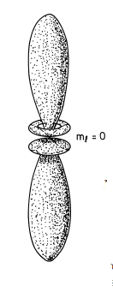
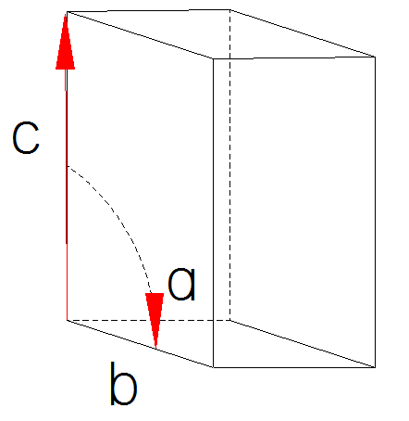
Development of R-Fe based permanent magnet
Why not Ce or La?
High coercivity in rare earth-transition metal permanent magnets results from highly anisotropic shape of 4f electron wave functions.
La and Ce --- No 4f electrons --- No magnetocrystalline anisotropy --- No coercivity.
Magnetocrystalline anisotropy (H_{a}) is the magnetic field required to pull the magnetic moment from the easy c axis to the basal plane.
Economically viable permanent
magnet must use either Nd or Pr
or mixture.
These highly anisotropic 4f wave functions are the most
important characteristic of the rare earths.

Slide 8
Serious Problem: No Suitable R-Fe Binary Phase Existed
Chart showing the rare earth-iron binary phases that form.
RFe₂ and R₆Fe₂₃ phases are cubic and not good candidates for permanent magnet development.
The only Nd-Fe and Pr-Fe binary compounds that form (R₂Fe₁₇) have very low Curie temperatures (~50ºC).
There appeared to be no way to begin development of a
R-Fe permanent magnet.

Slide 9
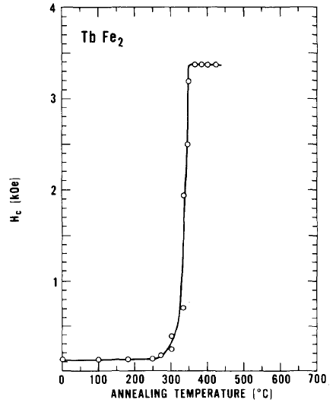
Found that amorphous TbFe₂ developed a coercivity of 3.5 kOe when annealed.
Annealing of amorphous TbFe₂
Clark, A. E., Appl. Phys. Lett. 23, 642 (1973).

Slide 10
Rapidly Solidified TbFe₂
Clark result was the first incidence of magnetic hardening in a R-Fe binary phase.
Also interesting because TbFe₂ is a cubic phase and should not have developed any coercivity.
Coercivity was believed to be almost certainly due to the formation of a new, magnetically hard metastable phase.
This work became the genesis of a research project at the General Motors Research Labs to investigate the possible formation of metastable phases in melt spun Nd-Fe and Pr-Fe alloys.

Slide 11
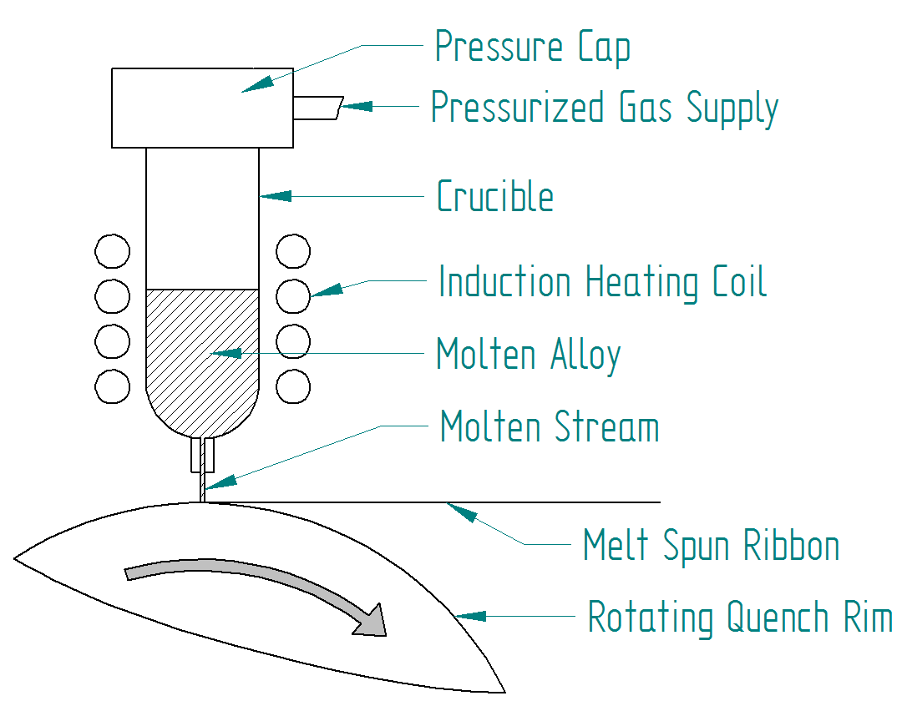
Late 1970s – Began investigated the possibility of producing, metastable, magnetically hard Nd-Fe and Pr-Fe using the melt spinning process.

Slide 12
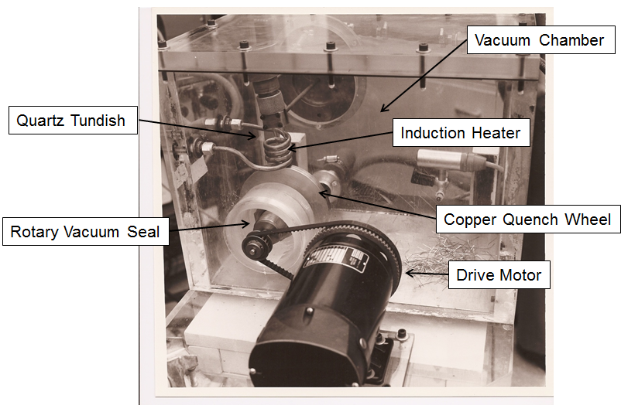
Laboratory Melt Spinner at GMRL

Slide 13
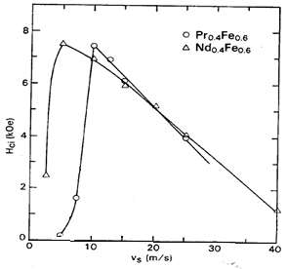
Late 1970s to early 1980s
Discovered that magnetically hard metastable phases readily formed in all of the R-Fe binary alloys when melt spun over a range of quench rate.
Intrinsic coercivities as high as 20 kOe were observed – the highest ever observed to date.
V_{s} = meters of rim surface
or substrate that passes
beneath the molten stream
in one second.

Slide 14
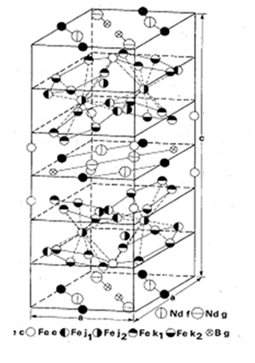
Discovered the Nd₂Fe₁₄B Intermetallic Compound – the basis of all NdFeB permanent magnets.
Ferromagnetic with reasonably high Curie temperature (315ºC). Uniaxial crystal structure (tetragonal).
Very high magnetic strength (16.1 kG).
High magnetocrystalline anisotropy of 7.9 T (79,000 Gauss).
.

Slide 15
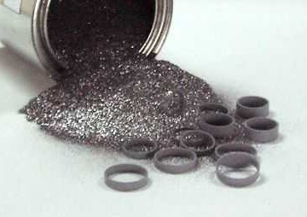
Commercial Development
Magnetic powder from ground from melt spun NdFeB ribbon was found to produce high performance epoxy bonded magnets.
Immediate interest in Delco Remy to investigate whether these magnets could be used to reduce the weight and size of various motors.
Decision was made to develop production melt spinning process at Delco Remy Division, Anderson, Indiana.

Slide 16
Development Melt Spinner at Delco Remy, Anderson, Indiana in late 1983.
Developed the technology and equipment needed for high volume production of melt spun NdFeB magnetic powder between 1984 and 1985.

Slide 17
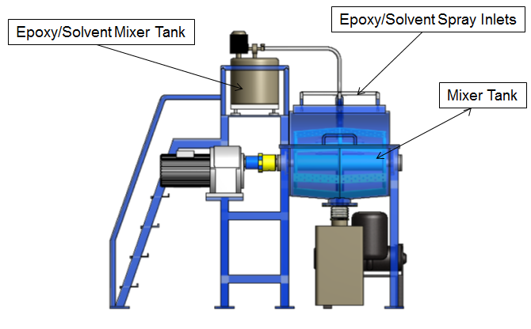
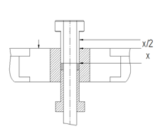
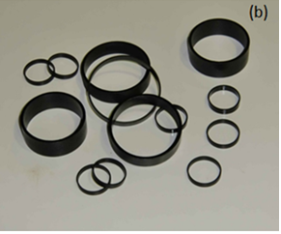
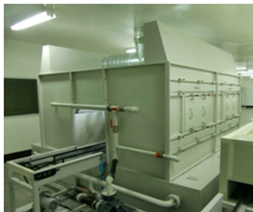
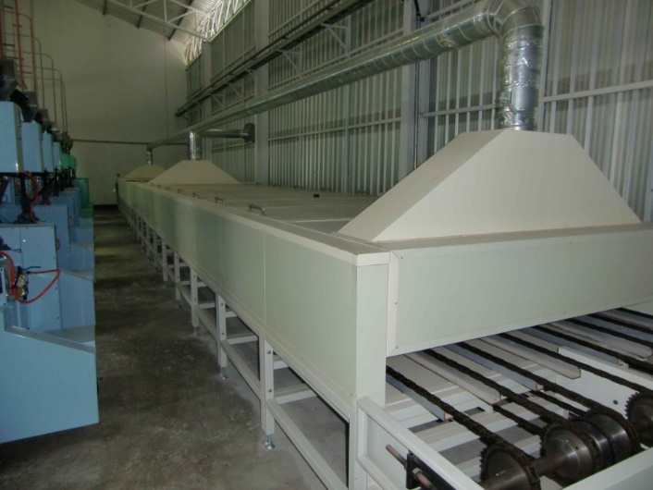
Developed technology for producing bonded Nd magnets
Blend with epoxy
Compact
Coated ring magnets
Spray coat magnets
Cure epoxy

Slide 18
Commercial Development
Founded Magnequench at Delco Remy, Anderson, Indiana in 1986.
First generation production melt spinners installed in new factory
First sales of melt spun magnetic powder to Japanese companies in 1987.
Examples of earliest applications :
Small motor for autofocus on both still and motion cameras.
Stepper motor for read/write on floppy disk drives (FDD).

Slide 19
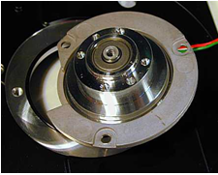
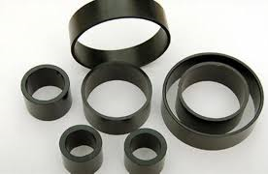
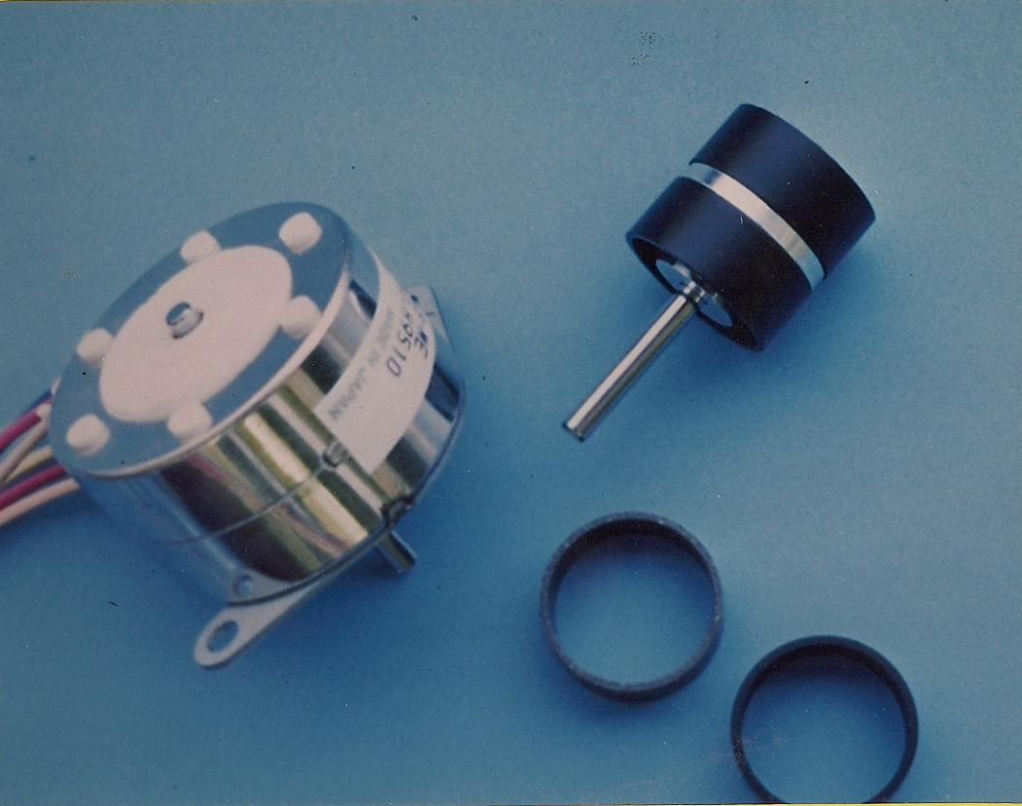
Examples of current high volume bonded Nd applications
HDD Spindle Motor
HDD
Bonded Nd Ring Magnets
Printer
Printer Stepping Motor

Slide 20
Magnequench
Commercial development of bonded Nd magnets coincided with early development of personal computer and related office automation equipment (printers, scanners, fax machines).
Between 1987 and 1995 there was a considerable increase in sales – future looked bright.
However, in 1995, GM suddenly announced that they were selling Magnequench because it was not core to the automobile business.
Although NdFeB magnets were much cheaper than SmCo5, they were still considered too expensive for high volume automotive use.
The business was eventually sold to a group of investors which included elements of the Chinese government.
Entire business and technology was transferred by the new owners to a new factory in Tianjin, China in 2001.

