Slide 1
ROADMAP TO NOWHERE
The Myth of Powering the Nation With Renewable Energy
By Mike Conley and Tim Maloney August 2017 A critique of the 2015 landmark paper "100% Clean and Renewable Wind, Water, and Sunlight (WWS) All-sector Energy Roadmaps for the 50 United States" By Mark Jacobson, Mark Delucchi, et al
(We read it so you don’t have to.)
Copyright © 2017 by Michael Sean Conley – all rights reserved

Slide 2
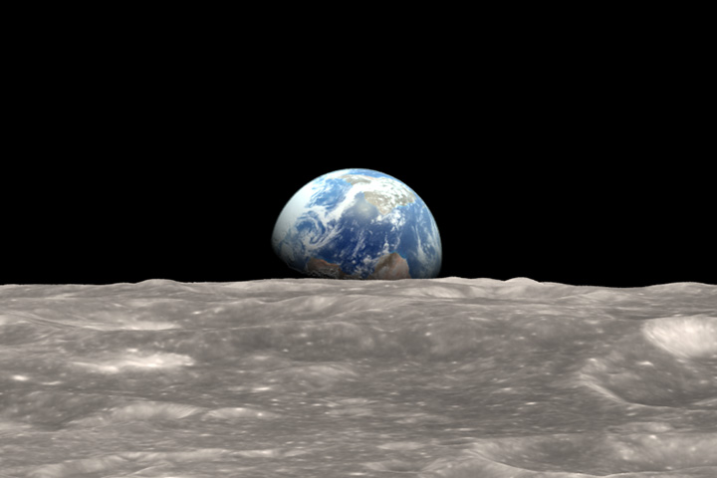
“There are no passengers on Spaceship Earth. We are all crew.” – Marshall McLuhan

Slide 3
Mother Nature doesn't give a damn about anyone's favorite technology.
"She doesn't care if some people think that nuclear power is awesome, or if others think it's the work of the devil.
“And she doesn't care if some people think that global warming is settled science, or if others think that it's an anti-capitalist con game concocted by liberal academics angling for grant money.
"She frankly doesn't care what anyone thinks, hopes, or believes.
“All she cares about is objective reality, quantified by math and explored by science, both disciplines guided by a diligent respect for the true nature of things. . . ."
­– From our 2016 paper: "Wind and Solar's
Achilles' Heel – the Meltdown at Porter Ranch”

Slide 4
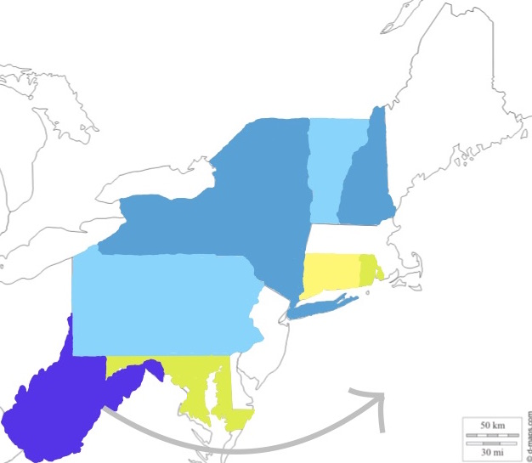
Bare-bones Cost $15.2 Trillion (Jacobson agrees with this price)
THE 2050 ROADMAP
An all-electric society
powered by a 1,591-GW grid
All primary energy to be generated with renewables
Utilize existing renewables and pumped hydro storage
Expand existing hydro dams
Install 1,515-GW of new-build renewables
to bring the total to 1,591-GW average power
Solar on land equal to Maryland, Rhode Island
and Connecticut
Wind on land equal to equal to New York, Pennsylvania, Vermont and New Hampshire
Offshore wind in areas larger than West Virginia
With 4 hrs of additional pumped hydro: $16.5 Trillion
With 24 hrs of pumped hydro: $22.8 Trillion (more than U.S. annual GDP)

Slide 5
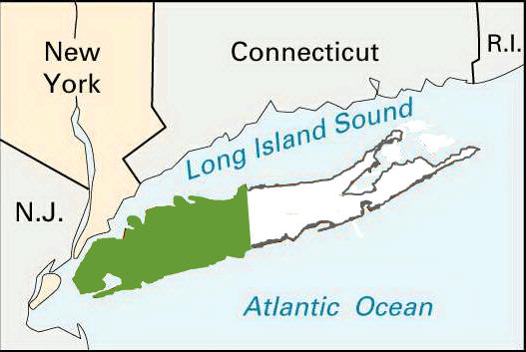
Our “roadmap”
A 1,591-GW grid
All primary energy generated with nuclear
Existing renewables and pumped hydro
Existing hydro dams
Install 1,515-GW of MSRs
18 months of all-grid storage
in the form of reactor fuel
Land equal to half of Long Island
(includes full security perimeters)
$6.7 Trillion with AP reactors
(South Korea's price for U.A.E.)
$3 Trillion with Gen IV MSRs
Total cost (depending on the reactors used):
$3 Trillion – $6.7 Trillion

Slide 6
Jacobson’s 35-year Roadmap:
500,000 5-MW wind turbines
18 billion square meters of PV panels
Over 50,000 wind and solar farms
75 Million residential rooftop systems
Almost 3 million commercial rooftop systems
The daily replacement of 1.23 million m² of PV panels – forever.
Cost: $15.2 Trillion (plus backup and storage)
Our 10-year MSR roadmap:
Utilize existing renewables and hydro
Install 1,515 gigawatts of factory-built MSRs precisely where the power is needed
Break out the beers
Cost: $3 Trillion (plus nachos and beer)

Slide 7
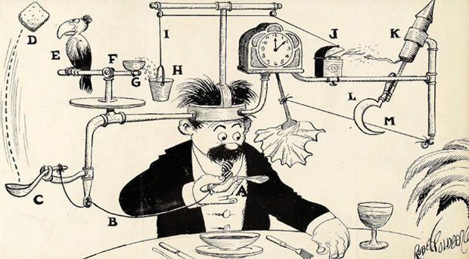
The interest in large-scale renewables is a direct result of a misinformed view of nuclear power.
Rube Goldberg and the Fukushima Syndrome
A renewables scheme to power the nation is like
a ginormous self-operating napkin.

Slide 8
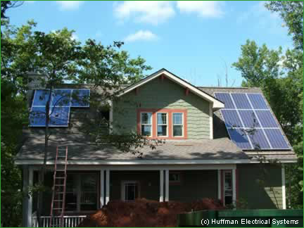
Residential solar is a big, fat waste of money.
Sorry, but it had to be said.
At a national cost of $1.5 Trillion, residential rooftop solar will produce less than 4% of the energy on the Roadmap’s 1,591-GW grid.
$1.5 Trillion is ONE-HALF the cost of
an ENTIRE national MSR grid.

Slide 9
Nuclear energy: Big punch / tiny package.
Renewables: Tiny punch / big package.
Renewables reverse the historical trend toward greater energy density, since wind, water, and sunlight can be thought of as less-dense forms of fuel.
Except they're not really fuels at all.
They are ambient natural phenomena that can be exploited – when they occur – to produce energy.
The rational response to climate change would be a transition to carbon-free fuels, not a transition to a fuel-free paradigm.
The fear of radiation – and the overblown prices that result – are the main reasons why nuclear power isn't being pursued vigorously.

Slide 10
Backup and storage
Backup is extra generating capacity on standby that can rescue a supply shortage on short notice.
Storage holds a supply of energy, or a supply of fuel from which electric power can be generated on demand.
The Roadmap proposes that we put enough wind and solar in thousands of sweet spots around the country, so it can all back each other up without fuel, and have only 1.5 hours of all-grid energy in storage for unexpected peak loads.
(It won’t work.)

Slide 11
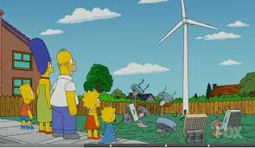
With enough wind and solar in enough places, it should all be able to back each other up. So who needs storage? The operative word is “should.”
The Roadmap’s approach
to powering the nation

Slide 12
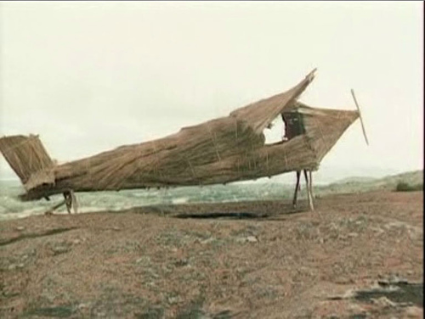
Cargo Cult
Staking out a patch of wilderness and waiting for energy to come along is what we call a Cargo Cult approach to power.

Slide 13
Massive backup and storage are the only ways to make a fuel-free renewables grid work.
The Roadmap has zero fueled backup,
and next to nothing in the way of storage.
99% of all mass energy storage is pumped hydro. No other technology exists that can be adequately scaled.
We cannot afford to build a $15 Trillion fuel-free national grid, and hope for a breakthrough in grid-scale storage.
We have to estimate and proceed with existing, proven, scalable technology.
Pumped hydro is the gold standard of mass storage, at a lowball price of $0.20 an installed watt-hour.
So how much would it take to back up the Roadmap?

Slide 14
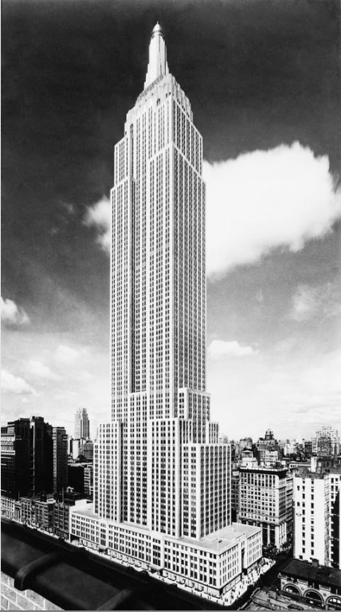
Imagine if the Empire State Building was nothing but water.
One ESB = 250 MWh of hydroelectric energy.
One day of storage for the Roadmap’s
1,591-GW national grid =157,200 ESBs.
Built window-to-window, that many ESBs
would cover 19 Manhattan islands.
That’s 156 cubic kilometers of water,
equal to 135 days of U.S. fresh water consumption.
@ $0.20 per watt-hour, 24 hours of pumped hydro =
$7.6 Trillion. That’s over twice the price of an MSR grid.
In contrast, every commercial reactor has 18 months of energy storage right inside the core.
It’s called “fuel.”

Slide 15
The Big Takeaway:
Fuel is storage.
Renewables are fuel-free systems.

Slide 16
Another big takeaway: Renewables are INTER-dependent. Nuclear power is IN-dependent.
Without adequate storage, the Roadmap will need backup from coal, gas, nuclear or pumped hydro during most of the 35-year buildout, to serve as training wheels until there are enough renewables in enough regions to back each other up.
Coal, gas, hydro and nuclear can operate on their own, independent of any other power plant. But wind and solar plants need training wheels, until there are enough of them to get their collective act together and roll with the big boys.

Slide 17
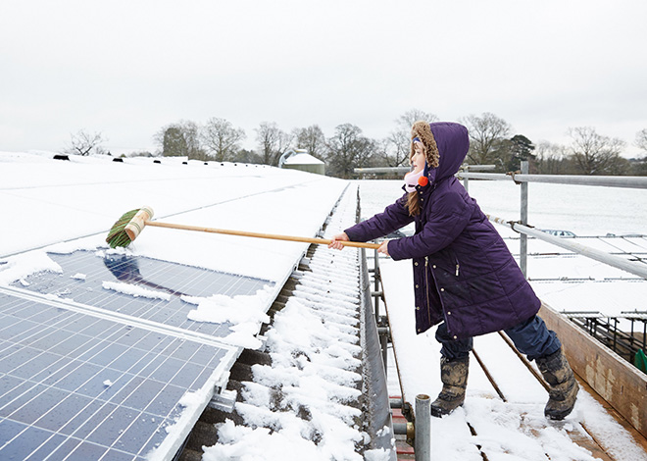
CLIMATE CHANGE will bring CHANGING WEATHER PATTERNS.
Which poses a problem:
Since wind and solar
are weather-dependent,
how can we depend on them
if we can’t depend on the weather?
The long-term success of a fuel-free, weather-dependent grid depends upon optimum siting, which in turn depends upon accurate, long-term weather prediction.
Which no longer exists.

Slide 18
Green elephants with training wheels
An interdependent, fuel-free grid is an all-or-nothing proposition – all (or most) of the pieces have to be in place, in order for the whole thing to (hopefully) work.
Fueled power plants are entirely different. If we launch a buildout of fueled plants and abandon it halfway through, we would still have a collection of fully functioning, independent power plants.
But if we launch the Roadmap and abandon it halfway through, we’d have a herd of green elephants that will always need training wheels.
And since coal is verboten, and since nuclear is the work of the devil, and since we can’t build more rivers, the only acceptable backup is . . .

Slide 19
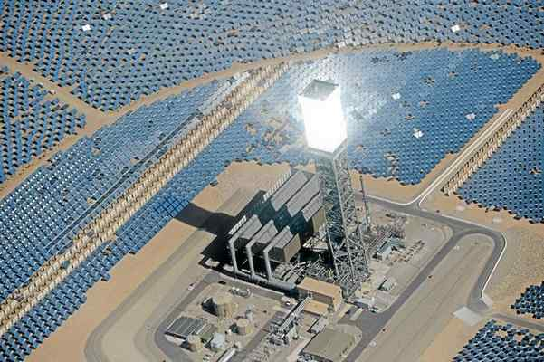
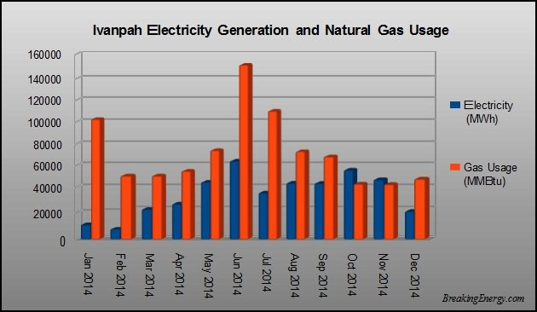
Natural Gas –– the polite term for methane "We need about 3,000 feet of altitude, we need flat land, we need 300 days of sunlight, and we need to be near a gas pipe. Because for all of these big utility-scale solar plants – whether it's wind or solar – everybody is looking at gas as the supplementary fuel. The plants that we're building, the wind plants and the solar plants, are gas plants.” – Robert F. Kennedy, Jr. Environmental activist Member of the board of Bright Source Developers of the Ivanpah Solar Station On the California / Nevada border

Slide 20
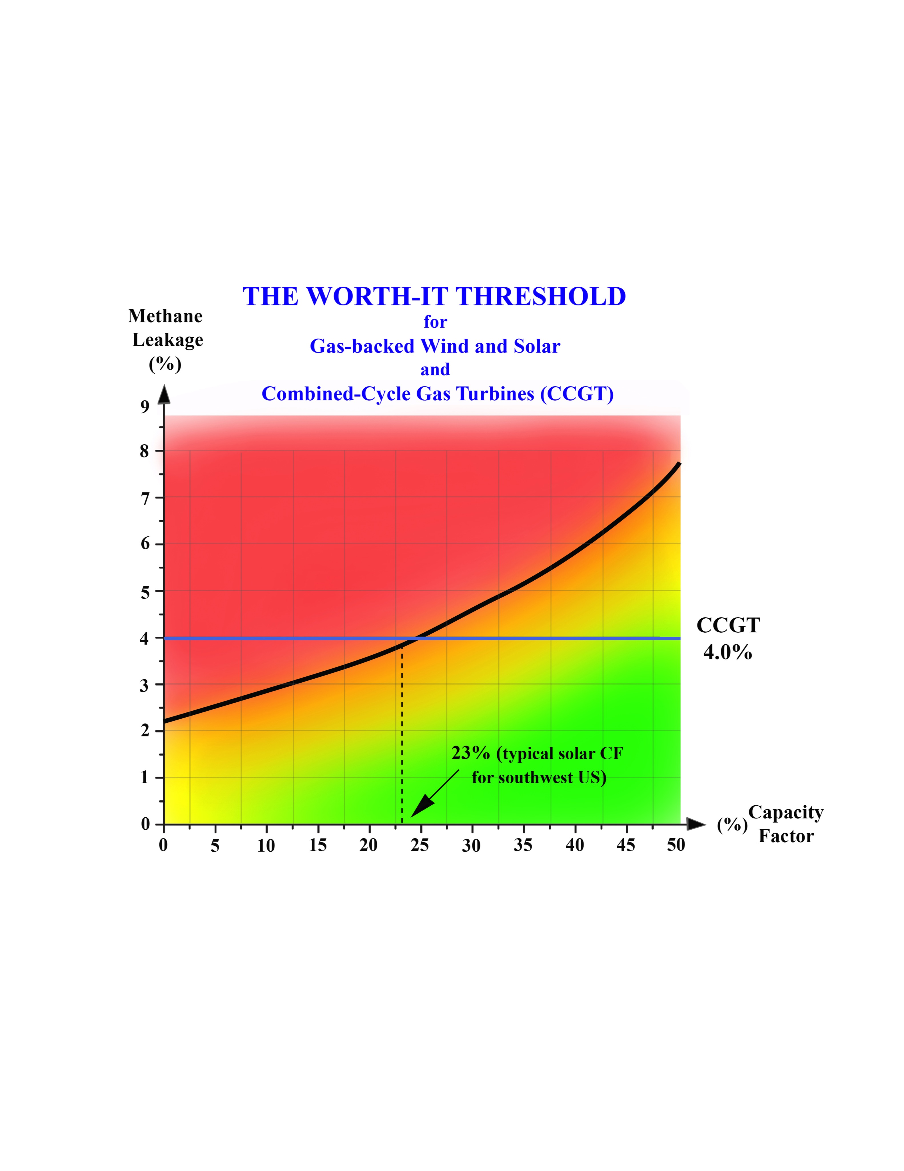
makes the average gas-backed renewables farm as bad for the climate as a coal plant. The national leak rate is 1.6%. That wipes out 40% of all potential climate benefits from gas-backed wind and solar. (1.6 is 40% of 4.)
A 4% methane leak

Slide 21
The Clack Evaluation:
The Roadmap’s own modeling shows that it will need a hydroelectric capacity it simply does not have. In fact, Ken Caldiera (Clack’s co-author) estimated that the required water flow would be equal to nearly100 Mississippi Rivers. (No, that’s not a typo.)
In four consecutive days of hydro backup, Day Two calls for 1.3 TWs (1,300 GWs). We determined that the Roadmap’s total hydro capacity comes to 120 GWs. They’ll be 90% short – in the dead of winter.

Slide 22
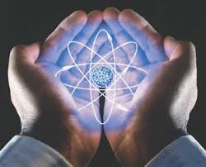
Power to the Planet!
A steady supply of clean, cheap and abundant energy will significantly improve our ability to adapt to climate change, mitigate its worst effects, and eventually restore the heat budget of the planet and the pH level of the oceans.
This is the challenge of our era, and will always be our legacy.
That includes all of us, because there are no passengers on Spaceship Earth.
We are all crew.
It’s in our hands
Go nuclear or go extinct.

Slide 23
ROADMAP TO NOWHERE
The Myth of Powering the Nation With Renewable Energy
By
Mike Conley and Tim Maloney
Mike Conley
MichaelSeanConley@gmail.com
Tim Maloney
t.maloney@bex.net
Copyright © 2017 by Michael Sean Conley – all rights reserved

