Slide 1
Mission: To energize and empower today’s generations to fight for the future of nuclear energy.
Generationatomic.org
facebook.com/generationatomic
@Gen_Atomic
Alan Medsker
alan@generationatomic.org
501(c)3 non-profit
EIN 81-4500446

Slide 2
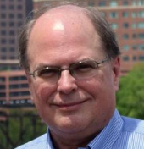
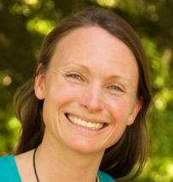
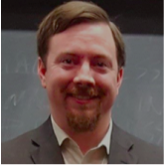
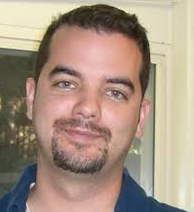
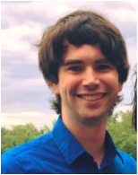
GOVERNANCE BOARD
Gene Grecheck
Fmr. Pres. ANS
Canon Bryan
Terrestrial Energy
Kristin Zaitz
Mothers for Nuclear
Daniel Curtis
MIT
ADVISORY BOARD
Lenka Kollar
NuScale Power
Art Wharton
Studsvik
Tim Crook
Transatomic Power (fmr.)
Nick Thompson
Los Alamos
Aries Loumis
Deep Isolation

Slide 3
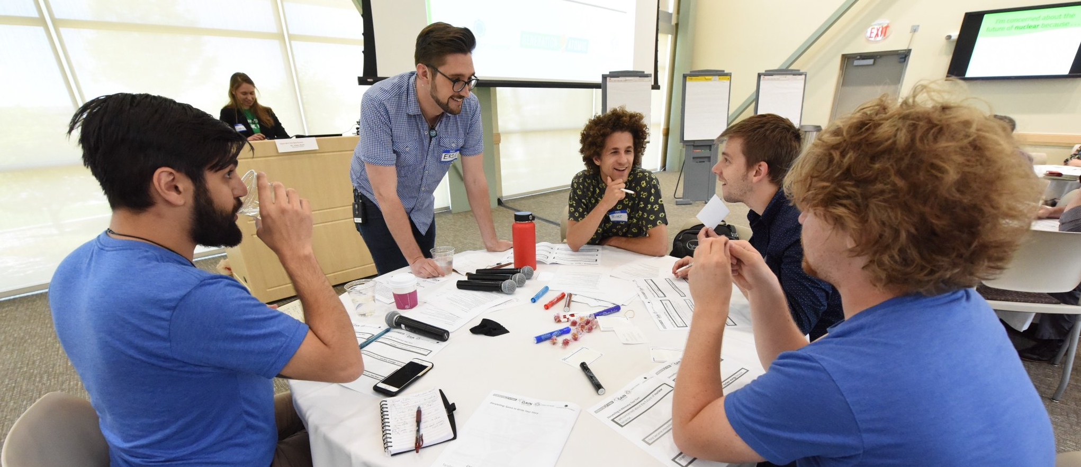
Why were we founded?
Generation Atomic is non-profit advocacy group with a mission of promoting nuclear literacy and building grassroots support for the technology, in order to defend today’s reactors from early shutdown and create the social license to deploy the reactors of tomorrow.
Why?
We’re trying to save the world from climate change and energy poverty.

Slide 4
Programs
ENERGIZING | EMPOWERING
Growing the movement

Slide 5
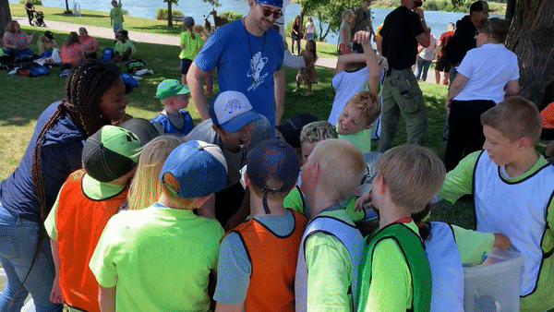
ENERGIZING | EMPOWERING
YOUTH EDUCATION WITH PLAY
Climate Clash | Ages 6-12 Tag game teaching about decarbonization and intermittency.

Slide 6
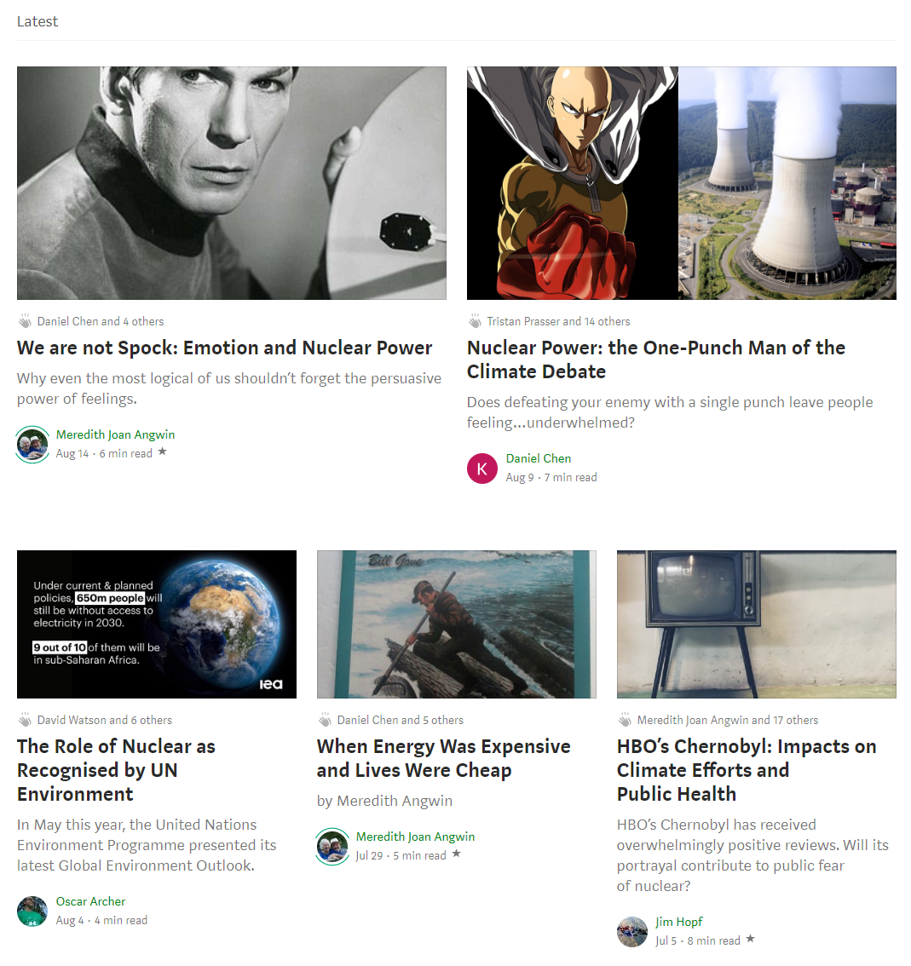
ENERGIZING | EMPOWERING
ONLINE MAGAZINE
Accepting Submissions

Slide 7
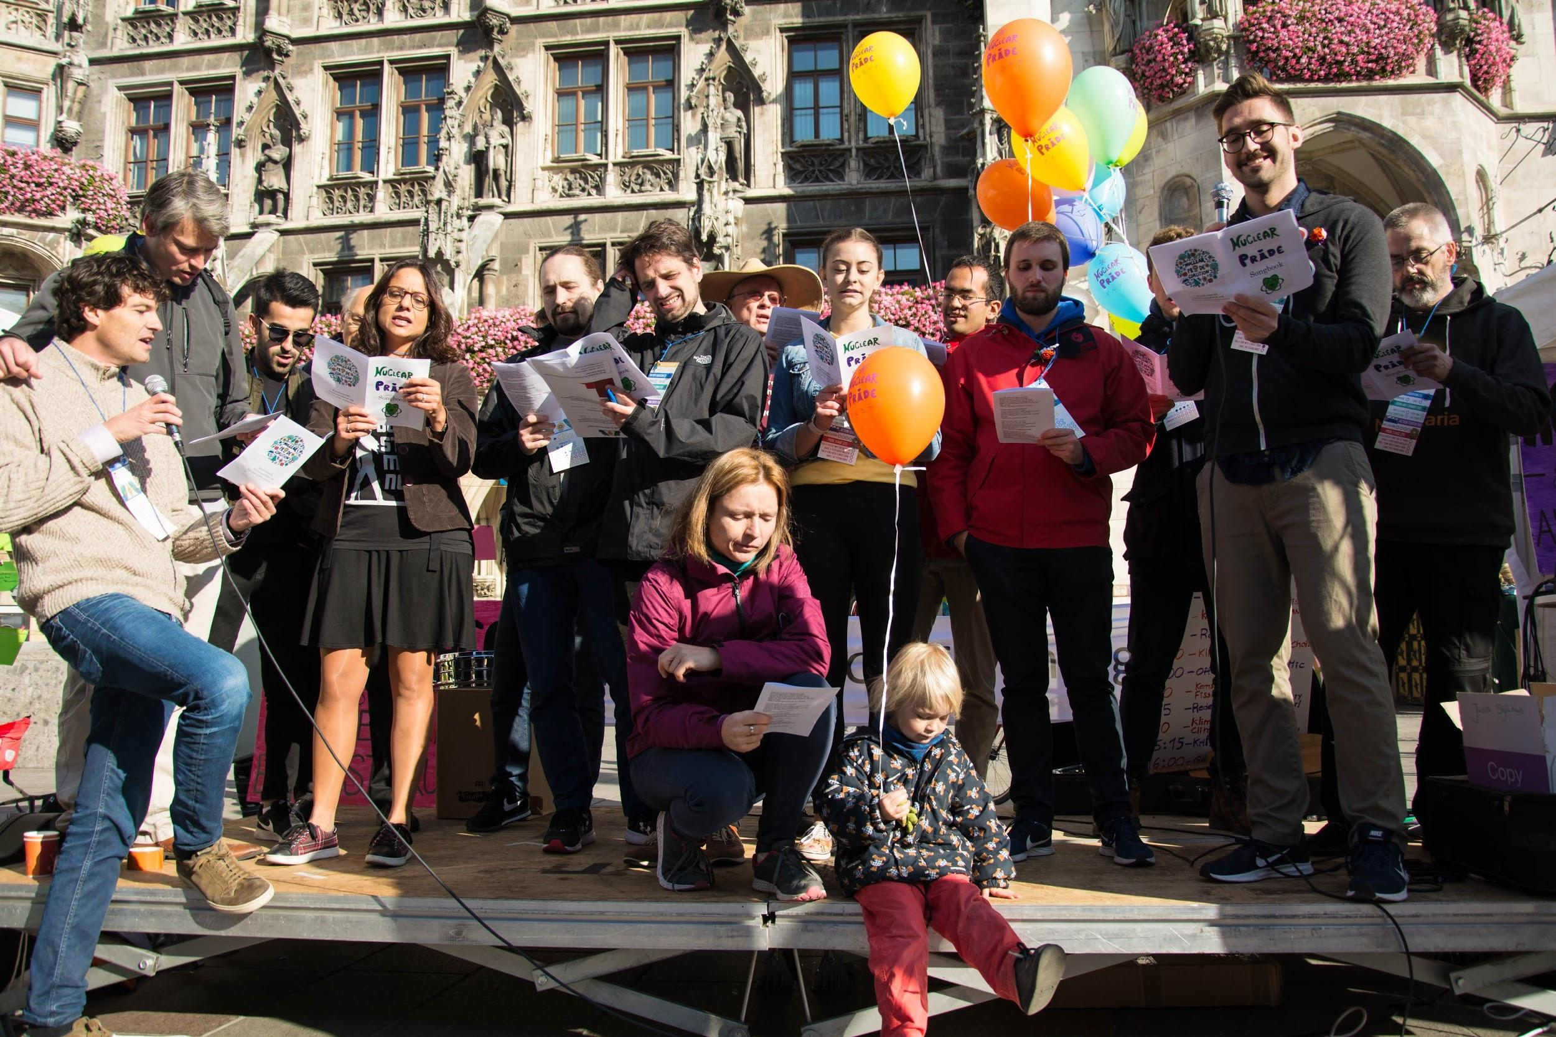
ENERGIZING | EMPOWERING
Nuclear Pride Fest - Munich
CREATIVE OUTREACH EVENTS

Slide 8
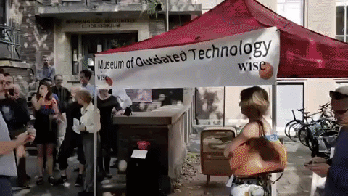
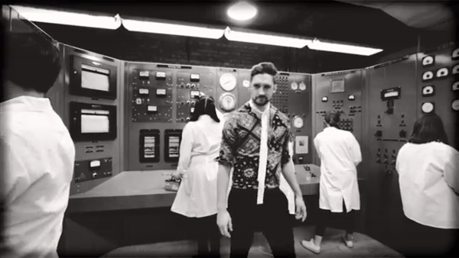
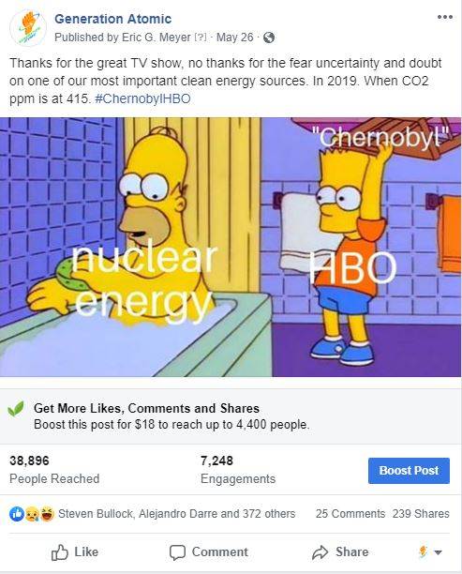
ENERGIZING | EMPOWERING
CREATIVE SOCIAL MEDIA

Slide 9
Programs
ENERGIZING | EMPOWERING
Building our skills

Slide 10
ENERGIZING | EMPOWERING
VOLUNTEER YOUR TIME TO HELP SAVE THE WORLD

Slide 11
ENERGIZING | EMPOWERING
Communications | Goal: To more effectively use print, online, and broadcast media to grow our community of nuclear supporters, move the needle on public opinion, and influence decision makers.
Activities/Tactics: Writing letters to the editor and blog posts. Making memes. Making videos. Developing campaigns to get influencers to come out in favor of nuclear energy.
Outreach | Goal: To bring nuclear conversations into new communities.
Activities/Tactics: Attending climate and energy themed events in your community and organizing your own. Giving presentations and finding presentation opportunities. Bringing the nuclear message to non-nuclear conferences.
Government | Goal: To increase the quality and quantity of legislative contact in order to build support for saving existing reactors and building the reactors of tomorrow.
Activities/Tactics: Designing digital actions. Organizing and attending legislative visits. Attending hearings.
VOLUNTEER TEAMS

Slide 12
ENERGIZING | EMPOWERING
SHARPEN YOUR SKILLS WITH ADVOCACY WEBINARS

Slide 13
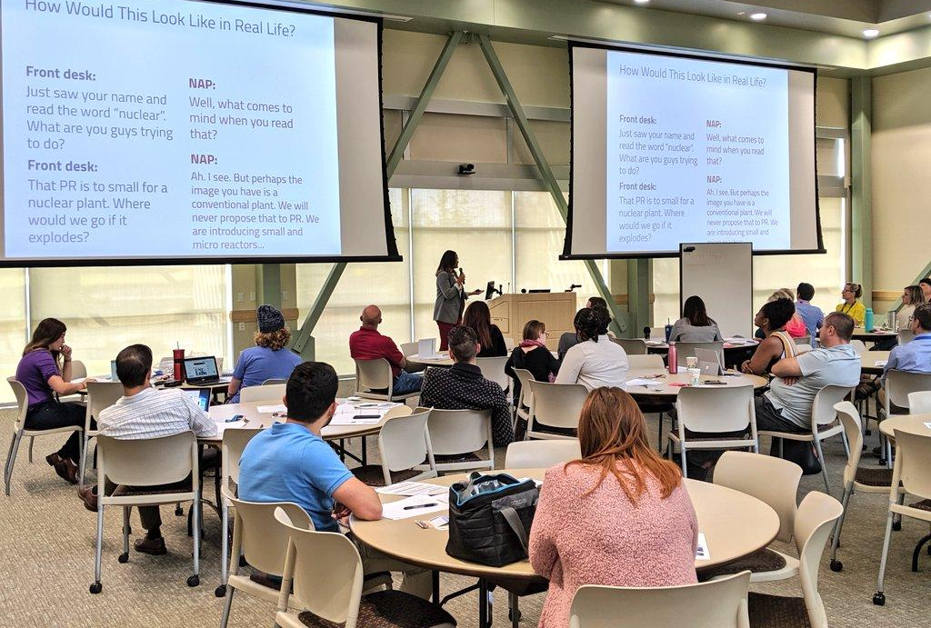
ENERGIZING | EMPOWERING
ADVOCACY TRAININGS
Social Media Content Creation
Making memorable and persuasive content
Ambassador Training
How to bring nuclear into new communities
Letter to the Editor 101
How to write a great LTE and get it published
Legislative Visit Training
Partnering with local legislators and staff for realistic roleplaying
Campaign Building 101
Picking an issue, organizing around it, and winning

Slide 14
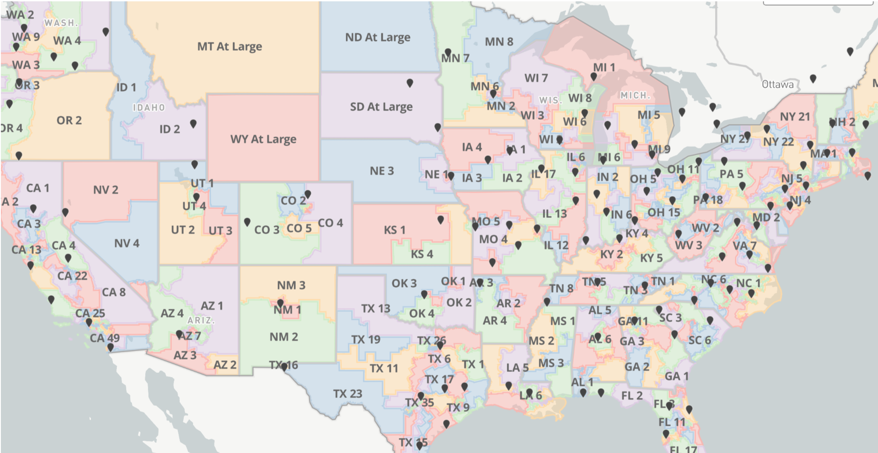
ENERGIZING | EMPOWERING
DIGITAL ACTIONS
We supercharge pro-nuclear legislative contact
Our software emails, calls, and tweets at decision makers in three countries
1900 legislative contacts since Apr. ’19

Slide 15
ENERGIZING | EMPOWERING
Let’s make the difference.
Email, call, and/or tweet your representatives to ask for their support of S-2093

Slide 16
WAYS TO SUPPORT
Heed calls to action
When we ask you to show up to a hearing, contact your legislator, or sign a petition-- do it. If nuclear supporters aren’t at the table, we’re on it.
Sharpen your skills
We all do better when we all do better, so attend an advocacy webinar. Maybe one day you’ll be leading the class.
Give Your Time -- generationatomic.org/get-involved
Join our corps of volunteers, in the comms, government, or outreach teams to keep moving the ball forward on the airwaves, in congress, and in communities.
Provide Funds -- generationatomic.org/donate
Individual donors are the life-blood of Generation Atomic. Without them it wouldn’t be possible to provide the innovative outreach programs and legislative contact initiatives.
Please give generously.

Slide 18
Mission: To energize and empower today’s generations to fight for the future of nuclear energy.
generationatomic.org
501(c)3 non-profit
EIN 81-4500446
Eric G. Meyer
Executive Director
eric@generationatomic.org
+1-218-384-1645
Generation Atomic
1878 Pascal St.
Falcon Heights, MN 55113

Slide 19
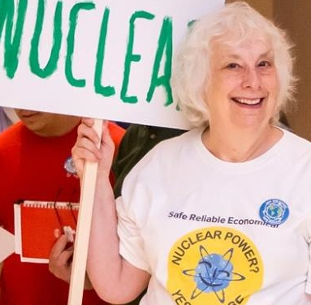
ENDORSEMENTS
“The nuclear industry has needed Generation Atomic for a long time. Years ago, I noticed that there were many anti-nuclear organizations that people could join, but no group that would organize pro-nuclear people to defend nuclear energy. Gen A provides a place for those people. It will help them move the needle toward stronger public acceptance of nuclear power.
Meredith Angwin
Author & Blogger
Yes Vermont Yankee “Campaigning for Clean Air”

Slide 20
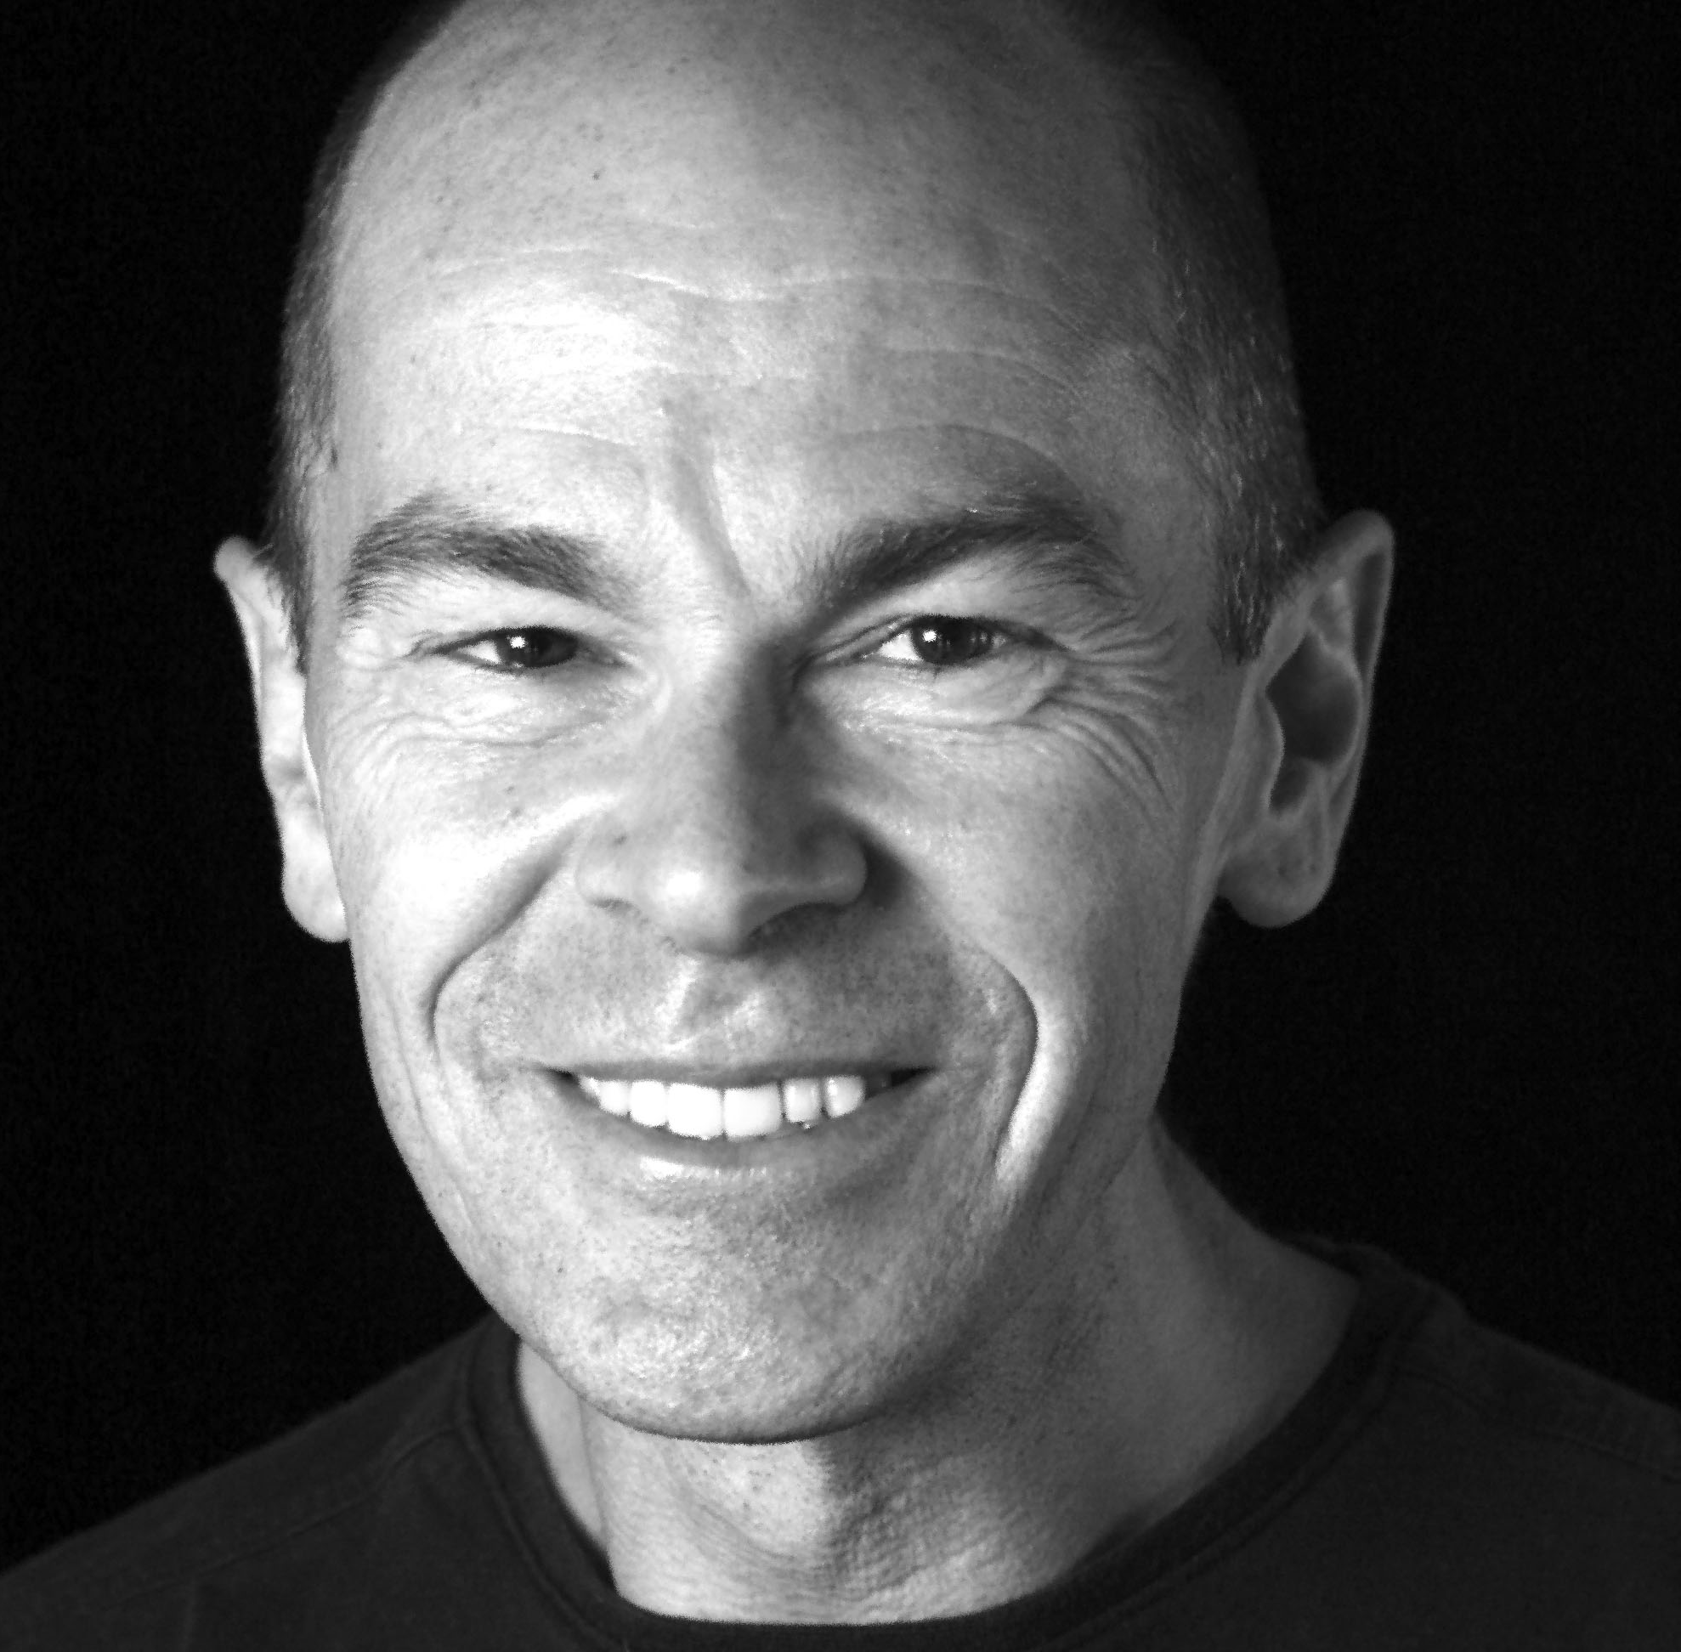
ENDORSEMENTS
“Gen A’s efforts deserve the strong support of anyone who believes, as I do, that nuclear energy is an essential component of any effective strategy to avert the worst consequences of climate change.”
Robert Stone
Oscar Nominated Filmmaker
Chasing the Moon
Pandora’s Promise
Radio Bikini

Slide 21
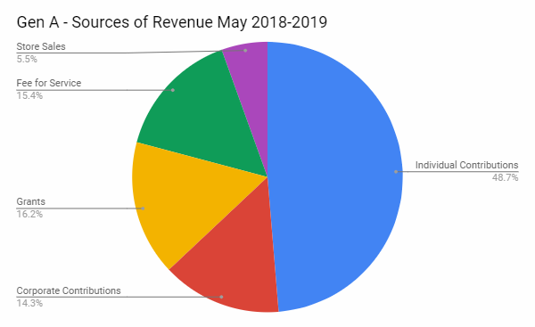
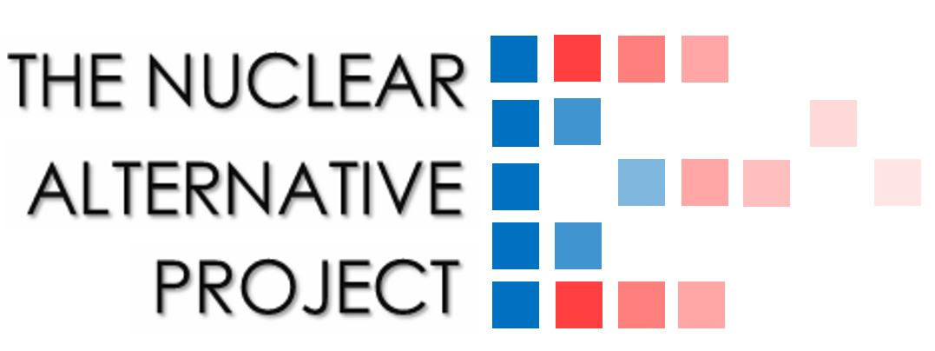
FUNDING
Profit & Loss
May ‘18 - ‘19
Total Income: $163,457
Total Expenses: $156,300
PARTNERS

