Slide 1
Replacing Cubic Miles of Oil
Get Real! Energy for the 21st Century
Ripudaman Malhotra, Ph.D.
TEAC 8
August 22, 2017
cmo-ripu.blogspot.com
Notes:
Thank you; Show of hands

Slide 2
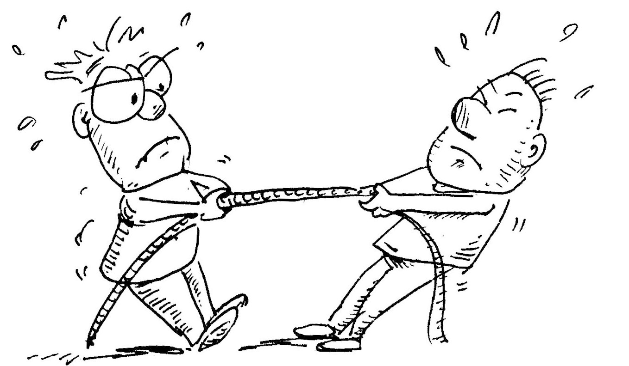
Energy Challenge: Tough Choices Ahead Time to reframe the debate about energy supply
Current practices of energy production and consumption are unsustainable
Energy use is central to our way of life, and the consequences of not meeting future energy demands are dire
Tension between protecting the environment and social justice
A comprehensive energy policy must acknowledge the magnitude of the problem

Slide 3
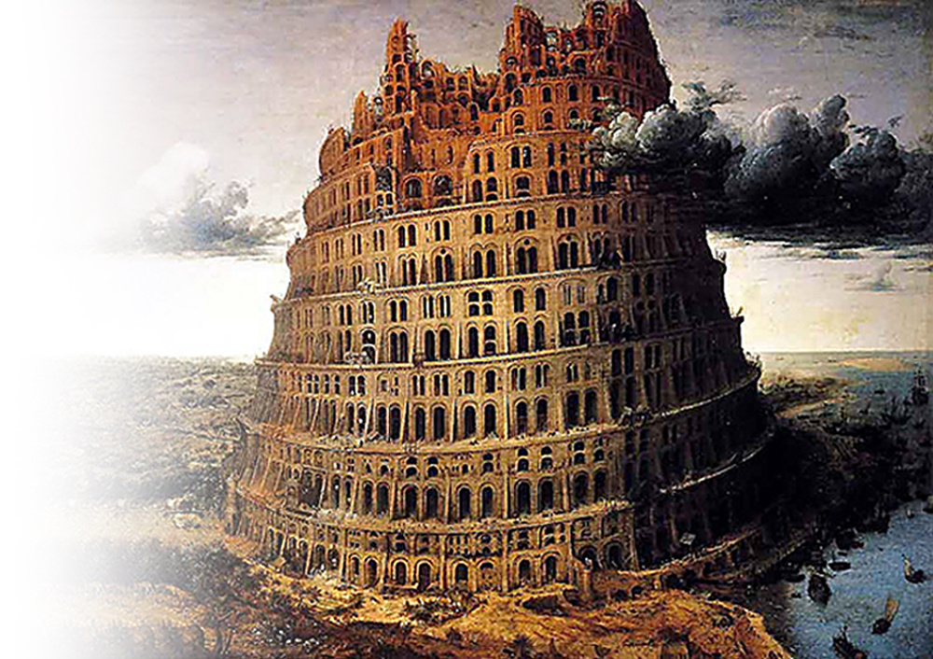
How Much Energy Do We Use? A good question to ask, but we confront a tower of Babel
We get energy from many sources: oil, coal, natural gas, nuclear…
Different units for different sources
Gallons or barrels for oil
Tons or BTUs for coal
SCFs for natural gas
kWh for electrical energy
Lack of uniform units
Presents a serious impediment to meaningful discussion
Creates confusion: millions, billions, trillions, quadrillions!!!

Slide 4
Annual Global Energy Consumption, 2006 We are living off our inheritance – how is it sustainable?

Slide 5
Annual Global Energy Consumption, 2016 Pattern essentially unchanged since 2006
Total 3.84 CMO

Slide 6
Global CO₂ Emissions
Global emissions in 1990 were 21.6 Gt-CO₂
Desired target: reduce emissions to 80% of 1990 levels (i.e., 17.3 Gt-CO₂) by 2035 and zero net emissions by 2050
Compliance with intended nationally determined contributions (INDC) in the Paris Agreement (COP21) would still result in global emissions increasing to 55 Gt-CO₂ by 2035
Nations must steeply ramp up their INDC
Will we?

Slide 7
It Takes Energy to Climb up on the UN HDI Scale
Notes:
About 1000 GO/cap/yr needed to achieve 0.9 on HDI and stabilize population growth.

Slide 8
Estimating how much energy will we need in 2050?
Assume a population of 9 billion people
Desired minimum per capita energy consumption to ensure an HDI >0.9 is 1000 GOe/yr (half of US consumption; comparable to Europe and Japan)
9 trillion gallons (>8 CMO)
Assume an all-electric scenario (1 GO ≅ 12 kWh)
108,000 TWh/yr (Current global electricity prod. = 24,000 TWh)
12.3 TW @ 100% capacity
Required investment for 30 years (@$5/W installed): $2T/yr or 2.7% GWP

Slide 9
Dramatic rise of wind and solar power
Notes:
Wind plus solar increase 2.5X during Bush years, and another 2.5X during Obama years

Slide 10
Still a long way to go…
✭
Target

Slide 11
Challenges for All-Renewable Scenario
Wind and solar are intermittent sources
Capacity factor is less than 30%
Increases requirement for installed capacity (to about 42 TW)
Materials intensive: energy recovered per ton of material is low
Strains global supply chain for basic raw materials such as copper, steel, cement
Requires spinning reserves of gas turbines for back-up
GHG emissions from CCNG < (PV + NG)
Add comparable storage (TWh, not just a few MWh)
Industrial development requires reliable supply
High penetration of wind and solar exacerbates the ”duck curve”

Slide 12
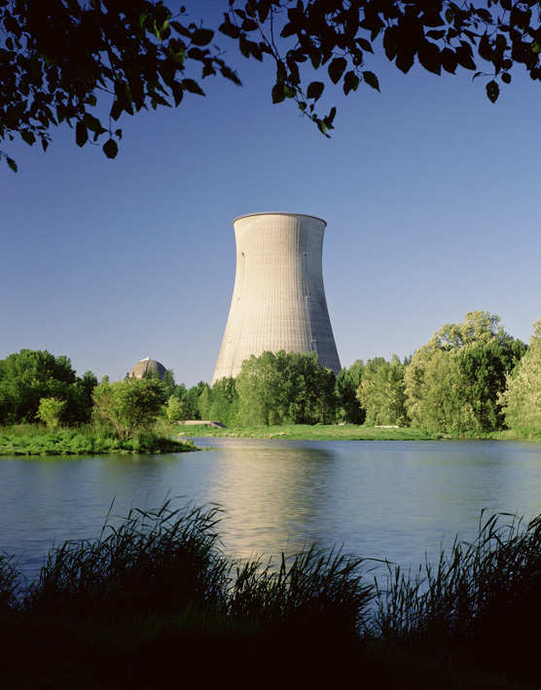
Nuclear Power An option we cannot ignore
Opportunity
Established scalable technology
Low footprint
Safest: least no. of casualties/TWh
Risks
Fears
Political Challenges
Technical
Cost (in part fed by fears)
Many newer designs, including those using Th, reduce the risks substantially
Nuclear fusion, if realized
Notes:
An alternative that should not be dismissed out of hand, but considered in light of risks posed by others

Slide 13
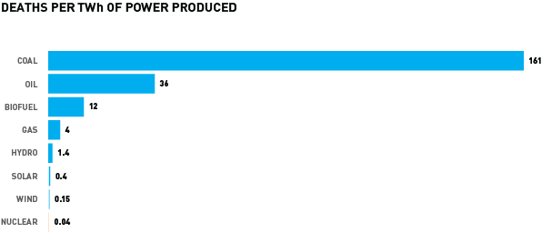
Nuclear Power Results in Fewest Fatalities
Source: Canadian Nuclear Assoc.

Slide 14
Public Concerns about Nuclear Power
Risks
Explosions
Radiation exposure
Technical
Long-term storage of “waste”
Lack of sufficient fuel resources
Political
Nuclear proliferation
Too expensive
But facts don’t matter

Slide 15
Unreasonable Standards Have Consequences High cost of nuclear power and increased use of fossil fuels
Source: Wade Allison

Slide 16
Take a look at nuclear power, again
Global demand for cubic miles of oil worth of electricity
The world also faces enormous risks of climate change from greenhouse gas emissions
Nuclear power is a scalable, safe, and carbon-free source of energy
Cost – the final barrier
Higher installation cost: $5-10/W for conventional nuclear vs. $2-3/W for wind and solar
Over their long life (60 y vs. 30) and high capacity factor (90% vs 30%), nuclear plants produce six times as much electricity
Higher degree of safety and smaller modular designs of MSRs reduce the upfront investment, lowering the financial barrier
Nuclear power deserves the tax credits afforded other carbon-free sources

Slide 17
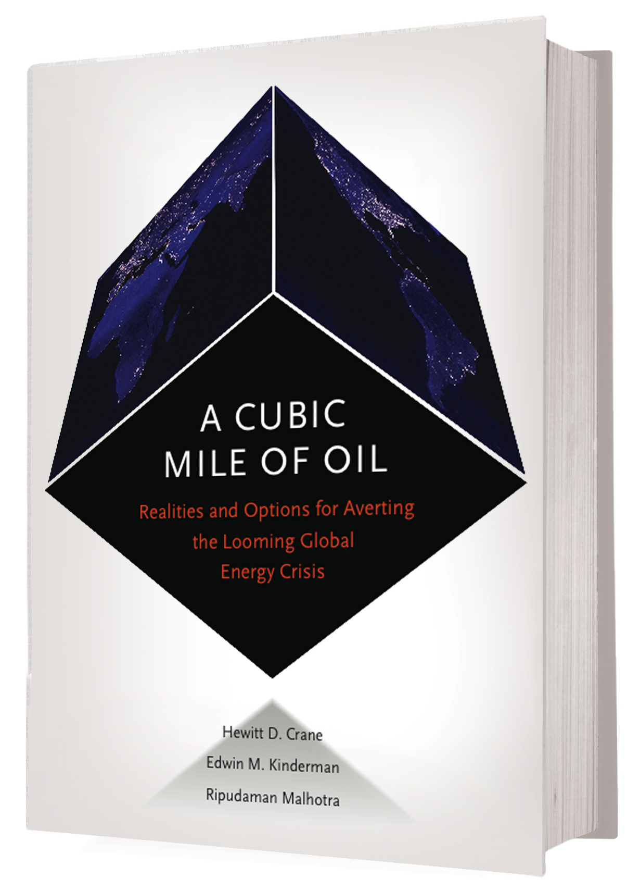
Thank You!
Don’t waste
Be informed
Get involved
cmo-ripu.blogspot.com

Slide 18
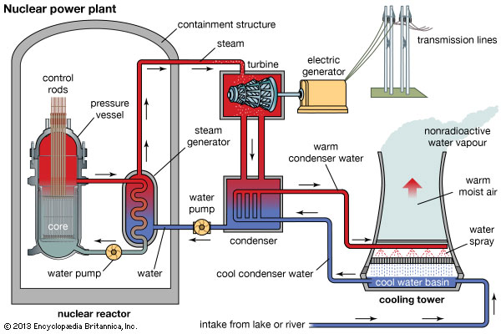
Schematic of a Pressurized Water-Cooled Reactor

Slide 19
A Cubic Mile of Oil
Introduction to CMO
Why talk about energy in CMO units?
Global production and consumption statistics
Evolving contribution of different sources
Rapid rise in wind and solar
Path forward
Estimating energy electrical needs for 2050
Wind and solar unlikely to displace fossil fuels
Nuclear Power: a safe and reliable resource
Fears over radiation exposure from power nuclear are largely unfounded
Nuclear waste is a resource for energy
Thorium-based nuclear power (LIFTR) is an inherently safe technology

Slide 20
A Cubic Mile of Oil – CMO Understandable unit: mental image
CMO is a unit of energy coined by SRI’s Hew Crane in the 1970s while waiting in line to buy gasoline. His realization: annual global oil consumption was then approaching one cubic mile!
mile
mile
Statue of Liberty
mile

Slide 21
Changes in Energy Landscape: 2006 to 2017
Overall energy use increased 20% over the 10 years
There was a marked decline in 2009 and 2010 following the economic crisis, but it rebounded in 2011
Net increase by 0.65 cmo
Wind and solar generation increased 9-fold (138 TWh to 1292 TWh)
Installed capacity for wind increased almost 6.3-fold: 74 GW ➟ 469 GW
Installed capacity for PV solar increased 44-fold: 6.7 GW ➟ 301 GW
In cmo units, total energy from wind and solar: 0.009 ➟ 0.084
Most of the energy increase came from fossil sources
Coal: 0.17 cmo
Natural gas: 0.17 cmo
Oil: 0.14 cmo
Global CO₂ emissions from energy use: 29.4 Gt ➟ 33.5 Gt

Slide 22
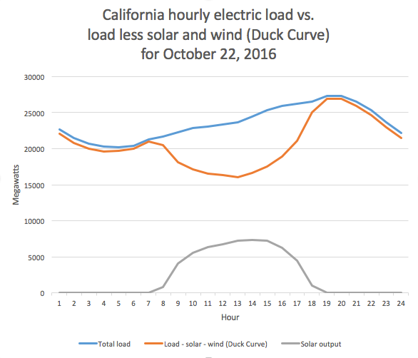
The Duck Curve
Steep rise of 5 GW between 5 and 6 pm
Minimum non-dispatchable power
Source: CA ISO
Notes:
CAISO's (California Independent System Operator) minimum non-dispatchable power production is about 15,000 MW - meaning the power grid's online generators cannot produce less than 15,000 MW at any one time. If solar installations are increased, we run the risk of overgeneration. Need Storage on the order of several GWh

Slide 23
What Radiation Exposure Level Is Acceptable? Living on earth: 200 mSv/mo
Source: Wade Allison
Notes:
ALARA: As Low as Reasonably Achievable
AHARS: As High as Reasonably Safe

Slide 24
Major Nuclear Accidents
3-Mile Island, Harrisburg, PA, 1979
Loss of cooling, partial melt down of core
Containment held
Some radioactive gases released
No casualties, no ill health effects from exposure
Chernobyl, Ukraine, 1989
Steam explosion during a flawed experimental safety test
Reactor had no containment, roof was blown off
Fire as oxygen contacted hot graphite in the core releasing more radioactivity and exposing 600,000 people
50 Workers died from acute radiation exposure, 231 suffered radiation illness
IAEA estimates 4,000 additional cancers among the exposed population over their lifetime
As such, 120,000 cases of cancer anticipated in that population from all causes

Slide 25
Major Nuclear Accidents, Fukushima
Power plant shut down according to plan
Loss of power meant cooling water could not be circulated; back-up diesel generators flooded; partial meltdown of fuel rods
Primary containment held; hydrogen explosions in secondary confinement led to release of radioactivity
Over 100,000 people displaced
Radiation levels 3 to 7 mSV/mo detected in the neighboring areas; compare with 200 mSv/mo of ambient exposure
No casualties from radiation, but 1,600 lives lost due to mental distress from forced evacuation

Slide 26
Molten Salt Reactors
Brief History
Developed at Oak Ridge National Labs in 1960s
Test reactor (without breeder) ran for over four years (1965-69)
Other designs with breeder blanket developed
Lost out to Liquid Metal Fast Breeder Reactor (higher yield of weapons-grade materials)
Aim of MSR
Improved safety
Minimize waste
Proliferation resistant
Notes:
Alvin Weinberg warned of safety concerns of light water reactors

Slide 27
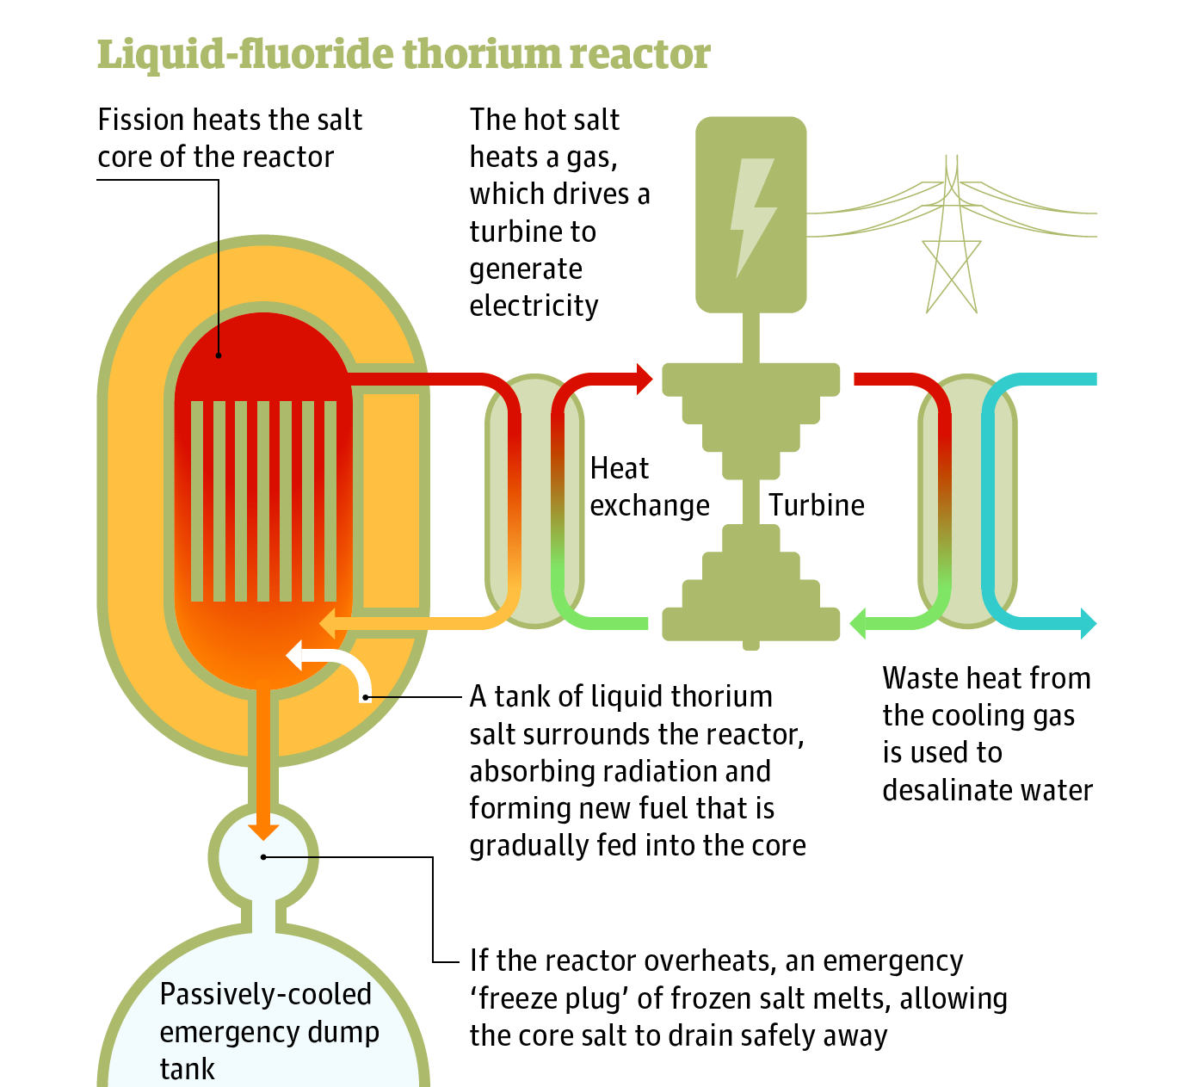
Schematic of a Thorium Molten Salt Reactor (LIFTR)
No concrete dome to contain high pressure steam
Liquid fuel precludes problems with cladding failure
Longer hold times burn fissile materials to completion
No long-lived actinides
Higher temperature steam cycle for greater efficiency
Source: Hargraves and Moir

Slide 28
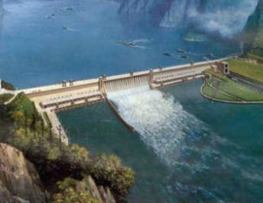
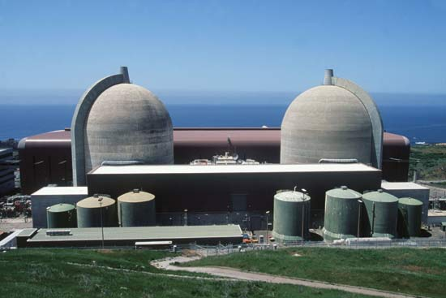
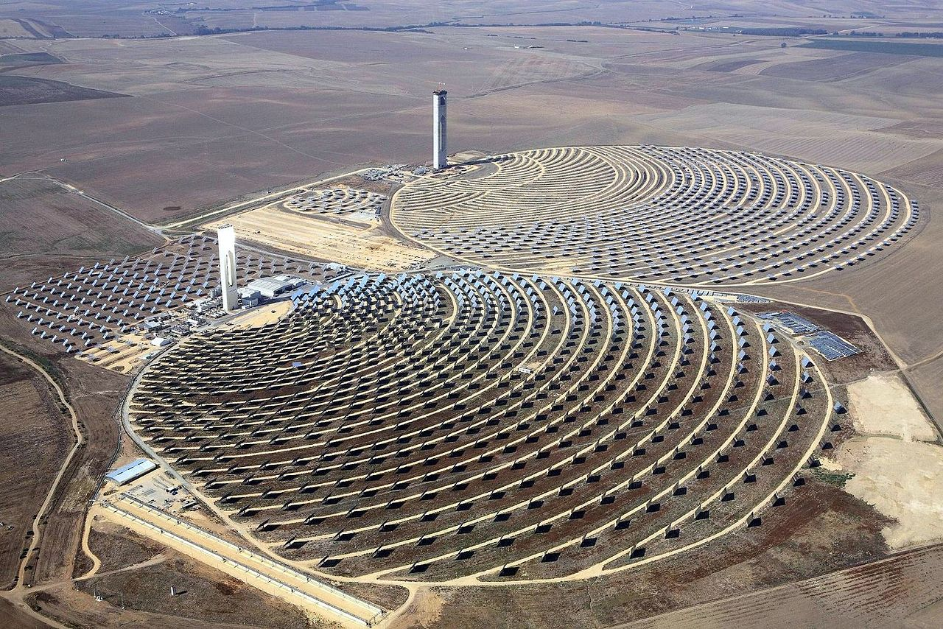
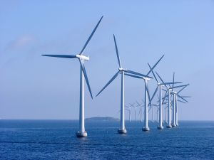
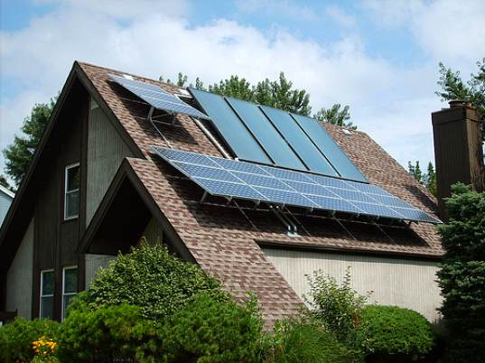
Producing 1 CMO Per Year from Various Sources Enormous task requiring trillions of dollars over decades
Hydro: 200 dams
1 every quarter for 50 years
18 GW with 50% availability (3 Gorges Dam)
Nuclear: 2,500 plants
1 a week for 50 years
900 MW with 90% av.
Solar CSP: 7,700 solar parks
3 a week for 50 years
900 MW with 25% av. (10X Andasol)
Windmills: 3 million
1200 a week for 50 years
1.65 MW with 35% av.
Solar Roofs: 4.2 billion
250k roofs a day for 50 years
2.1 kW with 20% av.

Slide 29
Public Concerns about Nuclear Power
Risks
Explosions
Radiation exposure
Technical
Long-term storage of “waste”
Lack of sufficient fuel resources
Political
Nuclear proliferation
Too expensive

